Slide 1

The Effects of Gun Control Policies on Crime and Public Safety
John R Lott, Jr.

Slide 2
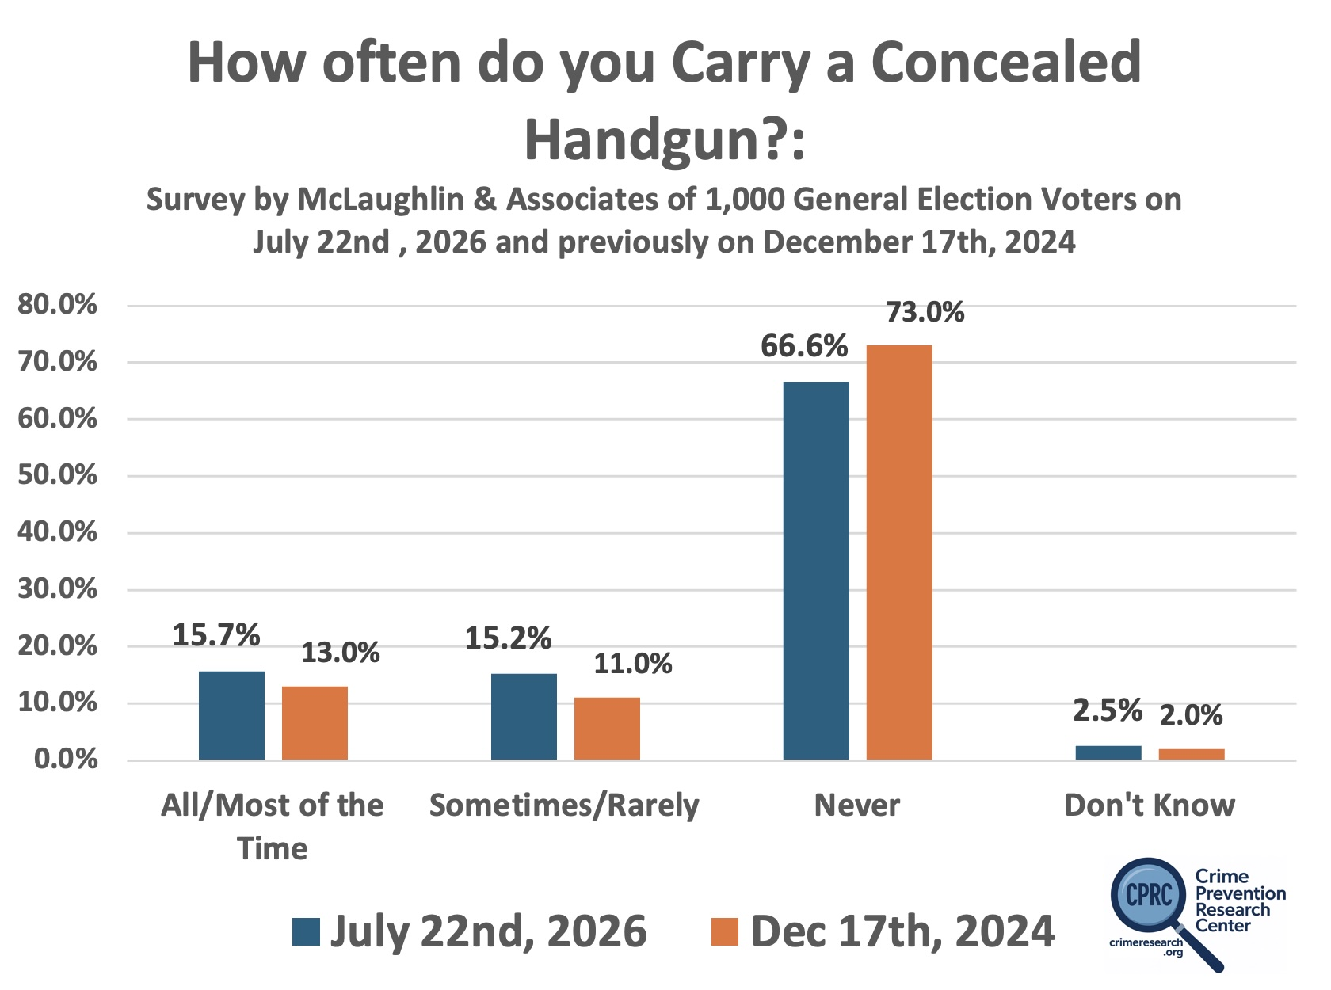

Slide 3
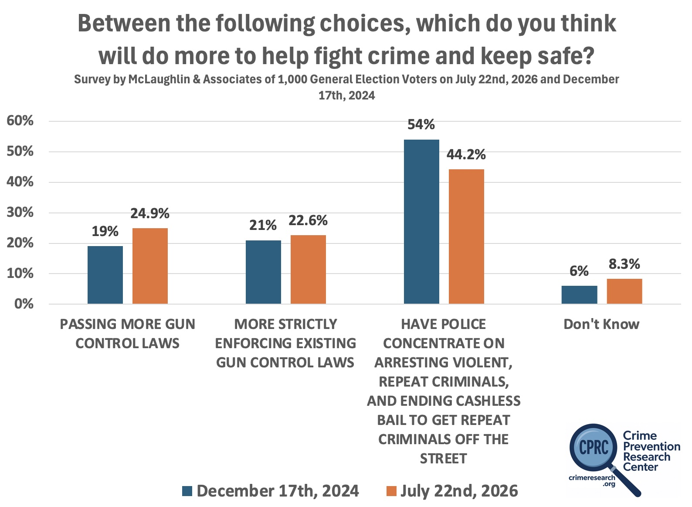

Slide 4
Gun laws stop law-abiding people, particularly the poor and minorities from obtaining protection
Why do just 4% of adults in Illinois have a permit, but 23% in neighboring Indiana? Why do relatively few poor and minorities have permits in Illinois?
May Issue Gun Control Laws – Struck down by the Supreme Court’s Bruen Decision
  For Los Angeles County, there were 341 concealed-carry permit holders in Los Angeles County, California. Democrats approved permits disproportionately for wealthy, politically connected, white, and male.
  In LA, only 7.6% female, 5% black, 6% Hispanic
Background checks
  Claim that background checks have stopped over 5 million dangerous or prohibited people from obtaining guns, but 99% are mistakes.
  Discriminates against minority males
  Universal background checks

Slide 5
A few basic facts
Police are the single most important factor in reducing crime
  But the police themselves know that they virtually always arrive on the crime scene after the crime has occurred.
The people who benefit the most from owning guns are the most vulnerable. They fall into two groups.
  The most likely victims – particularly poor blacks living in high crime areas
  Those who are weaker physically – women and the elderly
92% of violent crime don’t involve guns in any way
Guns are used defensively to stop crime about 5 times more frequently than they are used to commit it.
  Why don’t we hear about that more?
  What is newsworthy doesn’t always reflect reality.
  Only about 40% of violent crime is reported to police.
  Media bias

Slide 6
Crime in Other Countries
U.S. murder rate was about four per 100,000 people – roughly twice Australia’s and Canada’s 2024 homicide rate.
  Murders in the US are extremely concentrated in tiny areas.
Yet it’s also true that homicides account for only a tiny fraction of violent crime. In 2024, homicides represented just 0.21%. About 0.03% in Australia and Canada, but that is because their other violent crime rates are so high.
Murders are extremely heavily concentrated in tiny areas in the US.
  Just 2% of counties account for approximately 54% of all murders, and within those counties roughly two-thirds of killings occur within areas covering only about ten city blocks. 53% of U.S. counties report no murders in a typical year, while another 16% report only one.

Slide 7
Reported Crime versus Total Crime
Shocking how defenseless people feel in other countries.
The gap between police statistics and actual victimization is substantial.
  Argentina Example
In Canada, the police-reported violent-crime rate is 885 per 100,000 people. The GSS reported a violent victimization rate almost 10 times that – 8,300 per 100,000 – 10.6% of crimes reported.
During the same year, the US’s NCVS estimated 2,013,220 felonious violent crimes – rape or sexual assault, robbery, and aggravated assault, excluding simple assault. Police reports therefore captured 59.8% of the NCVS estimate.
Compare rape/sexual assault in the US and Australia.

Slide 8
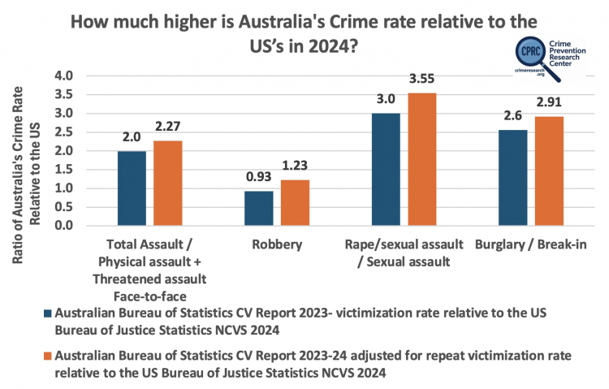

Slide 9
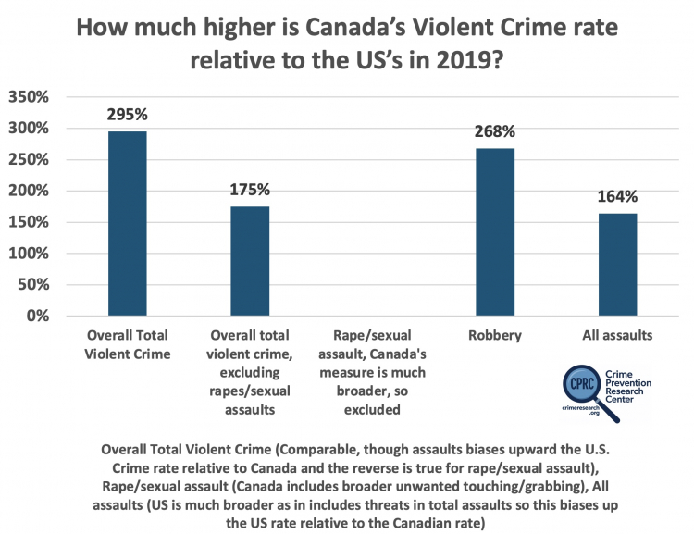

Slide 10
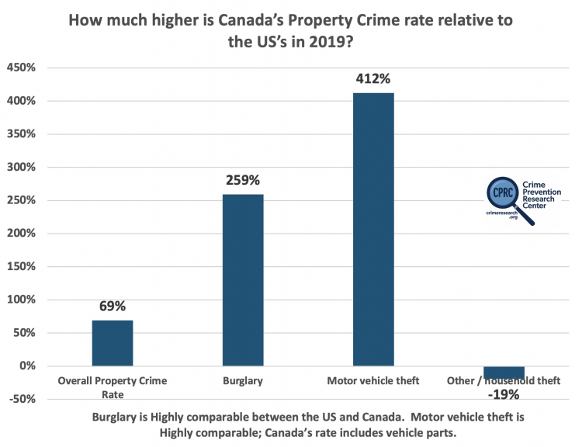

Slide 11
Women and crime
Women in these countries aren’t allowed to protect themselves with mace or pepper spray, let alone guns.
In New South Wales, of the 9,138 sexual assaults reported to police in 2022, there were only 1,016 convictions – just an 11% conviction rate.
Recent talk to students in New South Wales in Australia.

Slide 12
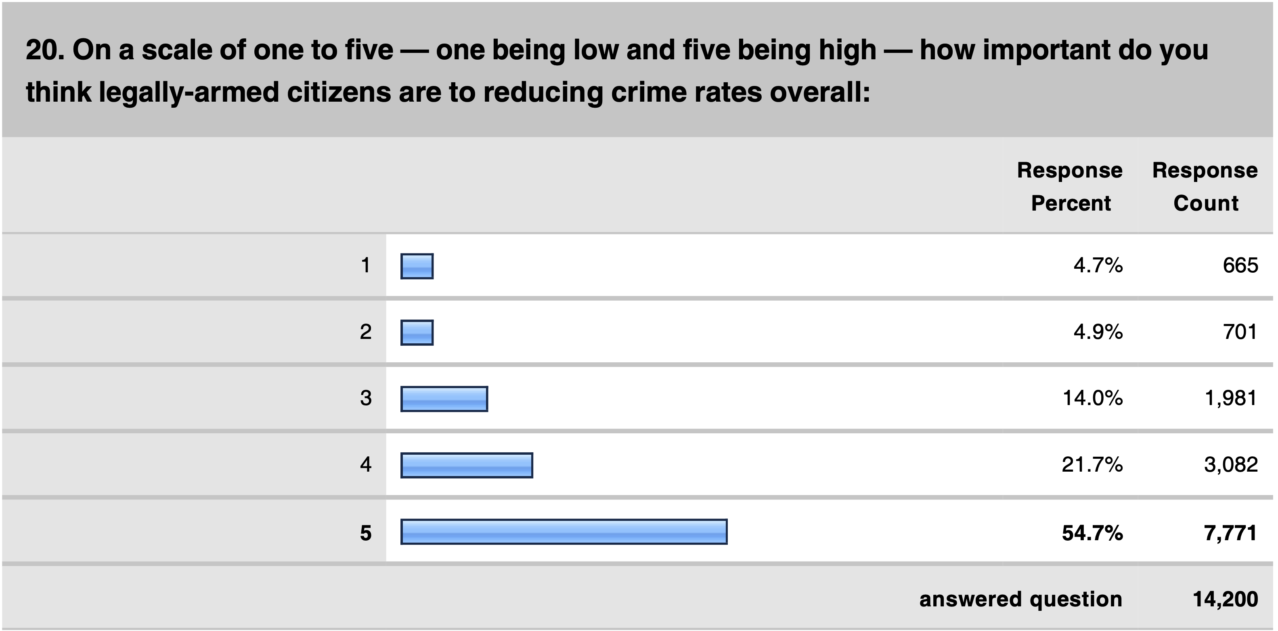
Surveys of Police Officers:
PoliceOne is the largest organization of police with 375,000 active full-time Officers

Slide 13
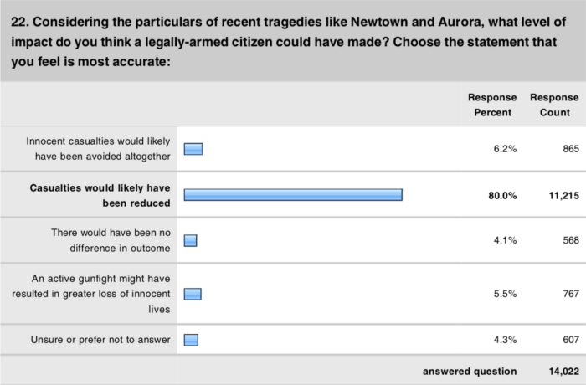

Slide 14
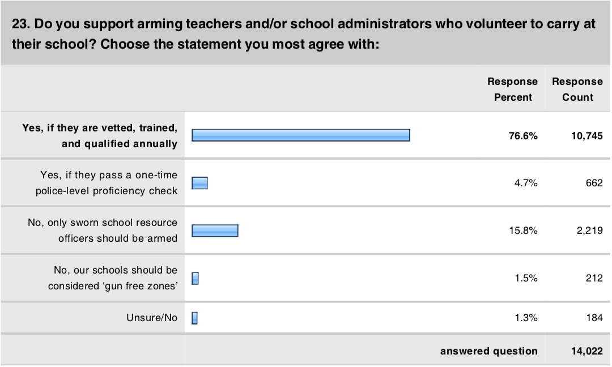

Slide 15
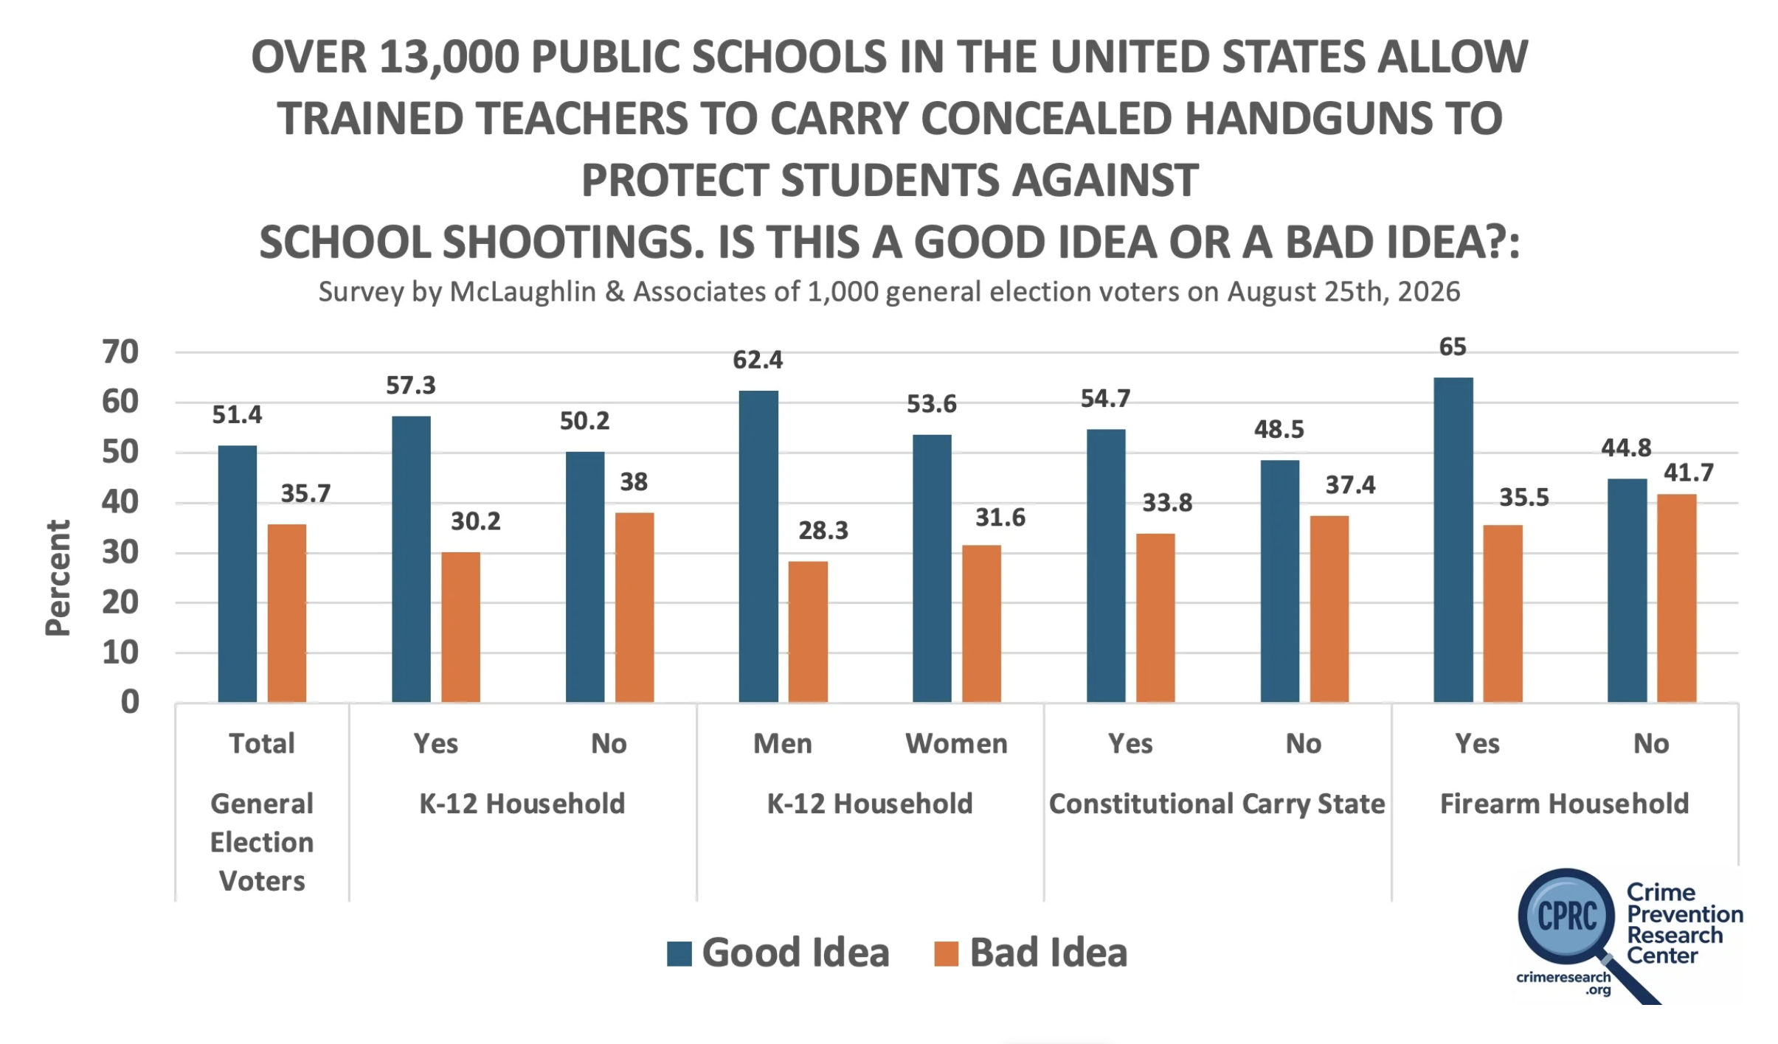

Slide 16
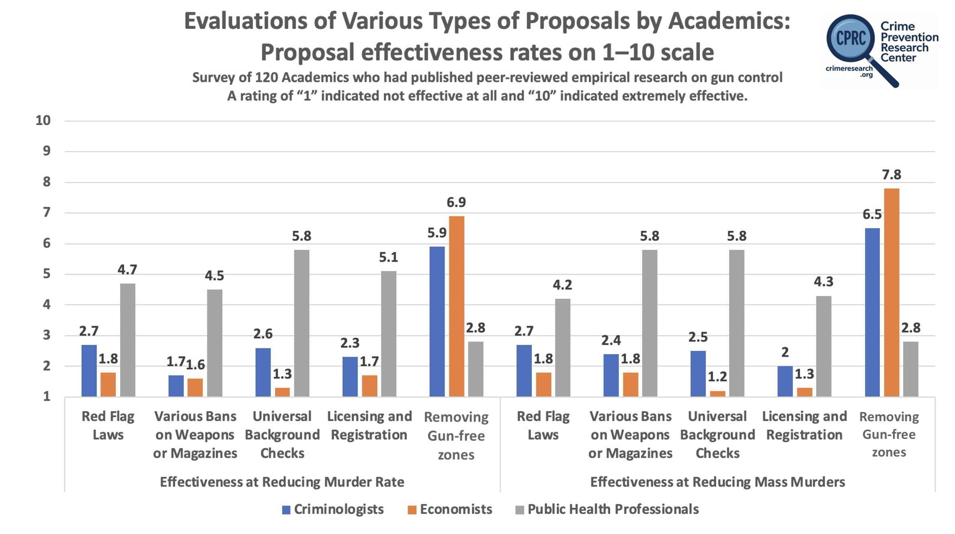

Slide 17
The Effects of Gun Control Policies on Crime and Public Safety
John R Lott, Jr.

