Slide 1

Restoring the Right to Self-defense
John R Lott, Jr.

Slide 2
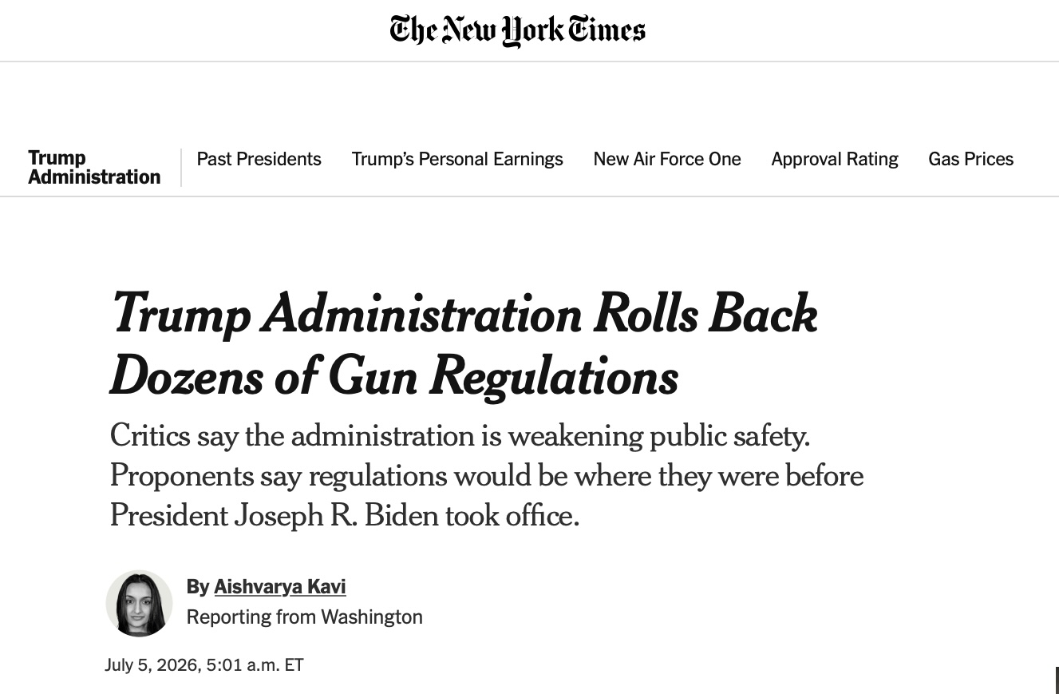

Slide 3
34 Regulatory Changes by ATF
Repeal the "Engaged in the Business" rule – defined virtually everyone as needing a Federal Firearms License
Raise the standard for revoking FFL licenses ("willfully") – any typos, no matter how trivial
Makes it clear that the Forearm Owners Protection Act of 1986 covers not just people transiting through Democratically controlled states inside their cars, but also when they stop at a gas station, hotel overnight, or going by train etc.
Putting limits on the number of years the feds can keep records and allowing dealers to trash records after 20 years too
Repeal the Pistol Brace Rule -- were originally designed to allow wounded and disabled veterans who may have lost the use of part of their hand to hold handguns.

Slide 4
Supreme Court Decisions Possible By Trump Appointments – Long delay after Heller and McDonald cases
Year | Case | Principal Holding
2022 | New York State Rifle & Pistol Ass'n v. Bruen | Recognized a constitutional right to carry handguns in public for self-defense & requiring objective permit rules
2024 | Garland v. Cargill | Held that ATF exceeded its statutory authority by classifying bump stocks as machine guns under the National Firearms Act and Gun Control Act.
2024 | United States v. Rahimi | Upheld the federal prohibition on firearm possession by individuals subject to qualifying domestic violence restraining orders, who had been adjudicated by a court. Important implication for Red Flag laws.
2025 | Smith & Wesson Brands, Inc. v. Estados Unidos Mexicanos | Held that Mexico's lawsuit against U.S. firearm manufacturers was barred by the Protection of Lawful Commerce in Arms Act.
2026 | Wolford v. Lopez | Held that Hawaii cannot presume all private property open to the public is off-limits to licensed concealed carriers absent the owner's affirmative consent.
2026 | United States v. Hemani (unanimous) | Stopped the federal government from prosecuting people as felons simply for using marijuana and securely owning a gun.

Slide 5
Harmeet Dhillon, Assistant Attorney General for the Civil Rights Division, set up Second Amendment Section
Aggressively fighting for protecting rights in the courts
Case | Issue
United States v. Los Angeles County Sheriff's Department | Multi-year delays in issuing concealed carry permits
United States v. Virgin Islands Police Department | Restrictive handgun licensing and permitting system
United States v. District of Columbia (Metropolitan Police Department) | D.C.'s prohibition on registering AR-15s and other semiautomatic rifles
United States v. City and County of Denver | Denver's 1989 "assault weapon" ban
United States v. Colorado | Colorado's 15-round magazine capacity limit
United States v. Virginia | Virginia's newly enacted assault weapon ban
United States v. California | California's Ban on Glocks and Glock style guns

Slide 6
Trump Administration is the most pro-gun
Appointed the most consistently pro-Bill of Rights judges in possibly the last 100 years.
Besides the Court decisions and the Regulatory changes
  Supreme Court will hear the assault weapon ban case
Democrats were using the government to censure information they didn’t like
  CDC taking down info on defensive gun uses
    Gun Violence Archive emails upset that defensive gun use number “has been used so often to stop [gun control] legislation.”
Allow military troops to carry guns with them on military bases

Slide 7
Warning: Democrats are promising to Pack the Supreme Court
All the Democrats in the Senate with the possible exception of John Fetterman support eliminating the filibuster and increasing the number of Justices on the Supreme Court
All the Democrats on the House Judiciary Committee support packing the Supreme Court
Look at the dissents from the Democrats on the Supreme Court to get an idea of where a Democrat majority would go.

Slide 8
Educational Battle
Judges don’t just look at the law, they won’t do things that they think endanger safety
Gun-free zones
  Progress despite massive media bias
Much of the gun-control debate centers on hypothetical risks, but we don’t have to guess.
Difficulties that police have in stopping public shootings
School shootings
How incredibly law-abiding concealed handgun permit holders are
  New York Times and others seem to have given up on this effort

Slide 9
Educational Battle
Politicians point to other countries that we should model our gun control laws on.
"Australia is a good example. Canada is a good example. A lot of other countries have much stricter gun laws than we do. And they have a much lower incidence of gun violence,” then President Obama noted in 2013. Democrats from Hillary Clinton to Joe Biden have made similar claims
The Australian Bureau of Statistics reports that only about 19% of rapes and sexual assaults are reported to police, while in the U.S. 45% are reported. Obviously, simply comparing reported crimes therefore dramatically understates the extent of the problem in Australia.
Australia’s rape and sexual assault rate is roughly three times higher than that of the United States. Australia’s assault rate is about twice as high, and its burglary rate is about 2.5 times higher. Robbery is the only category where the two countries report similar rates.
Canada – violent crime rate 295% higher than U.S. rate

Slide 10
Restoring the Right to Self-defense
John R Lott, Jr.

