Slide 1

Making People Safer
John R Lott, Jr.

Slide 2
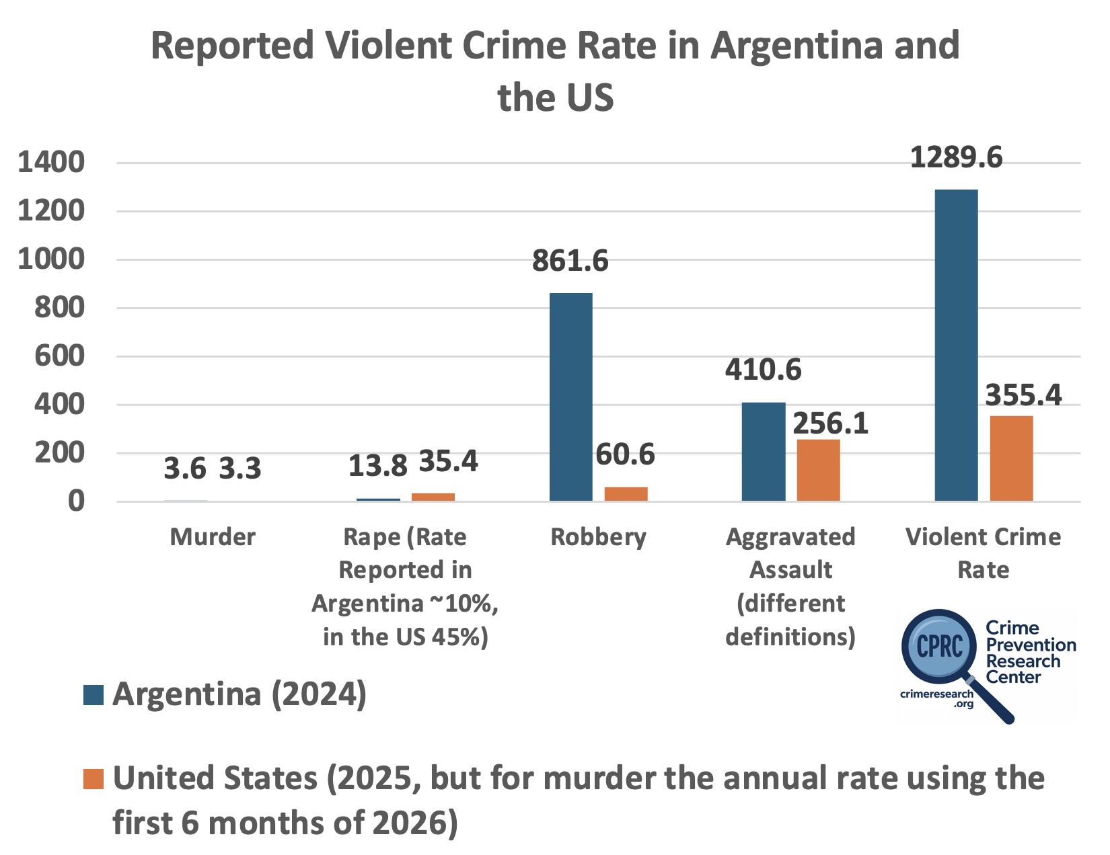

Slide 3
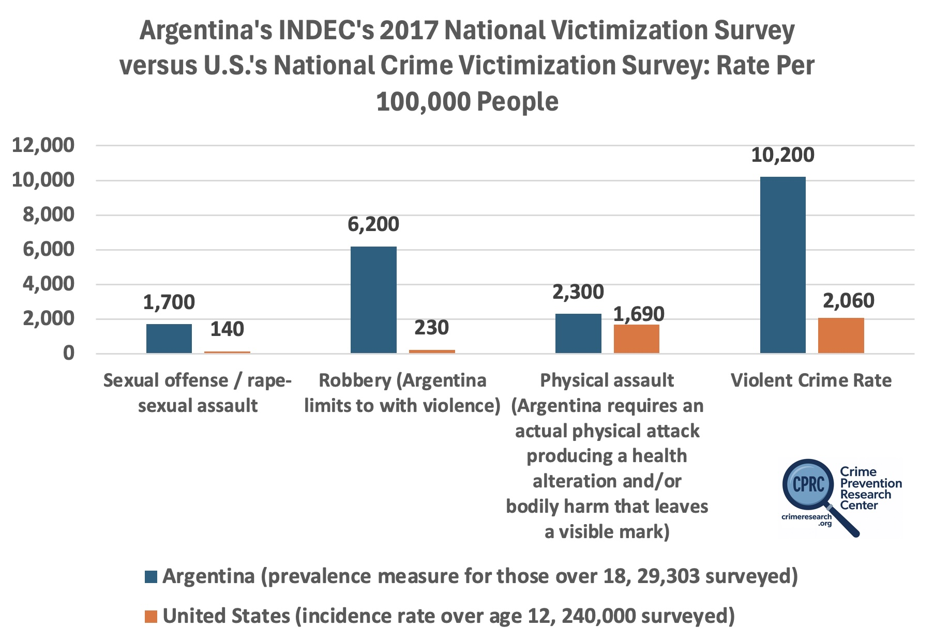

Slide 4
Reducing Crime Isn’t Rocket Science
Stating the obvious
If you make it riskier for criminals to commit crime, you will have less crime.
You can make it riskier with higher arrest or conviction rates, longer prison sentences, or the death penalty. (An example dealing with the death penalty.)
But you can also make it riskier for criminals to commit crime by making it possible for victims to defend themselves.

Slide 5
Police are Extremely Important, but They Have a Difficult Job and Arrive After the Crime Occurs
In 2024, Argentina had about 410,000 police officers
That is about 8.8 officers per 1,000 people. In Buenos Aires, there is also about 8 officers per 1,000.
But not all the officers will be on duty at the same time. Suppose with different shifts and vacations and some officers being administrators that one-third are on duty at any given time, you will have 2.95 officers on duty at any point in time to protect 1,000 people.
Police will virtually always arrive on the crime scene after the crime occurs.
Response time in the city Buenos Aires for serious violent crime with the criminal still there is around 5 minutes. 3.1 Seconds to answer phone call.
As noted, most crimes are never reported to the police.
People are frequently only able to call police when the crime is finished.

Slide 6
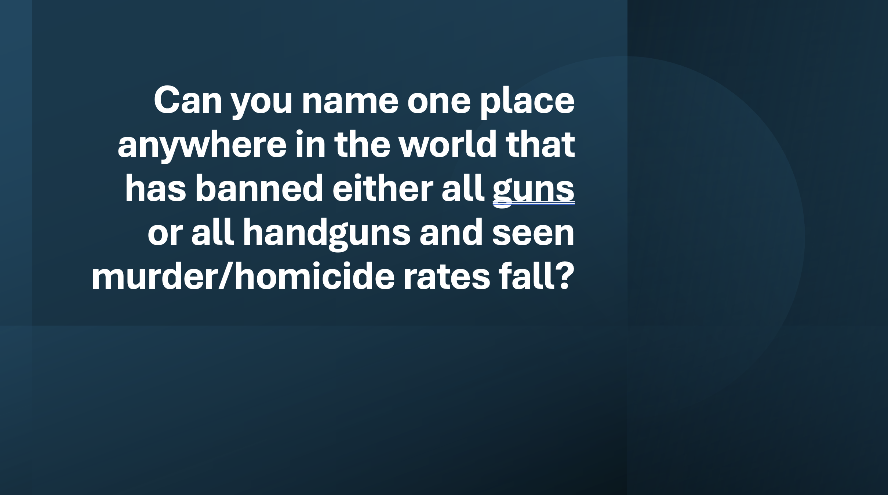

Slide 7
If guns on net are bad, it should be easy to find places where gun bans have lowered murder/homicide rates. Right?
Just out of randomness, you would expect to find a few times where murder/homicide rates went down.
Every single time murder/homicide rates have gone up.
But I can’t find such a place.

Slide 8
We have tried handgun bans in the United States: Washington, D.C. and Chicago

Slide 9
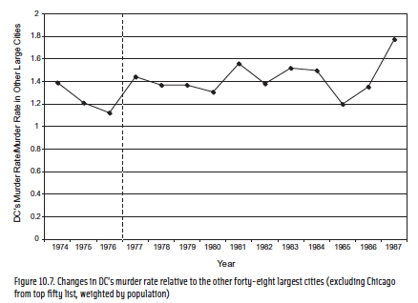

Slide 10
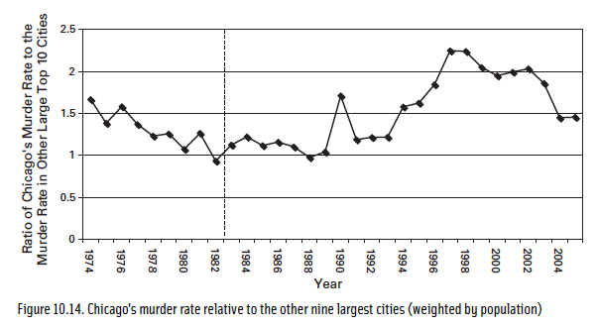

Slide 11
Gun control advocates say that the bans in DC and Chicago weren’t fair tests, that unless you ban guns everyplace in a country you can’t expect it to work.
Yet, even when whole nations have banned guns, it hasn’t worked. Take a few island nations that have banned guns.
But that can’t explain why murder rates went up. It might explain why they didn’t go down as they predicted, but criminals were able to obtain guns at those other places before the bans.

Slide 12
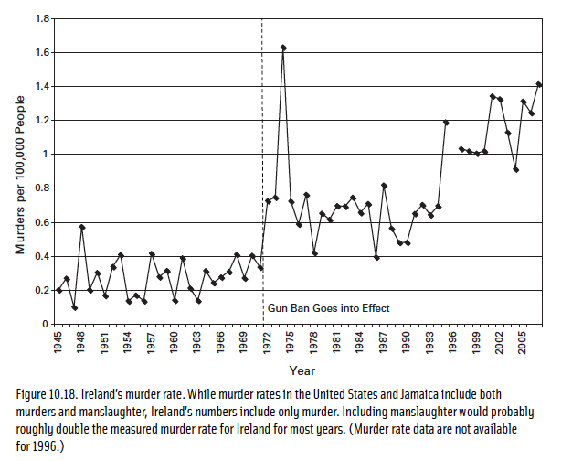
Republic of Ireland’s murder rate

Slide 13
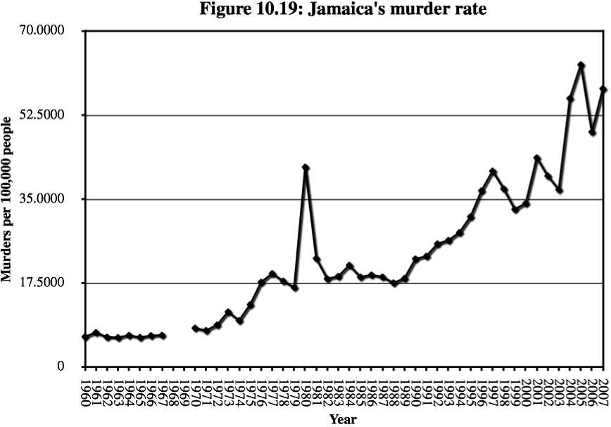

Slide 14
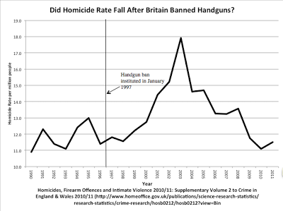

Slide 15
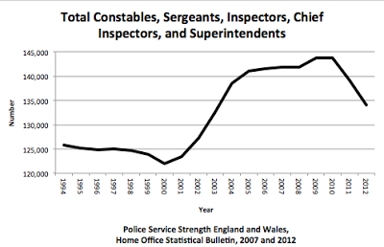

Slide 16
Predictions of what would happen to Homicide Rates in Brazil by increasing gun licenses
“Here’s a simple fact, affirmed by worldwide research, for Bolsonaro to consider: More guns means more deaths by gun — whether by homicide, accident or suicide.” -- Editorial Board, “Brazil’s Bolsonaro Makes a Dangerous Decision on Guns,” Bloomberg Opinion, January 18, 2019.
“Newly elected Brazilian President Jair Bolsonaro is supremely confident he can reduce violent crime — a core pillar of his election campaign. But his proposal to dismantle national gun laws is precisely the wrong way to go about doing this.” -- Robert Muggah, “Brazil’s High Murder Rate Could Get Even Worse If Gun Laws Are Relaxed,” National Public Radio, January 10, 2019.
“Mr. Bolsonaro’s promise to ease gun regulation . . . is worrying some experts who argue that more guns fuel more violence” -- Shasta Darlington, “Brazil’s New Leader Wants to Ease Gun Laws. Supporters Are Ready, and Training,” New York Times, December 1, 2018.
“Jair Bolsonaro wants Brazilians to have more guns: More young people will die.” – Headline in The Economist January 2019.

Slide 17
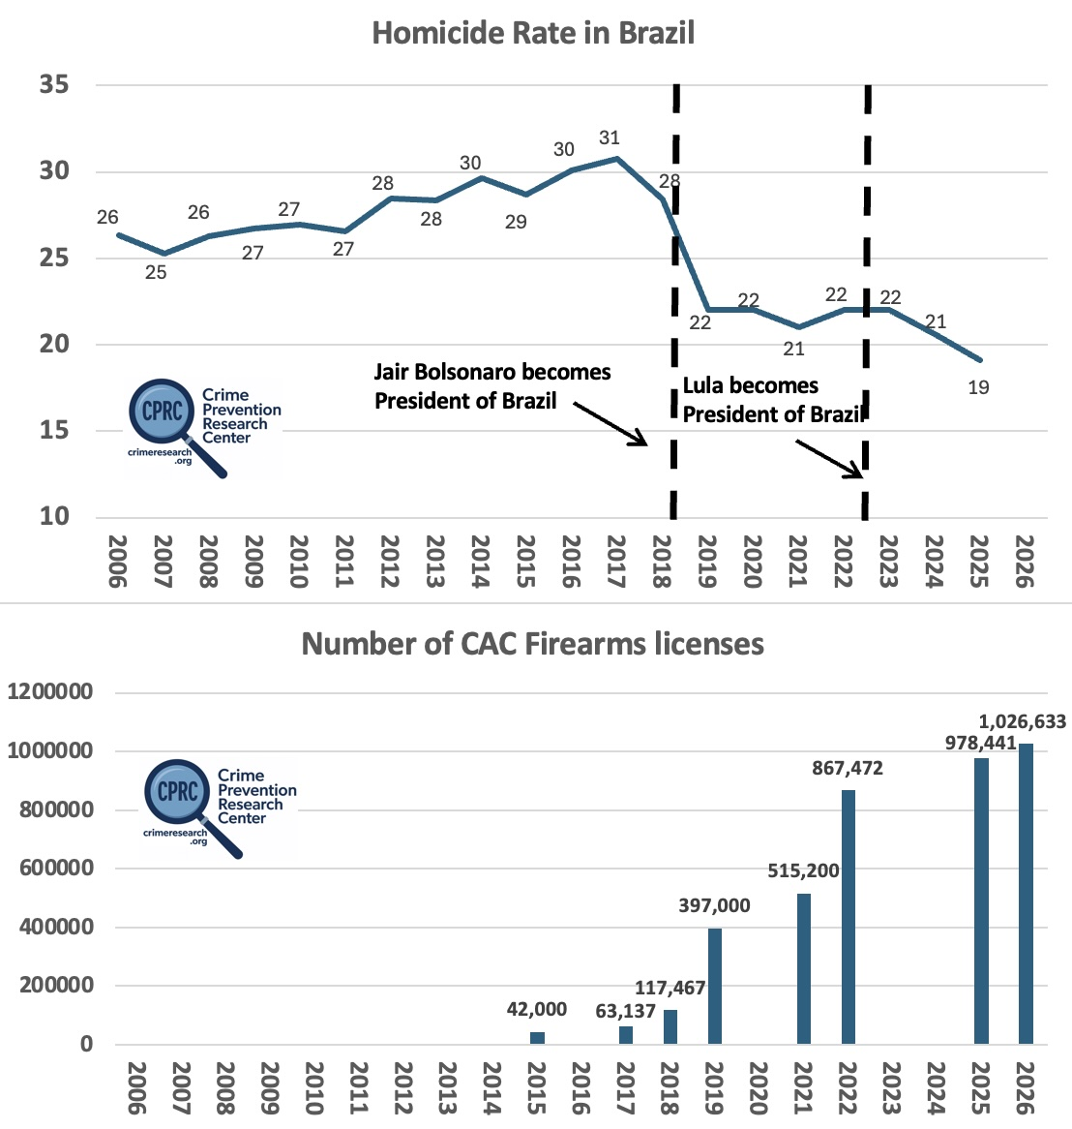

Slide 18
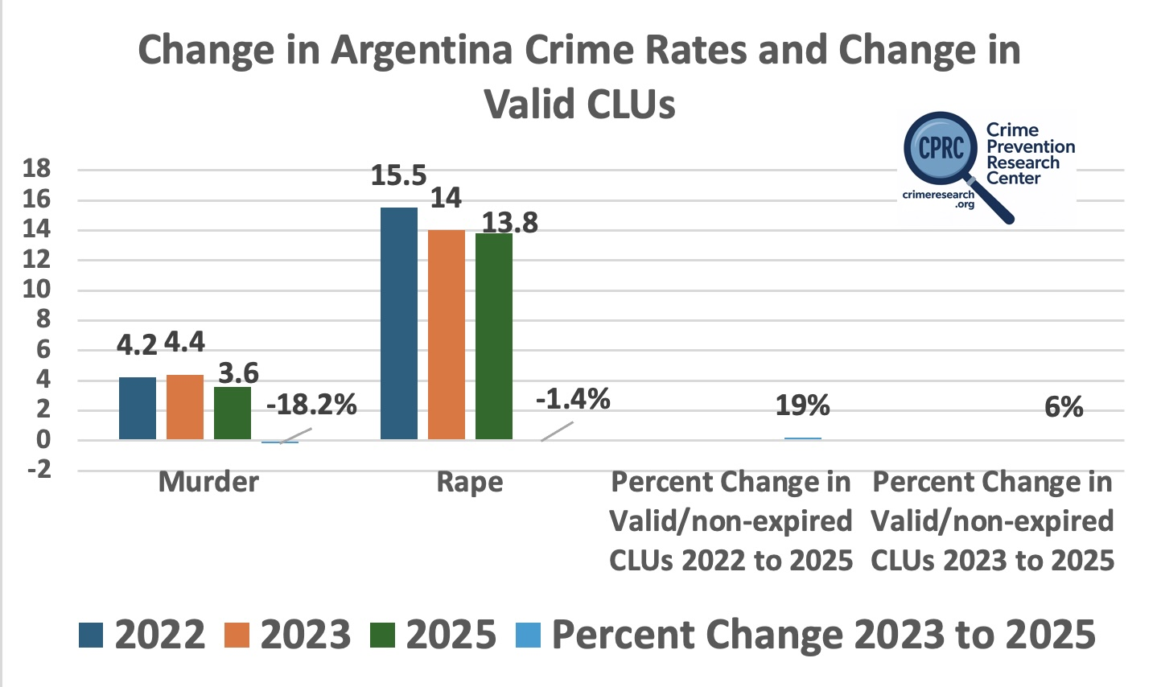

Slide 19
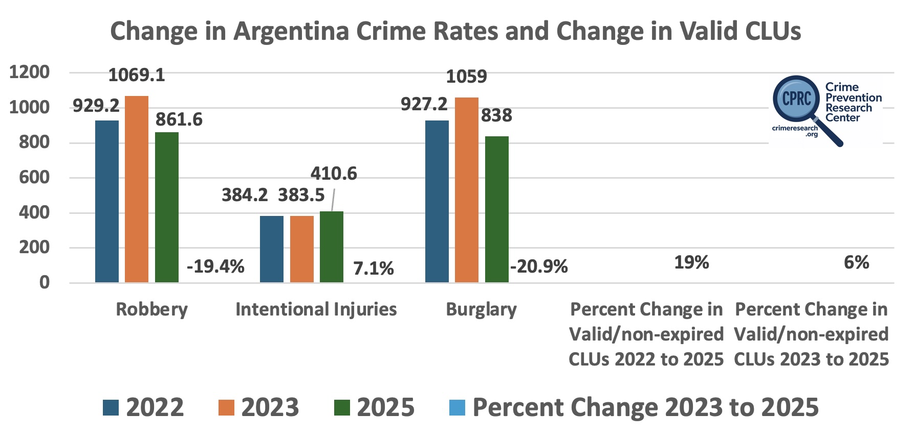

Slide 20
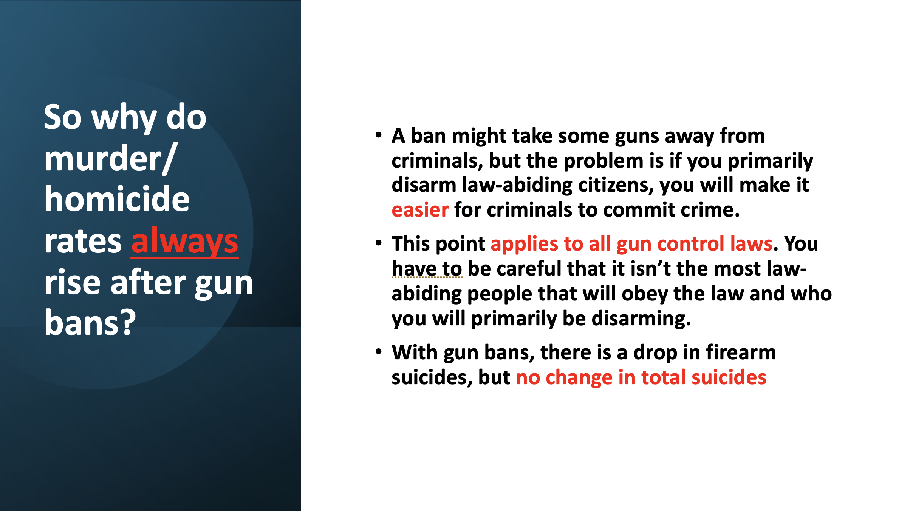

Slide 21
Video goes here

Slide 22
Do Armed Civilians Stop Active Shooters More Effectively Than Uniformed Police?
Television Police Shows – something is virtually always going wrong when a civilian uses a gun defensively. The main exception are shows by Taylor Sheridan (e.g., Yellowstone, Landman).
But how well does what we see on television reflect reality?
Looking at the FBI’s Active shooting cases.
  Define: guns fired in public, not part of some other type of crime, anything from one person being shot at and missed up to a mass public shooting.
From 2014 to 2025, there were 615 Active shooting cases, about 50 a year. These cases exclude instances where a law-abiding citizen with a gun stopped an attacker before he could fire a shot.

Slide 23
Understanding the difficult job that uniformed police have
How does being in uniform make it more difficult for police to stop these attacks and how does it make their job more dangerous.
  Compared to Air Marshals
  My first experience in Brazil
There is another problem that police face – there aren’t that many of them.
  In 2024, 21.5 million Americans—about 8.2% of adults—held concealed handgun permits (Lott et al., 2025). In addition, 29 states allowed Constitutional Carry, which requires no permit at all. Surveys we conducted with McLaughlin & Associates show that 15.6% of likely voters carry all the time, and another 8.4% carry some of the time
  Compare that to the roughly 671,000 full-time sworn law enforcement officers in 2020. If only a third are on duty at any given time, that leaves about 223,667 officers to protect a population of 340 million—less than 0.1% of the population.
Result: where civilians are legally able to carry guns, concealed carry permit holders stopped 51.5% of active shootings, compared to 44.6% stopped by police

Slide 24
Of the 615 Active Shootings from 2014 to 2025, 225 Total Instances were Stopped by an Armed Civilian & 189 Cases were Stopped by Police
Did permit holders end up accidentally shooting bystanders? That happened in just one case where they wounded someone (0.56 percent). Police killed the wrong person four times. Two of them were other police officers. Difference not statistically significant.
Did they interfere with police? In zero cases (0.0 percent).
Did they lose their lives in the confrontation? In two cases (1.1%). 19 police were killed in stopping these attacks (5.41%).
Were permit holders injured while saving lives? In 45 cases (25%). 48 police officers were injured.
Did they prevent a mass public shooting? In 58 cases (32 percent).
Did they have their gun taken away? In zero cases for both civilians and police.

Slide 25
Who benefits the most from owning guns?
People on the left claim that they care about the poor. But who are the most likely victims of violent crime?
People who are the most likely victims of violent crime benefit the most. Overwhelmingly poor blacks who live in high crime urban areas.
People who are relatively weaker physically – women and the elderly.
There is now over 21.5 million concealed handgun permit holders.
Over the last ten years, the growth in permits for women was 109 percent faster than for men, and 136 percent faster for blacks than for whites.
Women now make up 28.3 percent of permit holders, and black Americans make up 12 percent, close to their share of the population.

Slide 26
Comparing Defensive Gun Use to Other Methods of Self Defense
The myth of passive behavior
National Crime Victimization Survey
When a woman comes into physical contact with an attacker she is in trouble.
What I learned at the US Sentencing Commission.
For women, by far the safest course of action [when confronted by a criminal] is to have a gun. A woman who behaves passively is 2.5 times as likely to end up being seriously injured as a woman who has a gun.
Guns are the great equalizer.
Murder rates decline 3 to 4 times more for women or then men when they carry concealed handguns.
Rape rate falls by 25% in states adopting Right-to-Carry laws than in states that restrict or forbid women to carry concealed handguns.

Slide 27
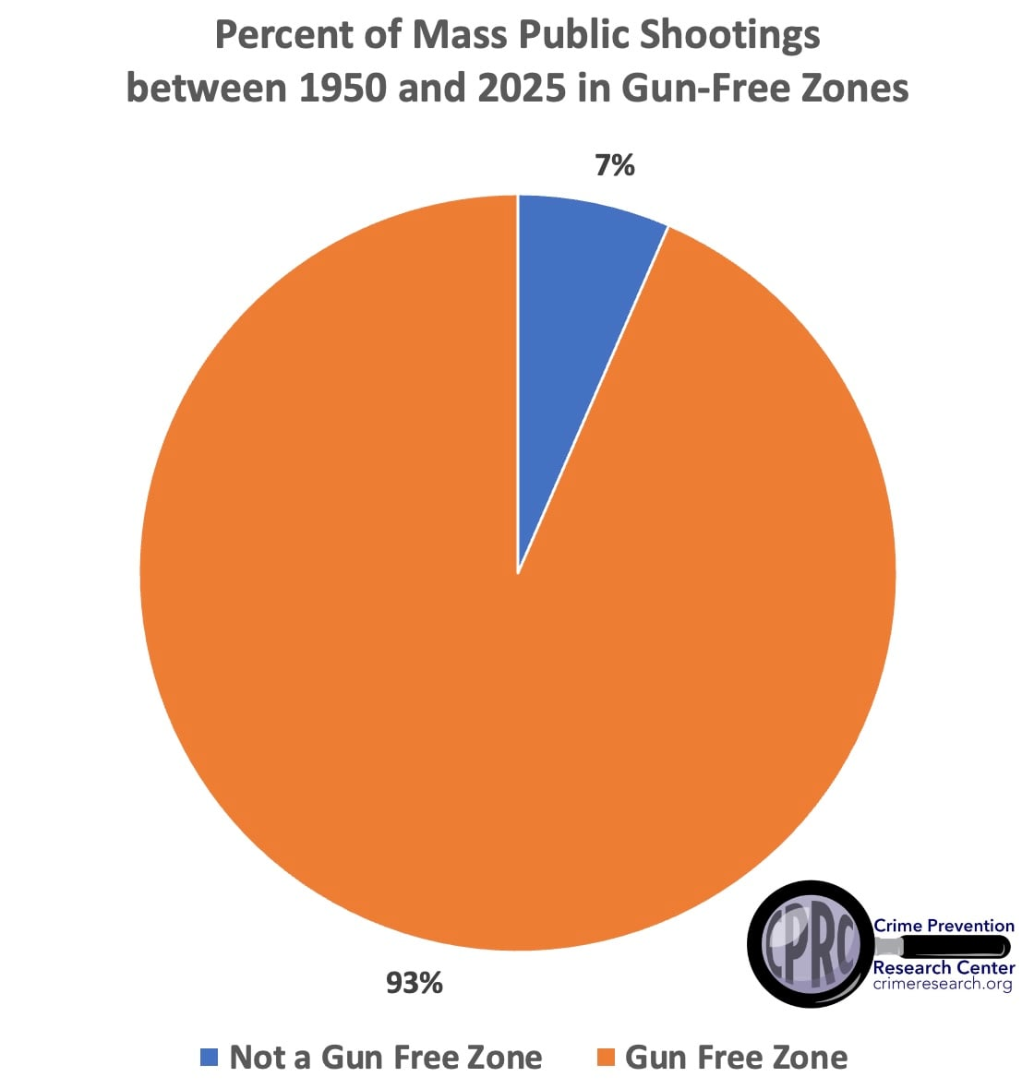
Mass Public Shootings

Slide 28
Why are mass murderers attracted to gun-free zones?
Time after time, mass public shooters explicitly explain why they pick the targets they do, but the news refuses to discuss those parts of their diaries and manifestos.
2025 Minneapolis School Shooter extensive discussion of what he learned from other mass murders
The 2023 Nashville Covenant School shooter made this explicit in her manifesto. “There was another location that was mentioned, but because of a threat assessment by the suspect of too much security, they decided not to,” said Nashville Police Chief John Drake.
the 2022 supermarket shooting in Buffalo, New York, wrote in his manifesto: “Areas where CCW permits are outlawed or prohibited may be good areas of attack.”
Dozens of cases going all the way back to the well-known Columbine massacre in 1999.

Slide 29
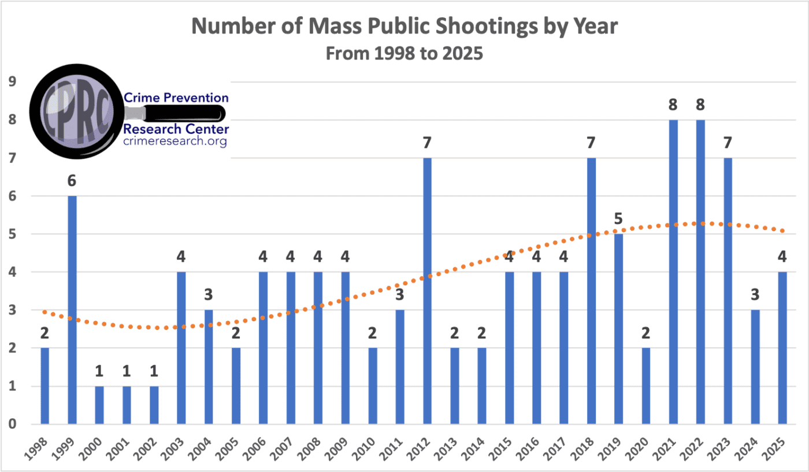

Slide 30
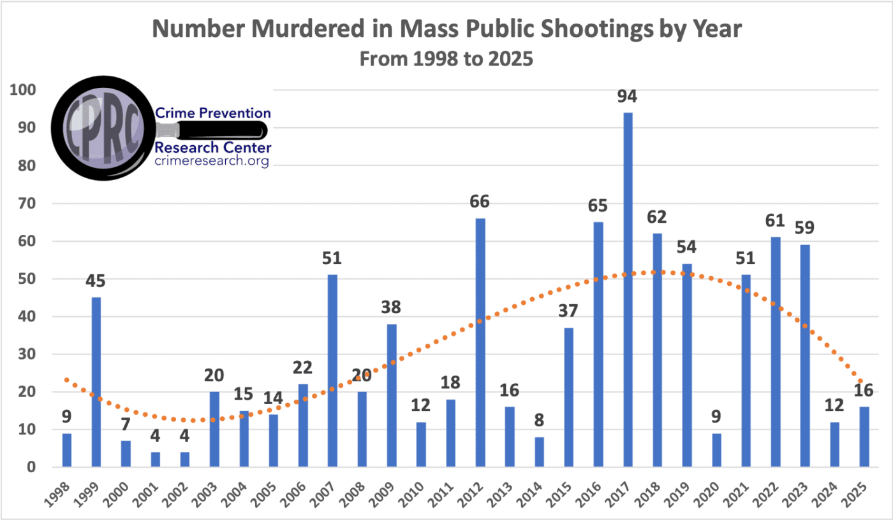

Slide 31
Making People Safer
John R Lott, Jr.

Slide 32
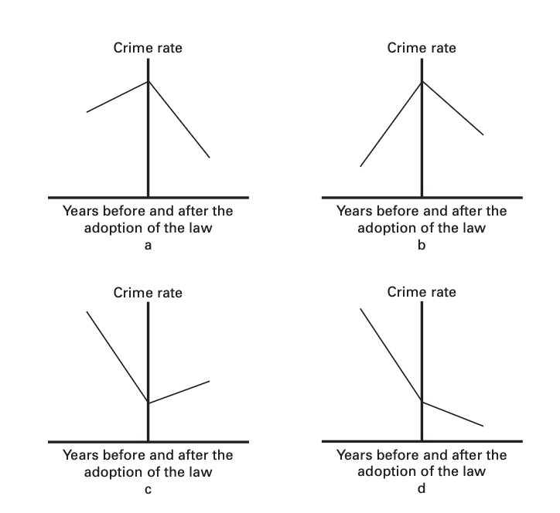
Australia’s Experience
Simple before-and-after averages of gun deaths in Australia are extremely misleading.
Australia’s buyback resulted in almost 1 million guns being handed in and destroyed, but after that private gun ownership once again steadily increased and by 2010 exceeded gun ownership before the “buyback.”
But since 1997 gun ownership in Australia grew over three times faster than the population (from 2.5 million (p. 5) to 5.8 million (p. 63) guns).

Slide 33
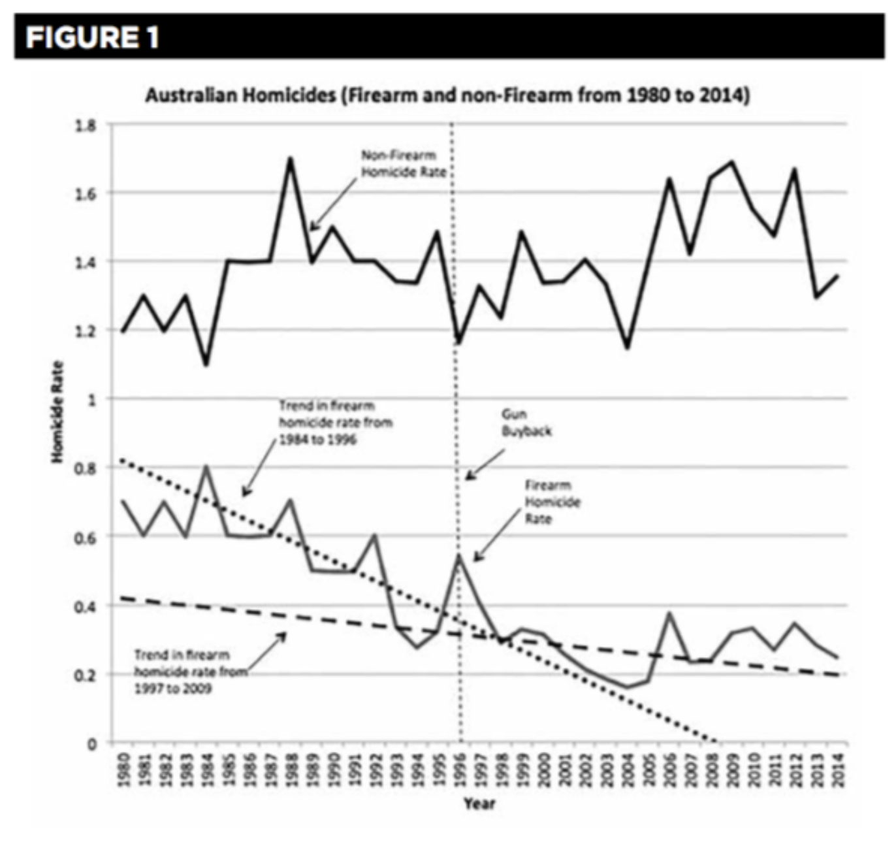
Australia
Homicides After the 1996-1997 “Buyback”

Slide 34
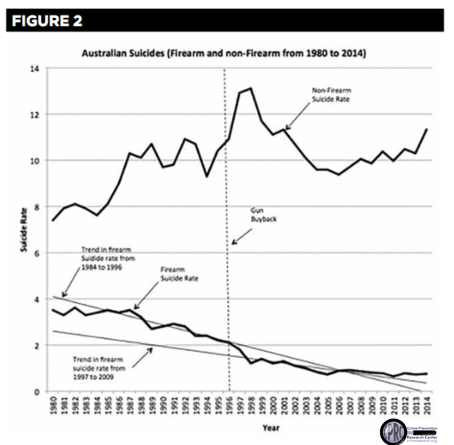
Australia
Suicides After the 1996-1997 “Buyback”

