Slide 1
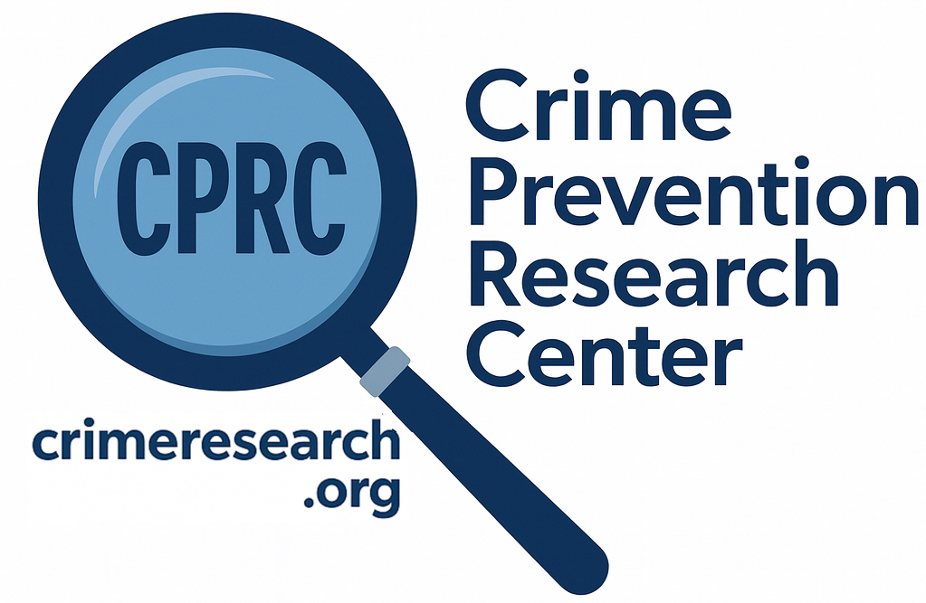
The Effects of Gun Control Policies on Crime and Public Safety
John R Lott, Jr.

Slide 2
Can you name one place anywhere in the world that has banned either all guns or all handguns and seen murder/homicide rates fall?

Slide 3
If guns on net are bad, it should be easy to find places where gun bans have lowered murder/homicide rates. Right?
Just out of randomness, you would expect to find a few times where murder/homicide rates went down.
Every single time murder/homicide rates have gone up.
But I can’t find such a place.

Slide 4
We have tried handgun bans in the United States: Washington, D.C. and Chicago

Slide 5
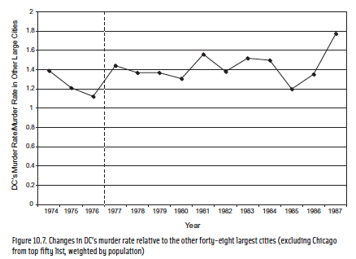

Slide 6
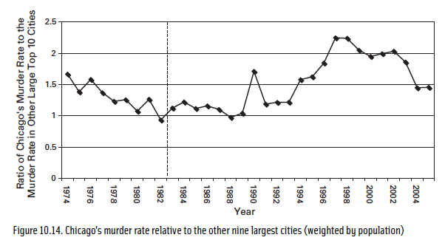

Slide 7
Gun control advocates say that the bans in DC and Chicago weren’t fair tests, that unless you ban guns everyplace in a country you can’t expect it to work.
Yet, even when whole nations have banned guns, it hasn’t worked. Take a few island nations that have banned guns.
But that can’t explain why murder rates went up. It might explain why they didn’t go down as they predicted, but criminals were able to obtain guns at those other places before the bans.

Slide 8
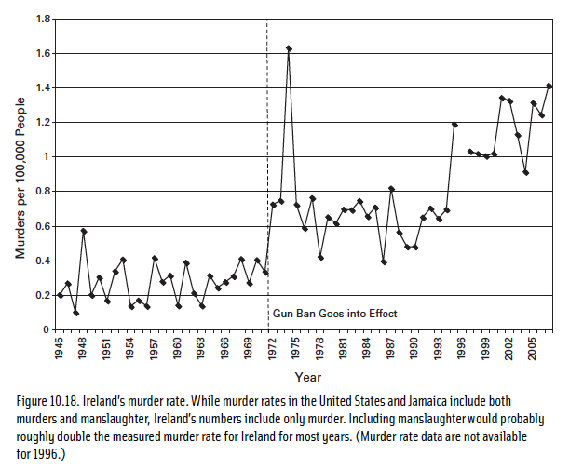
Republic of Ireland’s murder rate

Slide 9
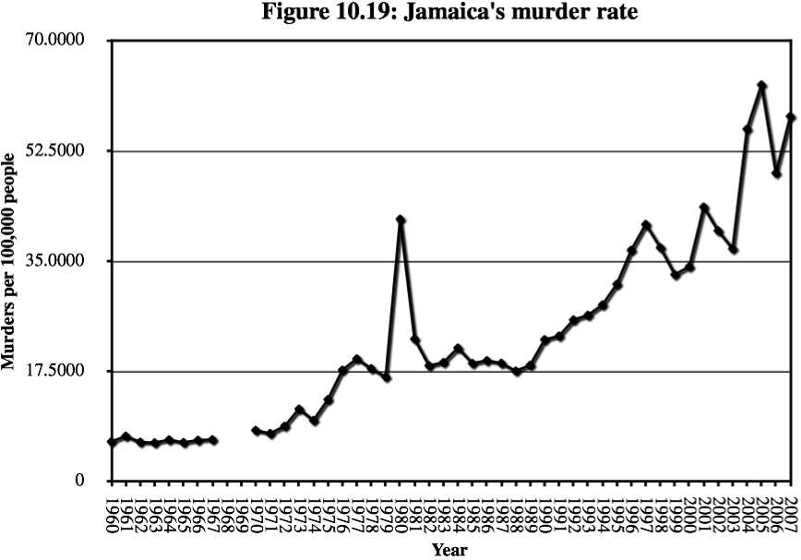

Slide 10
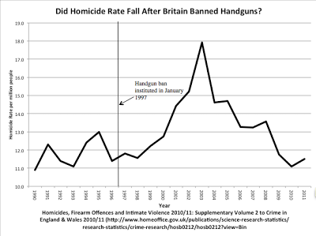

Slide 11
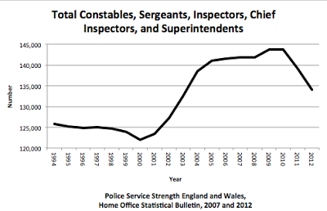

Slide 12
So why do murder/ homicide rates always rise after gun bans?
A ban might take some guns away from criminals, but the problem is if you primarily disarm law-abiding citizens, you will make it easier for criminals to commit crime.
This point applies to all gun control laws. You have to be careful that it isn’t the most law-abiding people that will obey the law and who you will primarily be disarming.
With gun bans, there is a drop in firearm suicides, but no change in total suicides

Slide 13
Gun laws stop law-abiding people, particularly the poor and minorities from obtaining protection
Why do just 4% of adults in Illinois have a permit, but 23% in neighboring Indiana? Why do relatively few poor and minorities have permits in Illinois?
May Issue Gun Control Laws – Struck down by the Supreme Court’s Bruen Decision
  For Los Angeles County, there were 341 concealed-carry permit holders in Los Angeles County, California. Democrats approved permits disproportionately for wealthy, politically connected, white, and male.
  In LA, only 7.6% female, 5% black, 6% Hispanic
Background checks
  Claim that background checks have stopped over 5 million dangerous or prohibited people from obtaining guns, but 99% are mistakes.
  Discriminates against minority males
  Universal background checks

Slide 14
A few basic facts
Police are the single most important factor in reducing crime
  But the police themselves know that they virtually always arrive on the crime scene after the crime has occurred.
The people who benefit the most from owning guns are the most vulnerable. They fall into two groups.
  The most likely victims – particularly poor blacks living in high crime areas
  Those who are weaker physically – women and the elderly
92% of violent crime don’t involve guns in any way
Guns are used defensively to stop crime about 5 times more frequently than they are used to commit it.
  Why don’t we hear about that more?
  What is newsworthy doesn’t always reflect reality.
  Only about 40% of violent crime is reported to police.
  Media bias

Slide 15
Crime in Other Countries
U.S. murder rate was about four per 100,000 people – roughly twice Australia’s and Canada’s 2024 homicide rate.
Yet it’s also true that homicides account for only a tiny fraction of violent crime. In 2024, homicides represented just 0.21%. About 0.03% in Australia and Canada, but that is because their other violent crime rates are so high.
Murders are extremely heavily concentrated in tiny areas in the US.
  Just 2% of counties account for approximately 54% of all murders, and within those counties roughly two-thirds of killings occur within areas covering only about ten city blocks. 53% of U.S. counties report no murders in a typical year, while another 16% report only one.

Slide 16
Reported Crime versus Total Crime
Shocking how defenseless people feel in other countries.
The gap between police statistics and actual victimization is substantial.
  Argentina Example
In Canada, the police-reported violent-crime rate is 885 per 100,000 people. The GSS reported a violent victimization rate almost 10 times that – 8,300 per 100,000 – 10.6% of crimes reported.
During the same year, the US’s NCVS estimated 2,013,220 felonious violent crimes – rape or sexual assault, robbery, and aggravated assault, excluding simple assault. Police reports therefore captured 59.8% of the NCVS estimate.
Compare rape/sexual assault in the US and Australia.

Slide 17
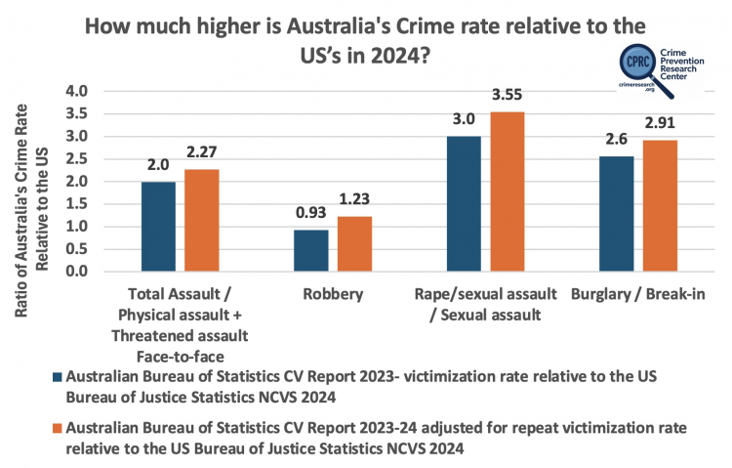

Slide 18
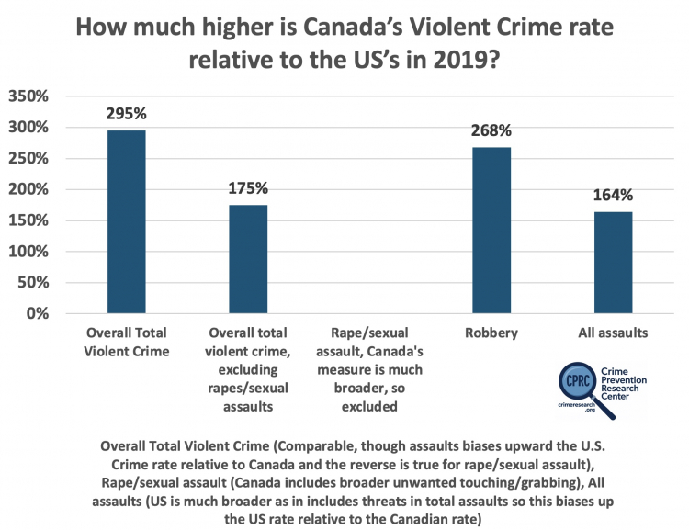

Slide 19
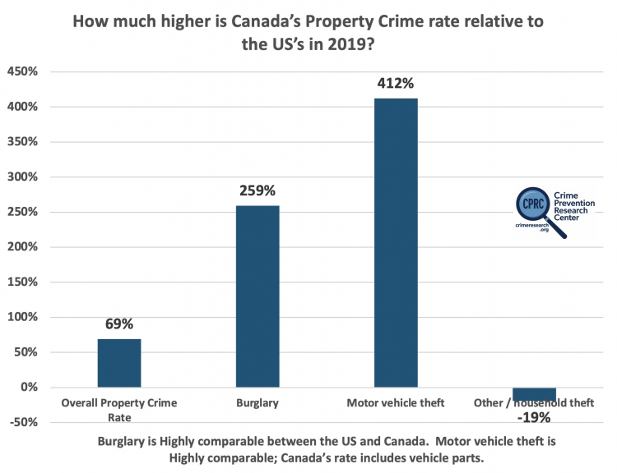

Slide 20
Women and crime
Women in these countries aren’t allowed to protect themselves with mace or pepper spray, let alone guns.
In New South Wales, of the 9,138 sexual assaults reported to police in 2022, there were only 1,016 convictions – just an 11% conviction rate.
Recent talk to students in New South Wales in Australia.

Slide 21
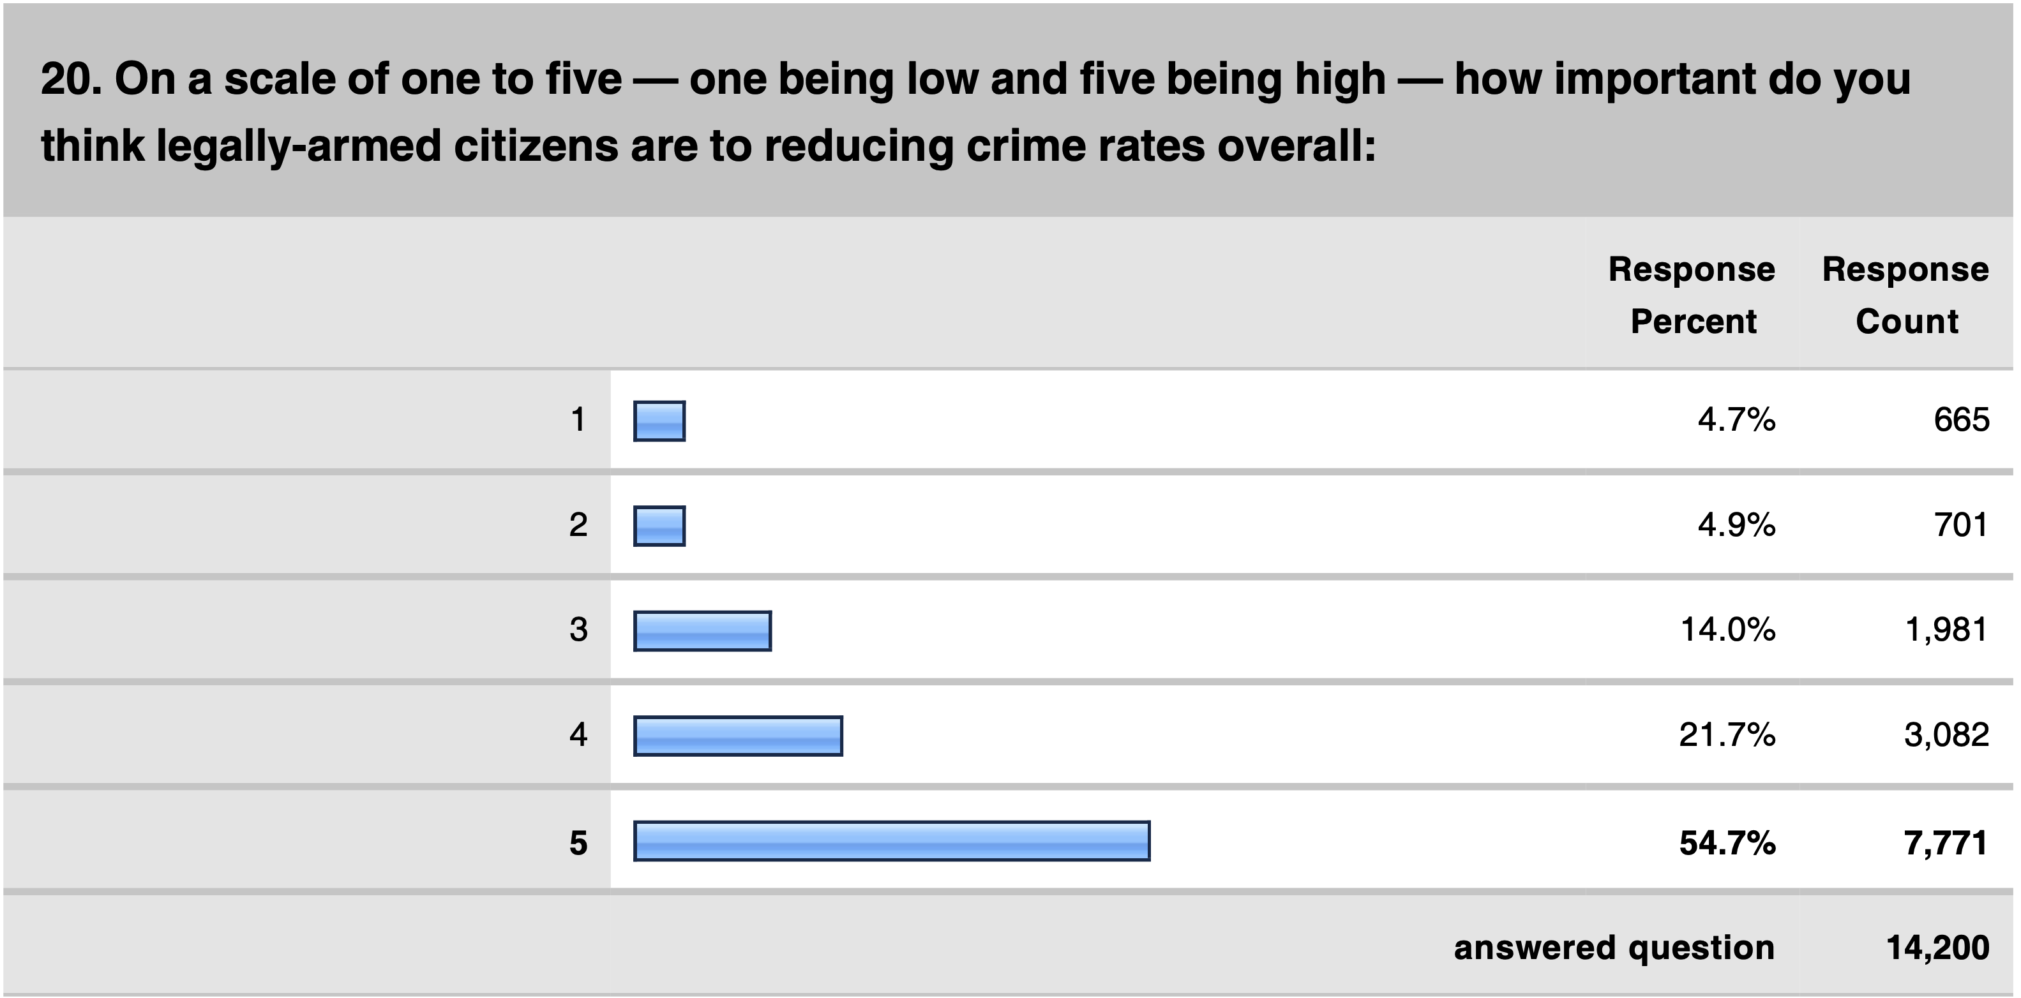
Surveys of Police Officers:
PoliceOne is the largest organization of police with 375,000 active full-time Officers

Slide 22
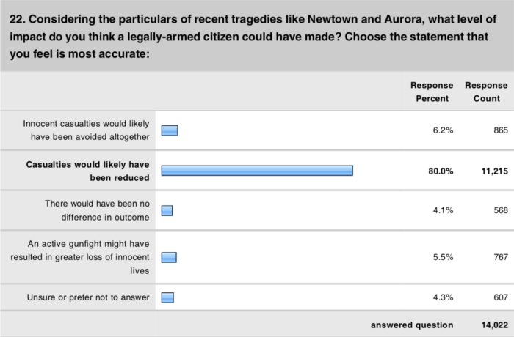

Slide 23
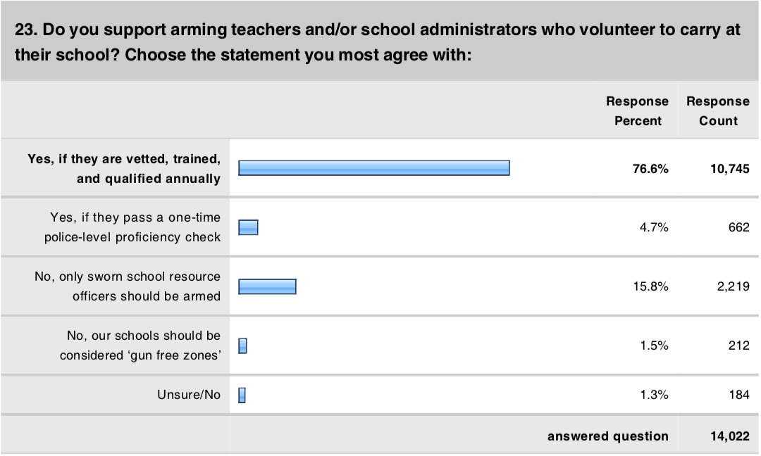

Slide 24
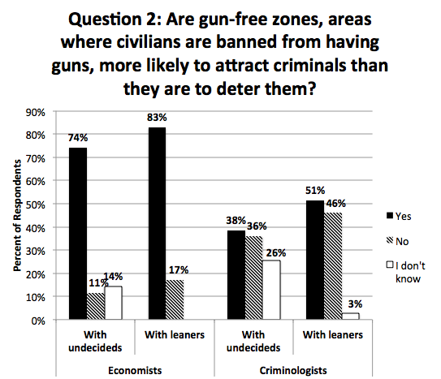
Regulation, Spring 2020, Vol. 39, No. 2

Slide 25
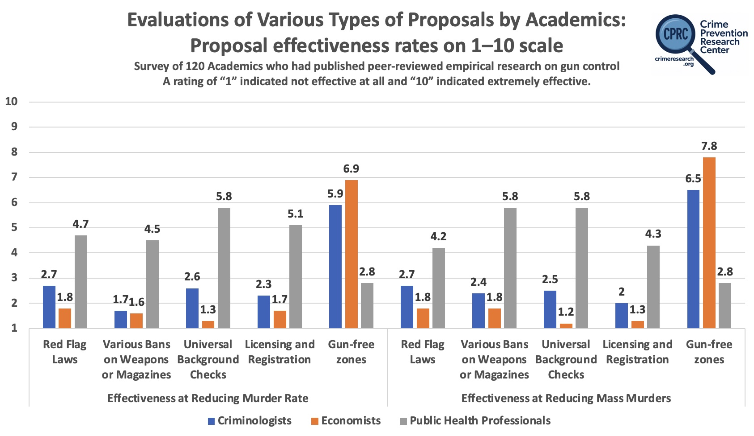

Slide 26
Video goes here

Slide 27
Errors in the FBI Active Shooting Reports
Until January 2021, I worked in the U.S. Department of Justice as the senior advisor for research and statistics in the Office of Justice Programs, and part of my job was to evaluate the FBI’s active shooting reports.
  Define
While the FBI includes cases where civilians stop active shooters, the news media frequently relies on the limited number of these cases to argue that such interventions are rare. Headlines illustrate this framing: “Rare in US for an active shooter to be stopped by bystander” (Associated Press); “Rampage in Indiana a rare instance of armed civilian ending mass shooting” (Washington Post); and “After Indiana mall shooting, one hero but no lasting solution to gun violence” (New York Times).
Discovered the FBI either missed or misidentified many cases of civilians using guns to stop active shootings.
https://tinyurl.com/FBIMissedActiveShootings

Slide 28
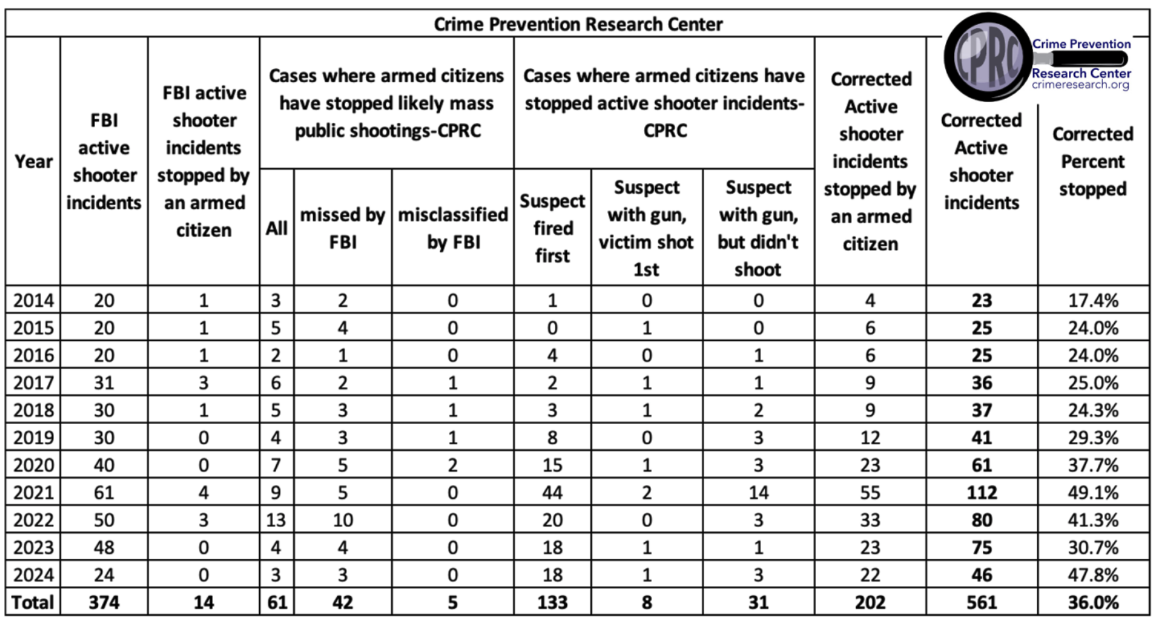

Slide 29
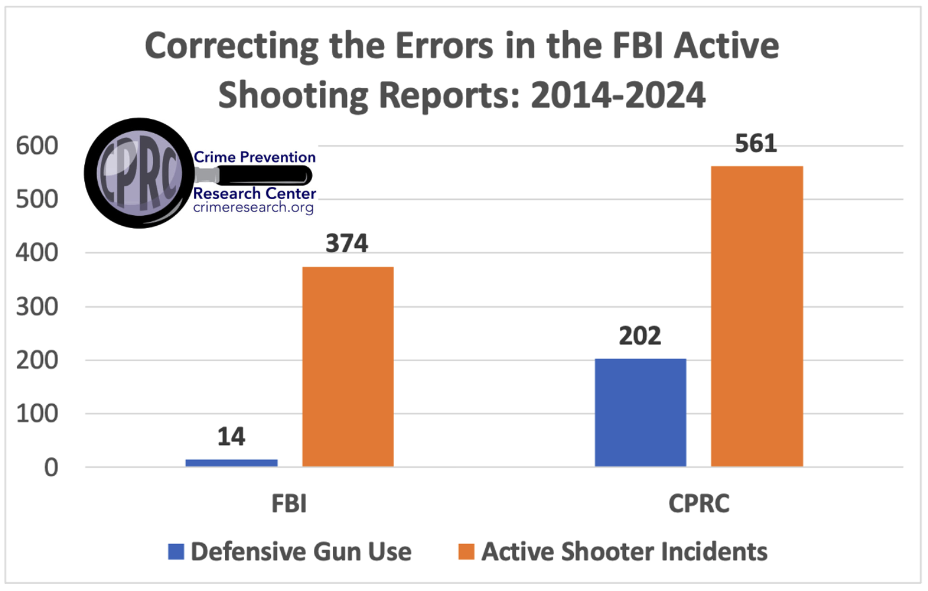

Slide 30
FBI Response to Media Questions
When John Stossel asked the FBI about our claim that they had omitted many cases, the Bureau responded: “[Our data is] not intended to explore all active shooting incidents but rather to provide a baseline understanding . . .”
In addition, earlier in 2023, Glenn Kessler with the Washington Post reached out to both the FBI and Texas State University's ALERRT. While he didn't get a response from the FBI, he did get a response from ALERRT.
M. Hunter Martaindale, research assistant professor at Texas State University: “Events are excluded for a variety of reasons (e.g., gang motivated, targeted or domestic only events, attacks in the commission of another crime, etc.) but none are excluded based on the manner in which they end. We have courses dedicated to civilian response and firmly believe that citizens can play a vital role in ending these tragic events.”
  But the FBI includes otherwise identical cases with the sole exception that an armed civilian stopped the attack
  In 2019, a man opened fire in a dental office in Colonial Heights, Tenn., killing a woman.
    But the FBI includes fourteen similar cases
  Another incident, in 2014, involved a shooter who opened fire in a strip club in Portland, Ore
    Several exactly the same cases are included in the FBI case count

Slide 31
Summary
the FBI continues to report that armed citizens stopped only 14 of the 374 active shooter cases identified between 2014 to 2024
Corrected: Out of 581 active shooter incidents from 2014 to 2024, armed citizens stopped 202, saving countless innocent lives.
For 2023 and 2024, the FBI claims that there are zero cases of a legally armed civilian stopping the attack, we think 48% of the attacks were stopped, and if you exclude gun-free zones it is 63%.
Our numbers even excluded 31 cases where a law-abiding citizen with a gun stopped an attacker before he could fire a shot.

Slide 32
New Research Comparing Civilians and Police stopping Active Shooting Attacks
Data from 2014 to 2024
Motivation for looking at this.
Rates that the two groups stop attacks
Rates that the two groups are killed in stopping attacks.
Why the difference?

Slide 33
Overwhelmingly Academic Research Shows a Benefit from Self Defense
https://tinyurl.com/AcademicConcealedCarryResearch

Slide 34
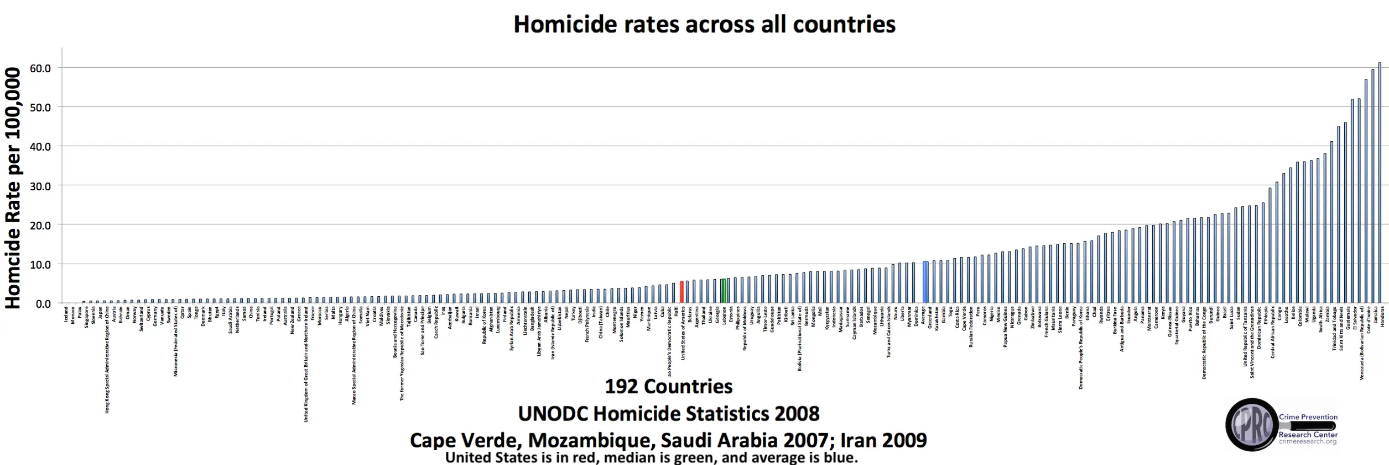

Slide 35
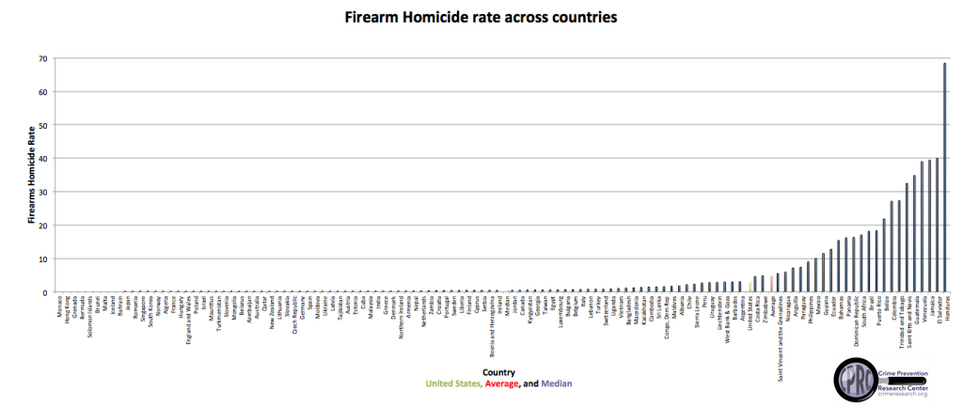

Slide 36
Notes
Gun control usually endangers public safety, and doesn’t lower crime rates
Gun control has been used consistently to disarm the poor and minorities
Many misimpressions about guns

Slide 37
The Effects of Gun Control Policies on Crime and Public Safety
John R Lott, Jr.

Slide 39
Australia
“there is a wide consensus that our 1996 reforms not only reduced the gun-related homicide rate, but also the suicide rate. … Our gun buyback scheme cut firearm suicides by 74 percent.”
-- John Howard prime minister of Australia from 1996 to 2007 in the New York Times, January 16, 2013 (https://archive.is/4h0Xi#selection-585.142-585.264)
“The average firearm homicide rate went down by about 42 percent.”
-- Zack Beauchamp, “Murders and suicides plummeted,” Vox, May 25, 2022

Slide 40
Considerations about Australia’s “buyback”/Confiscation of guns
-- almost 1 million guns being handed in and destroyed, 29% of total
-- since 1997 gun ownership in Australia grew over three times faster than the population (from 2.5 million guns in 1997 to 5.8 million in 2010).
-- So how would you predict how crime/suicide rates should change?
-- Why look at just firearm homicides and suicides? Why not total homicide and suicide?
-- Are homicide and murder the same thing? Why lump them together?
-- Could you give an example of a law reducing murder but increasing homicides? Or the reverse?

Slide 41
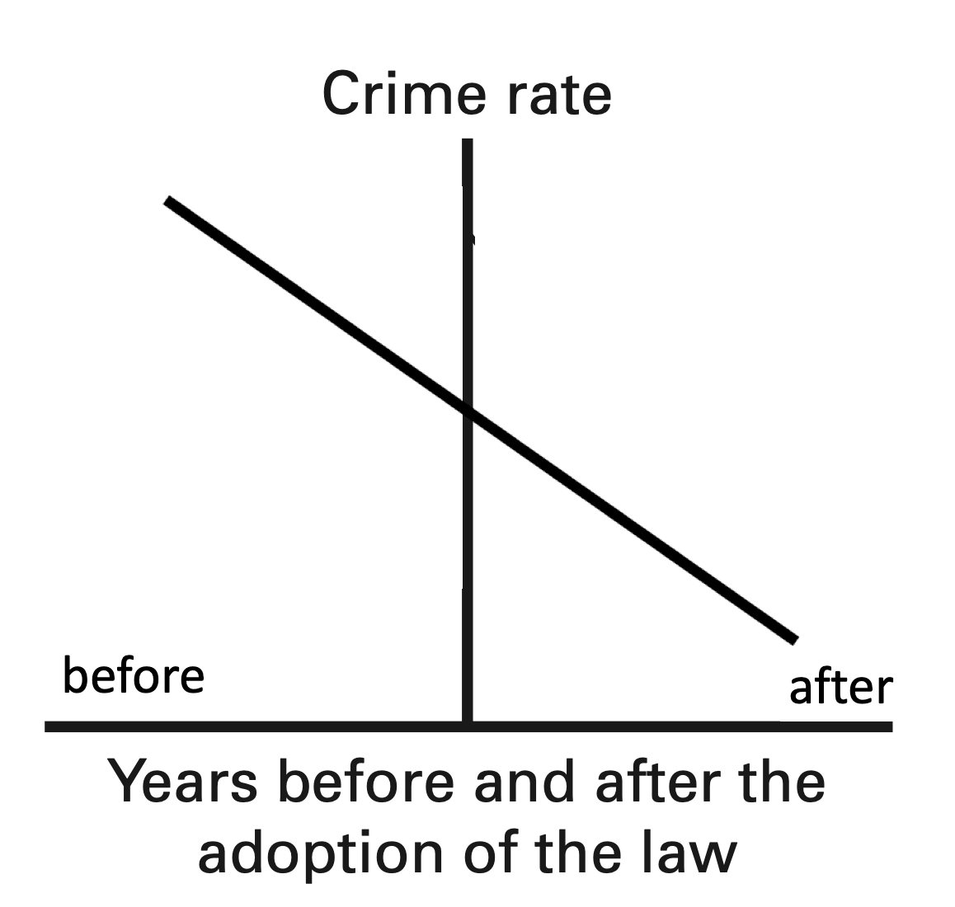

Slide 42
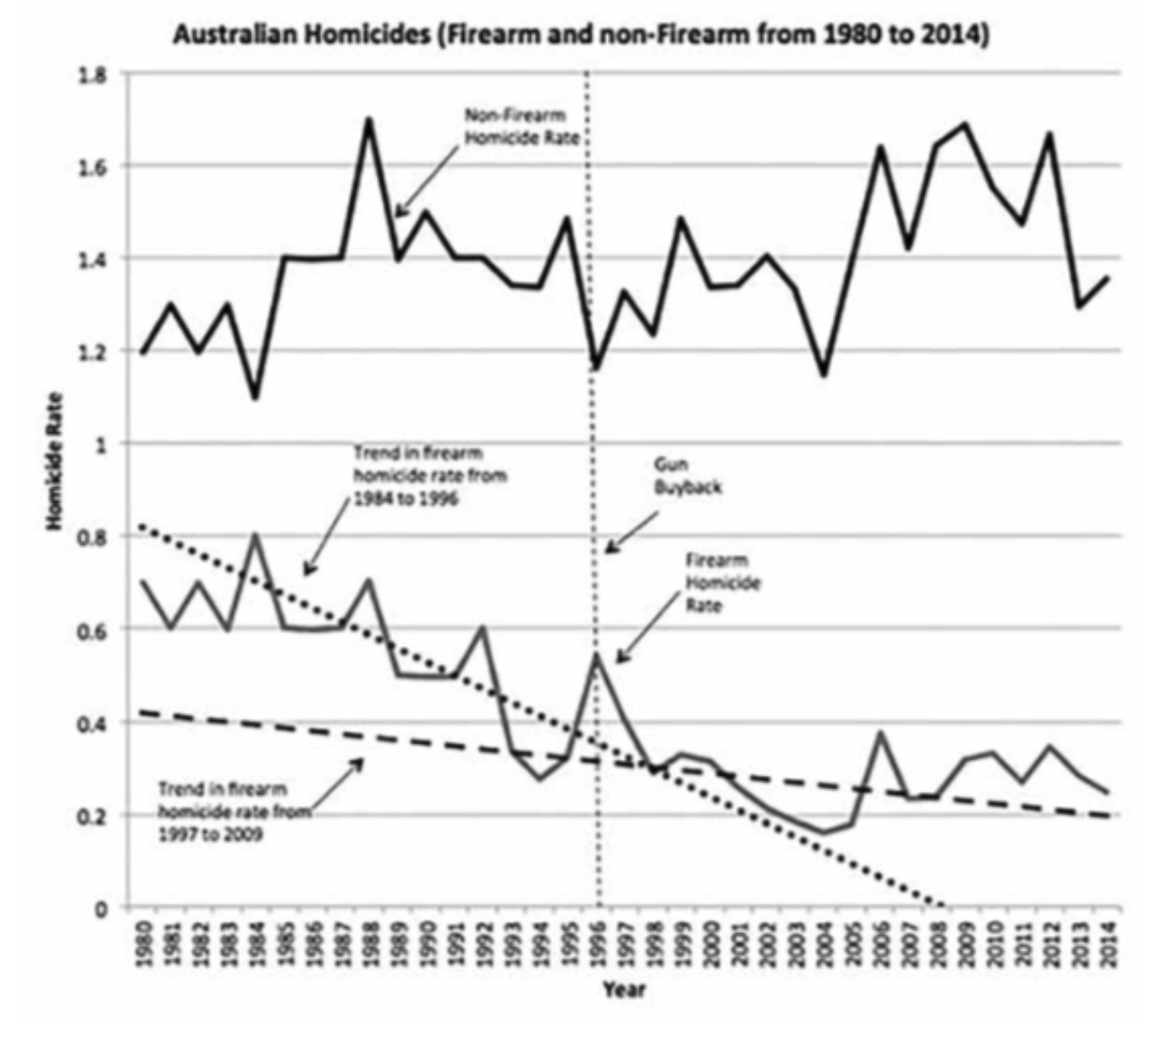

Slide 43
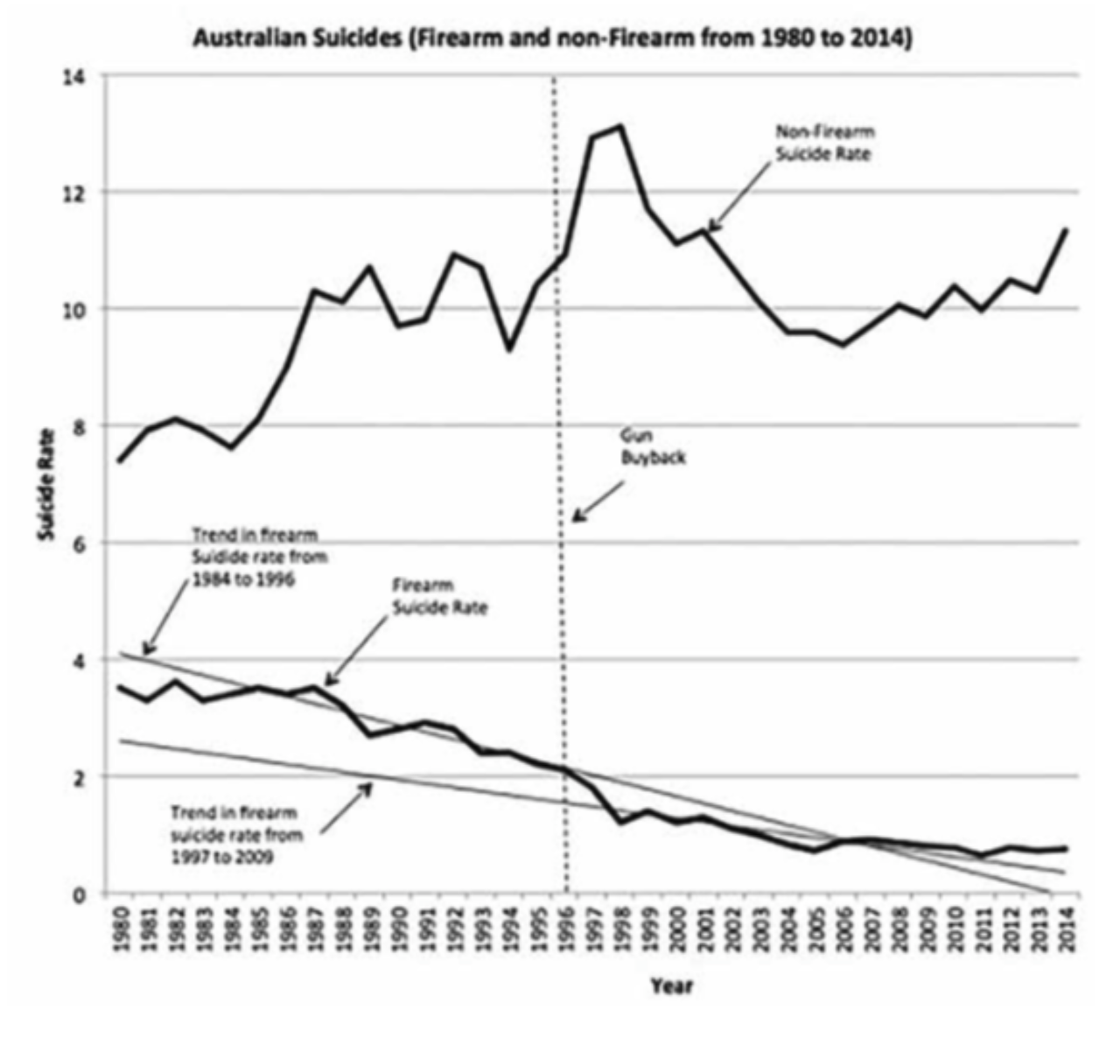

Slide 44
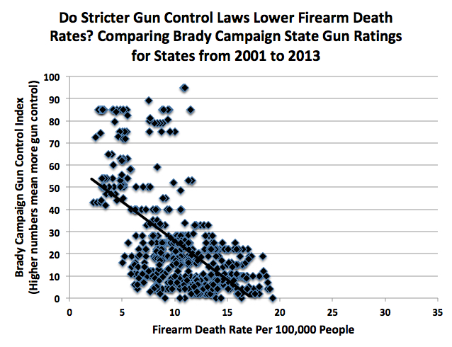

Slide 45
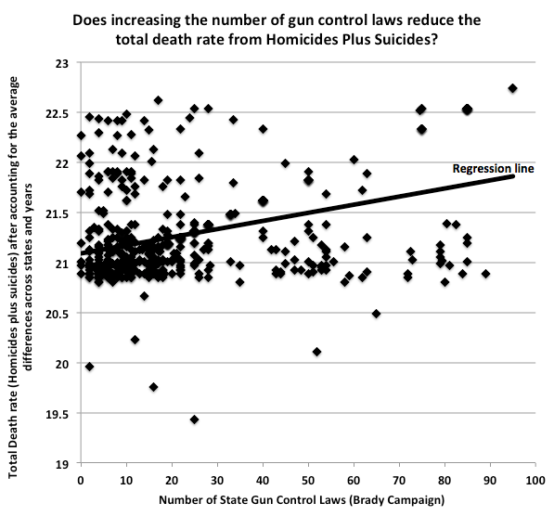
After taking account of average differences by state and time

Slide 46
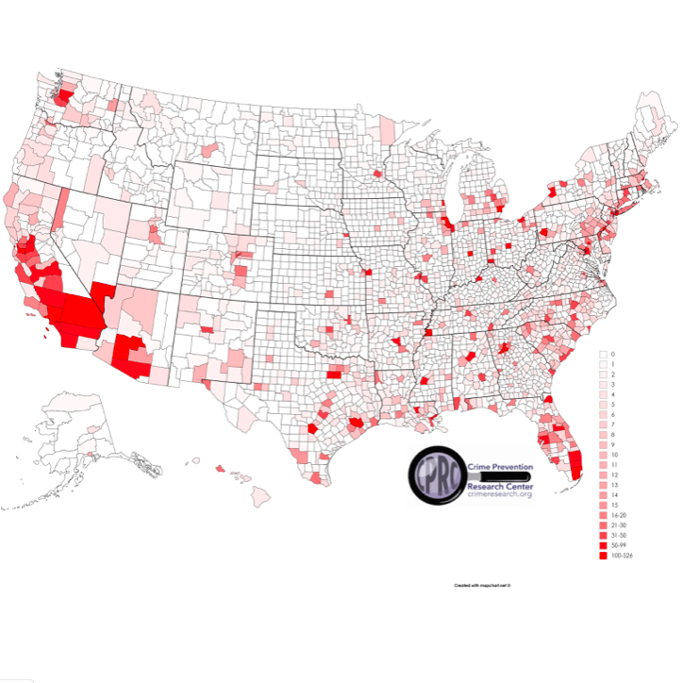
How concentrated murders are in the US
2% of counties have 23% of the population and account for 56% of murders.
  About 2/3rds of those murders occur within 10 block areas within those counties.
54% of the counties have 11% of the population and have zero murders
15% of counties have 10% of the population and have one murder each

