Slide 1

Gun Control Myths
John R Lott, Jr.

Slide 2
Video shown on Media Bias

Slide 3

-- Banning gun sales for those under 21 because they commit crime at relatively high rates.
-- Gun control laws needed to protect minorities and the poor.
-- California warns people moving to Texas about the mass public shooting rate in Texas

Slide 4
Understanding Background Checks
-- Everyone wants to stop dangerous people from getting a gun
-- What are Universal Background Checks?
-- Typical claim is that background checks aren’t enforced
-- The Current System is a Mess
-- Racist
-- Not Costless
-- Creating a national Registry of Law-abiding Citizens who own guns
-- How to simply fix the system

Slide 5
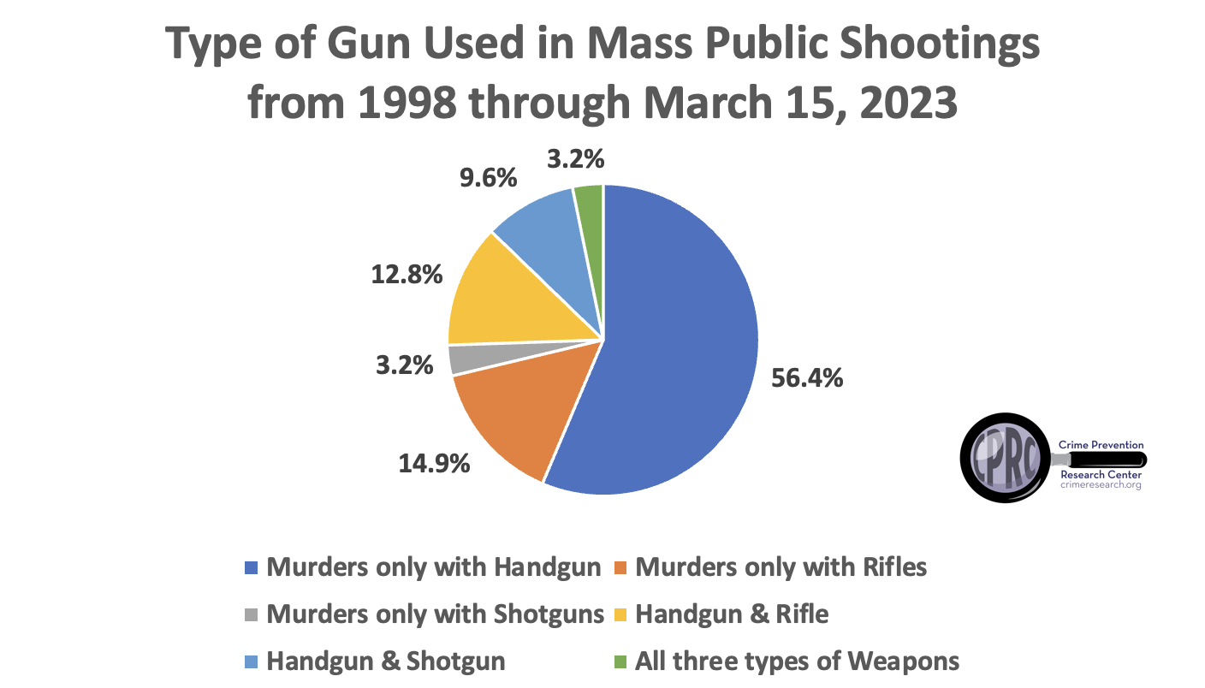

Slide 6
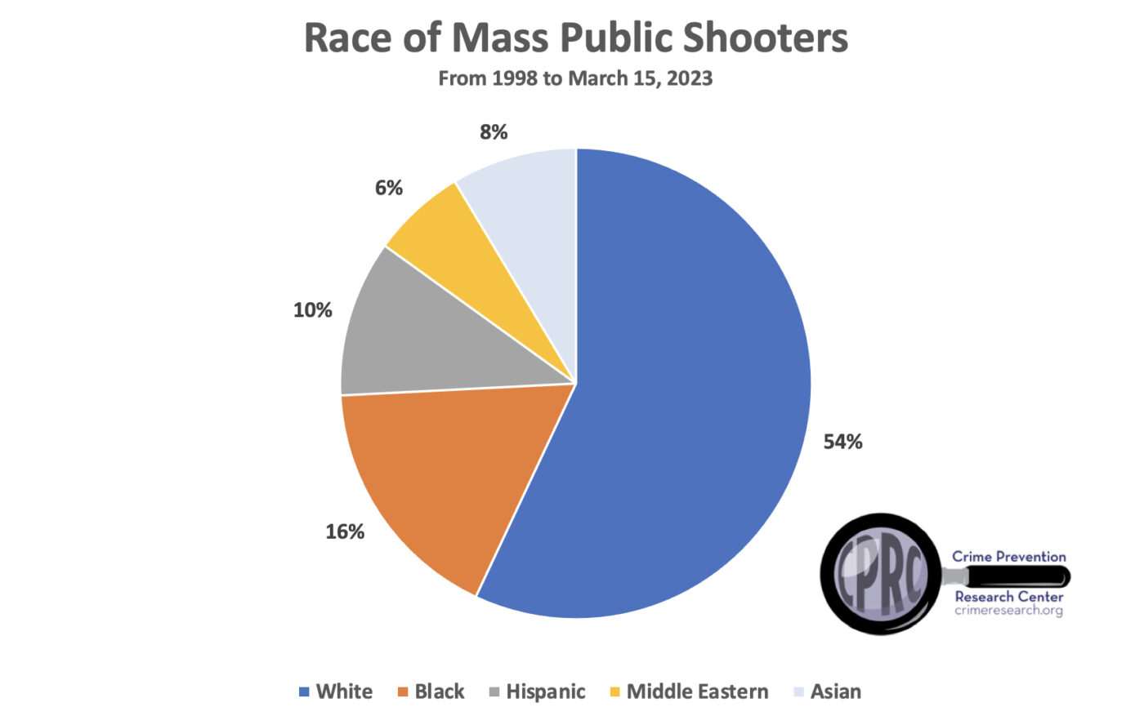
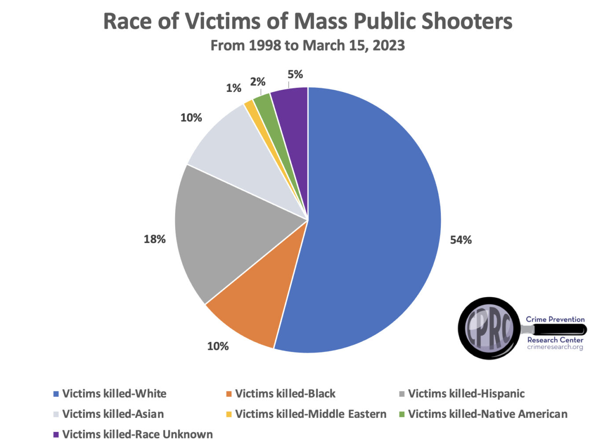

Slide 7
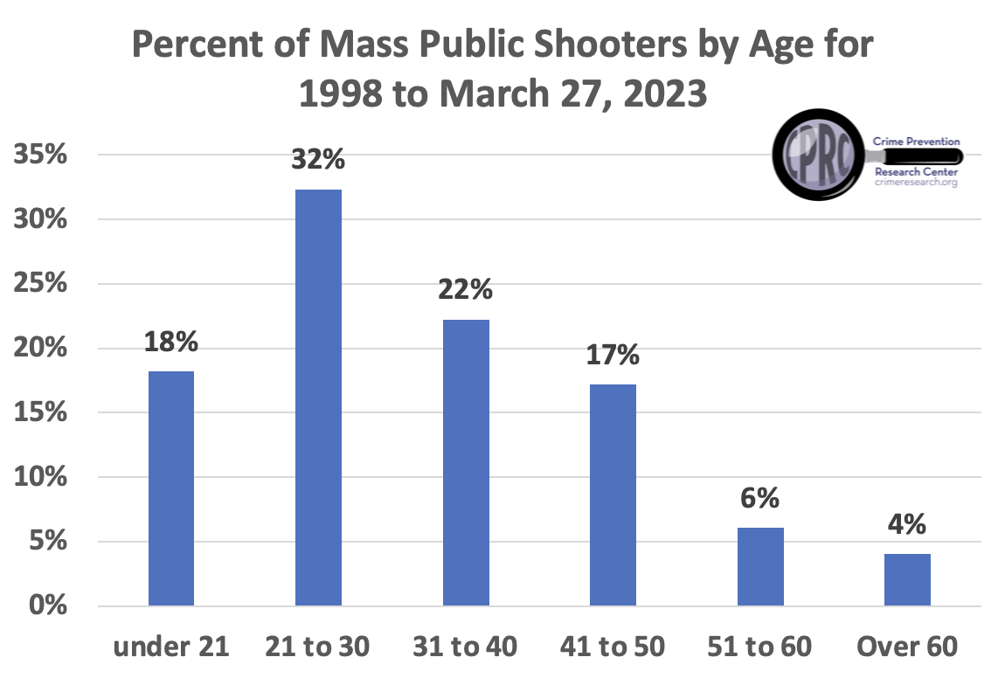

Slide 8
Some common claims that we see in the gun control debate

Slide 9
1) Claim the US is unique in terms of Homicides

Slide 10
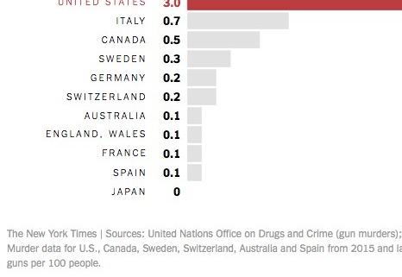

Slide 11
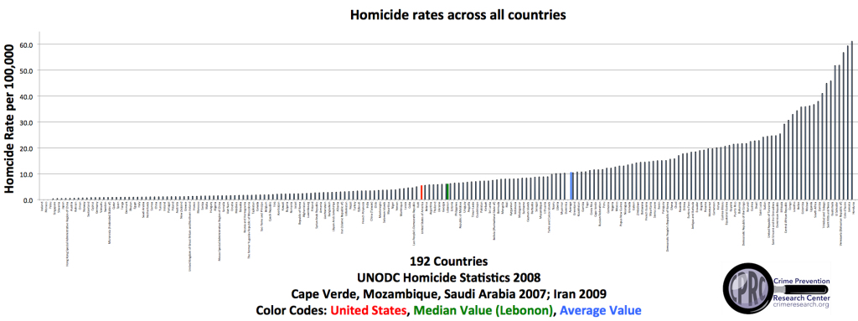

Slide 12
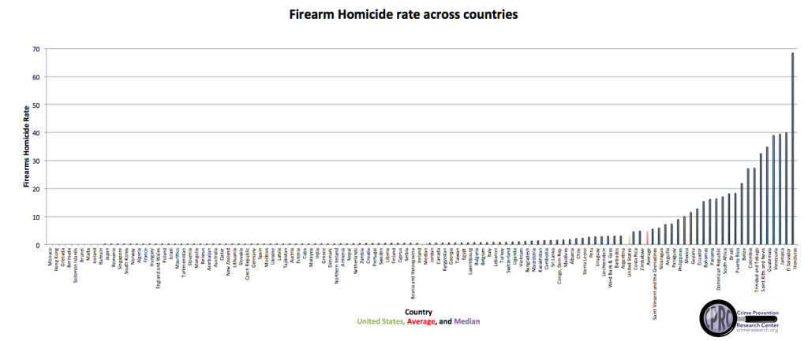

Slide 13
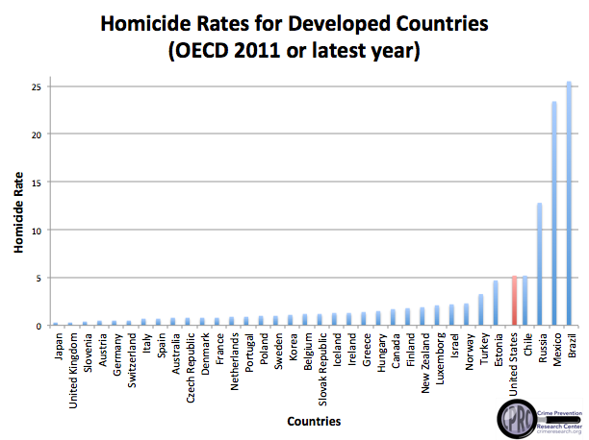

Slide 14
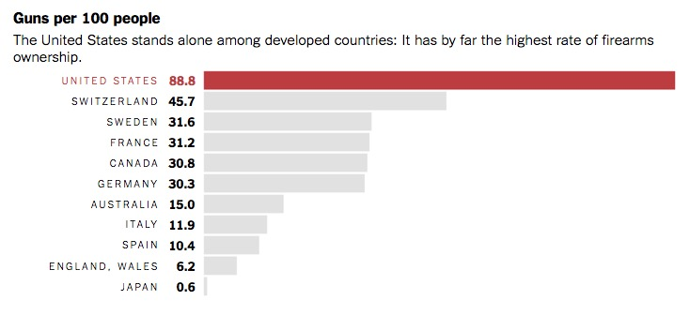
2) US unique in gun ownership

Slide 15
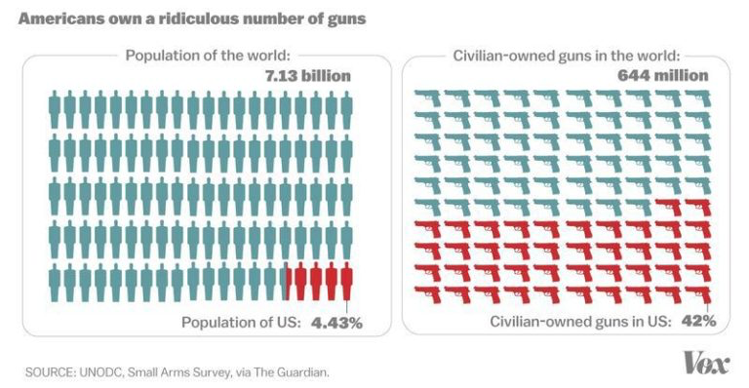

Slide 17
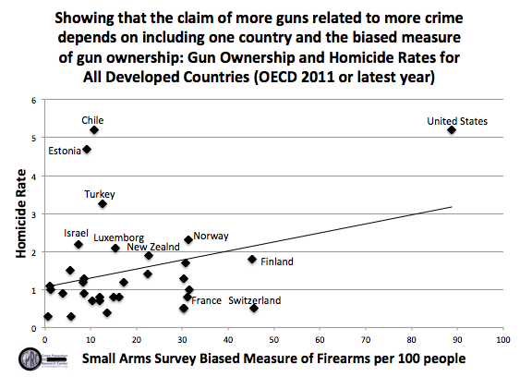

Slide 18
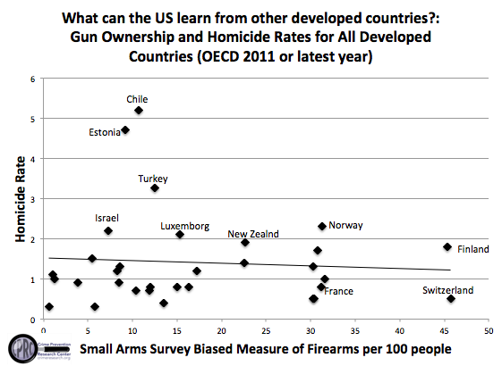

Slide 19
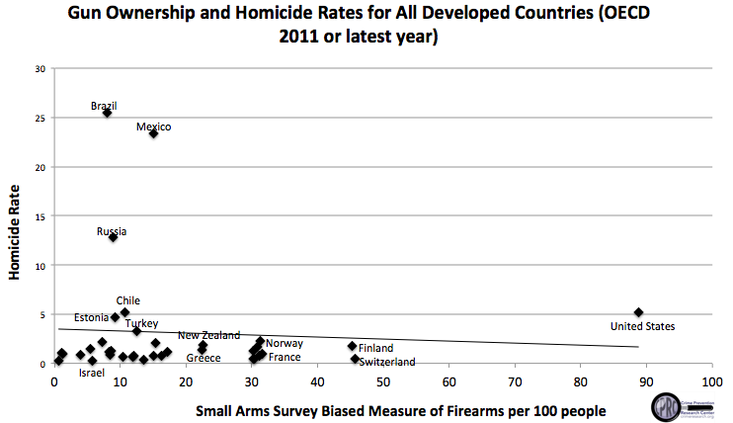

Slide 20
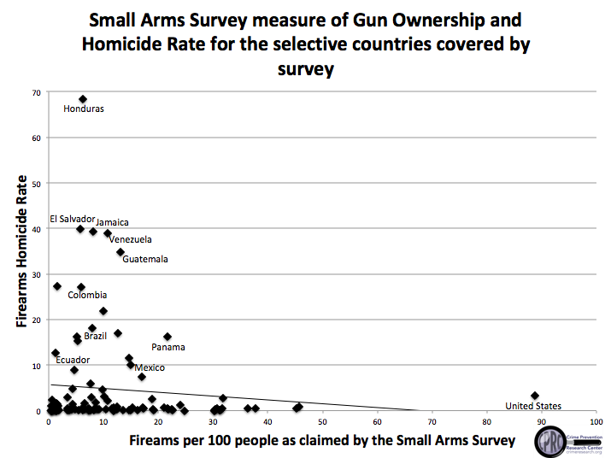

Slide 21
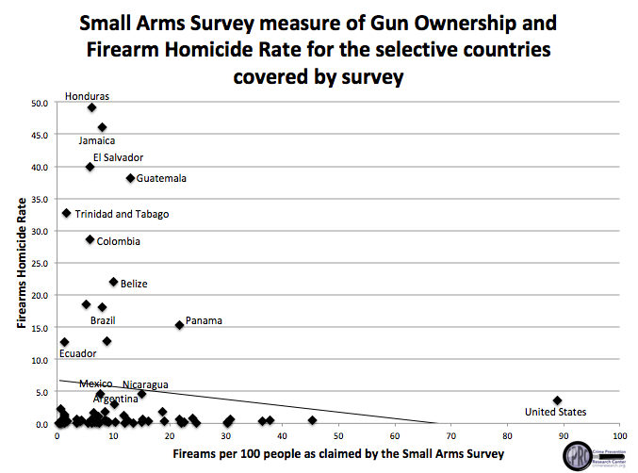

Slide 22
Can you name one place anywhere in the world that has banned either all guns or all handguns and seen murder/homicide rates fall?

Slide 23
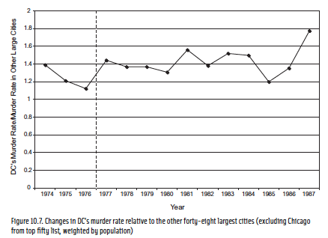
http://www.disastercenter.com/crime/dccrime.htm

Slide 24
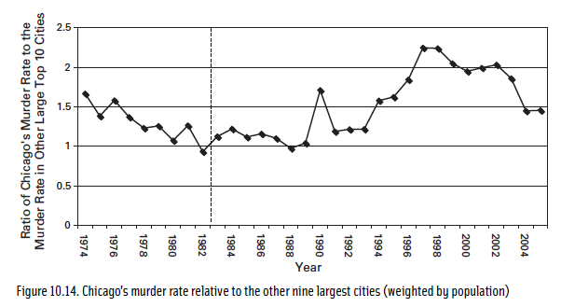

Slide 25
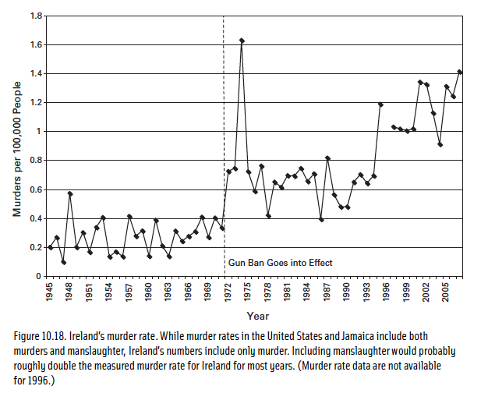
Ireland’s murder rate

Slide 26
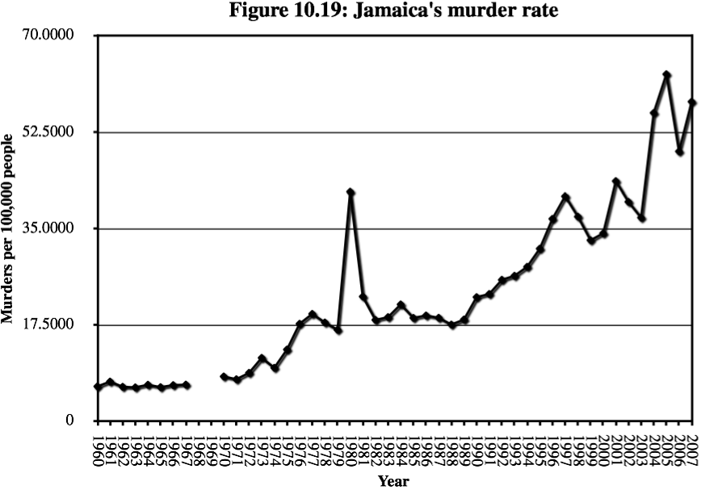

Slide 27
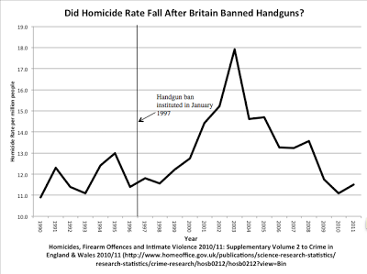

Slide 28
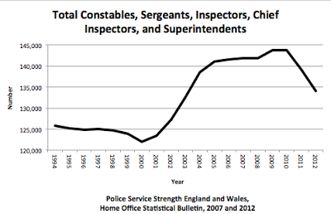

Slide 29
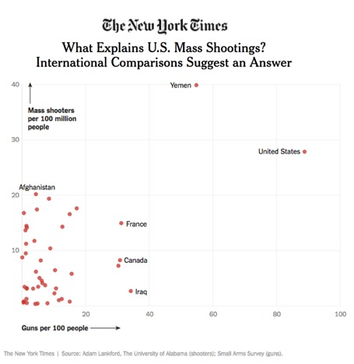
Mass Public Shootings

Slide 30
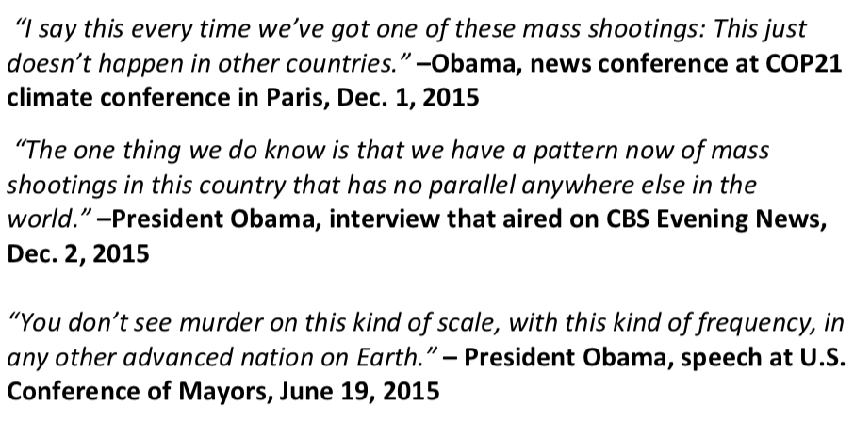
This is one of the most important claims in the gun control debate

Slide 31
Video on Mass Public Shootings Across the World

