Slide 1
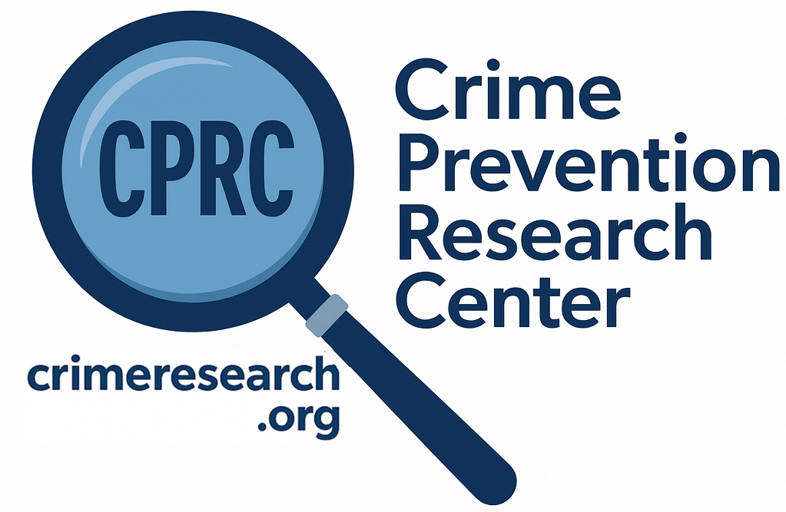
The FBI Crime Data is a Mess
John R Lott, Jr.

Slide 2
Impact on the 2024 Election: FBI’s estimates of reported crime for 2022
Relying on the 2022 data, news headlines, like NPR in early 2024 asserted: “Violent crime is dropping fast in the US — even if Americans don’t believe it.”
ABC’s David Muir used this misleading data to “fact check” Donald Trump during the presidential debate against Kamala Harris. “Crime here is up and through the roof despite their fraudulent statements that they made,” Trump said. Muir rebutted him with, “President Trump, as you know, the FBI says overall violent crime is actually coming down in this country.”
The only finalized FBI crime data that existed at that point when David Muir made his claim was for 2022.

Slide 3
When the FBI released its numbers for 2023 in September 2024, it hid that it had revised its earlier crime data for 2021 and 2022, hiding the increase in 2022.
  No mention in the press release
  Just a one sentence footnote stating that they had revised the 2022 data
    No mention if they had increased or decreased the numbers,
Never mentioned that the bureau had revised its violent crime for 2022 data from a 2.1 percent drop to a 4.5 percent increase, more recently 5.2 percent increase.

Slide 4
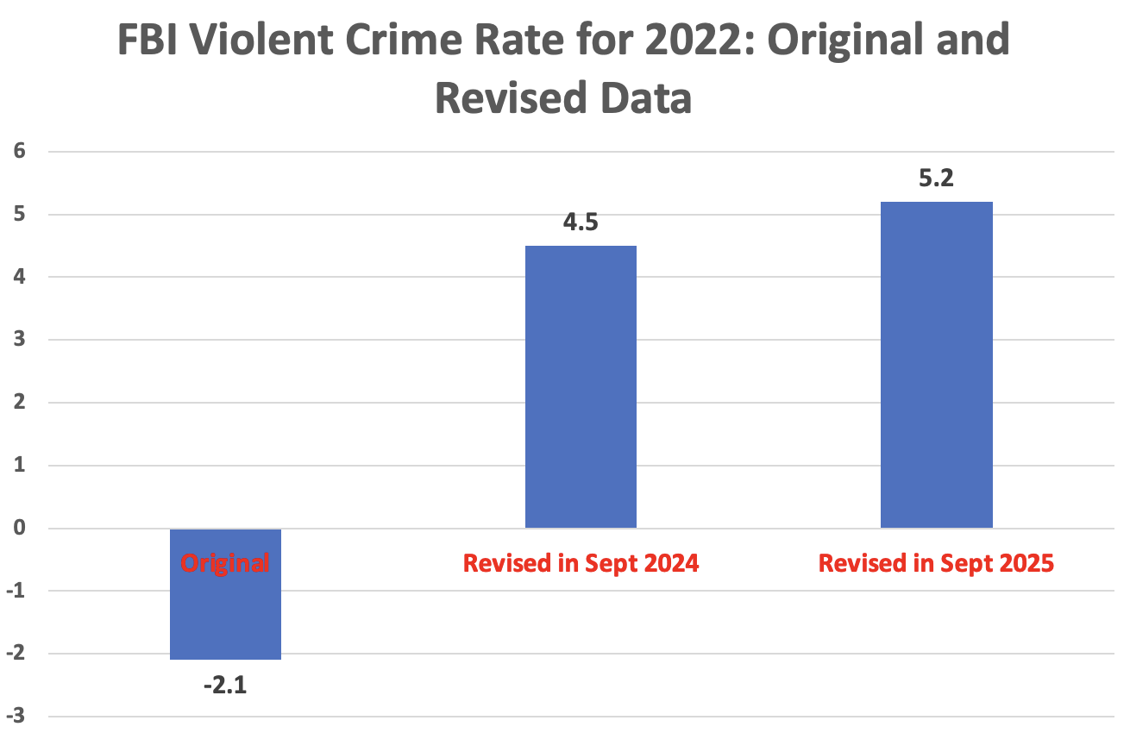

Slide 5
When the Change was Discovered the FBI wouldn’t clearly admit it
The FBI never explained the reason for the changed numbers in 2022 in their report nor in their responses to the media.
A former editor for USA Today, David Mastio, wrote about the FBI’s response to his inquiry about the changed data: “Here’s what I’ve learned in decades of covering Washington: When bad news is false, agency press people go out of their way to make it crystal clear that reports are definitely not true. When bad news is true, agency press people spew a wall of fog and bury you under an avalanche of distractions or in this case, contradictions.”

Slide 6
Note Even the FBI Data isn’t The Whole Story: National Crime Victimization Survey
NCVS measures Total Crime, FBI measures reported crime
  Why differences: Arrest rates, More difficult to report crime
During the Biden administration, total serious violent crime (rape, robbery, and aggravated assault), the categories that correspond to the FBI’s measure of violent crime, soared.
Total violent crime was 59% higher.
Rapes were up 38%, robbery 67%,aggravated assault 62%.
By far the largest percentage increases over any four-year period on record, more than doubling the previous record.
Violent Crime fell by 15 percent during Trump administration.

Slide 7
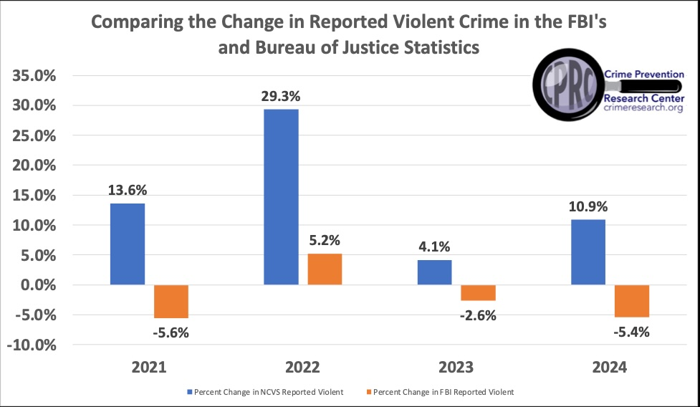

Slide 8
Errors in the FBI Active Shooting Reports
Until January 2021, I worked in the U.S. Department of Justice as the senior advisor for research and statistics in the Office of Justice Programs, and part of my job was to evaluate the FBI’s active shooting reports.
  Define
While the FBI includes cases where civilians stop active shooters, the news media frequently relies on the limited number of these cases to argue that such interventions are rare. Headlines illustrate this framing: “Rare in US for an active shooter to be stopped by bystander” (Associated Press); “Rampage in Indiana a rare instance of armed civilian ending mass shooting” (Washington Post); and “After Indiana mall shooting, one hero but no lasting solution to gun violence” (New York Times).
Discovered the FBI either missed or misidentified many cases of civilians using guns to stop active shootings.
https://tinyurl.com/FBIMissedActiveShootings

Slide 9
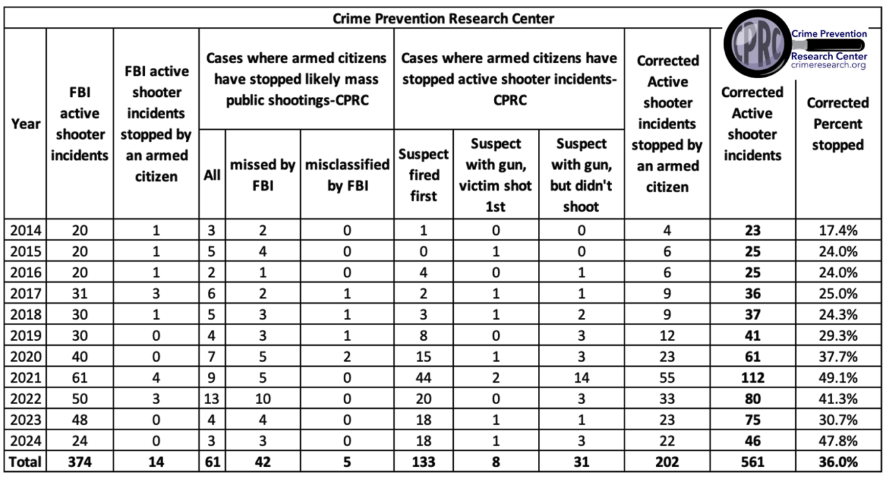

Slide 10
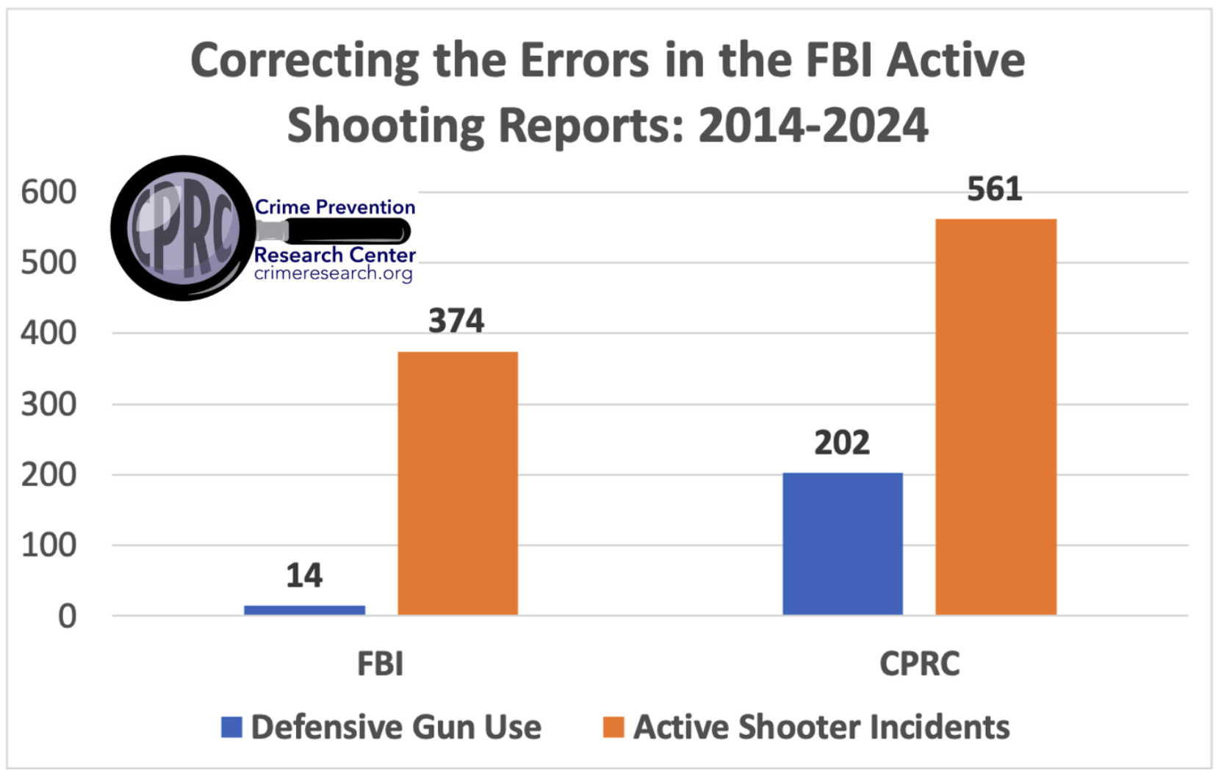

Slide 11
FBI Response to Media Questions
When John Stossel asked the FBI about our claim that they had omitted many cases, the Bureau responded: “[Our data is] not intended to explore all active shooting incidents but rather to provide a baseline understanding . . .”
In addition, earlier in 2023, Glenn Kessler with the Washington Post reached out to both the FBI and Texas State University's ALERRT. While he didn't get a response from the FBI, he did get a response from ALERRT.
M. Hunter Martaindale, research assistant professor at Texas State University: “Events are excluded for a variety of reasons (e.g., gang motivated, targeted or domestic only events, attacks in the commission of another crime, etc.) but none are excluded based on the manner in which they end. We have courses dedicated to civilian response and firmly believe that citizens can play a vital role in ending these tragic events.”
  But the FBI includes otherwise identical cases with the sole exception that an armed civilian stopped the attack
  In 2019, a man opened fire in a dental office in Colonial Heights, Tenn., killing a woman.
    But the FBI includes fourteen similar cases
  Another incident, in 2014, involved a shooter who opened fire in a strip club in Portland, Ore
    Several exactly the same cases are included in the FBI case count

Slide 12
Summary
the FBI continues to report that armed citizens stopped only 14 of the 374 active shooter cases identified between 2014 to 2024
Corrected: Out of 581 active shooter incidents from 2014 to 2024, armed citizens stopped 202, saving countless innocent lives.
For 2023 and 2024, the FBI claims that there are zero cases of a legally armed civilian stopping the attack, we think 48% of the attacks were stopped, and if you exclude gun-free zones it is 63%.
Our numbers even excluded 31 cases where a law-abiding citizen with a gun stopped an attacker before he could fire a shot.

Slide 13
New Research Comparing Civilians and Police stopping Active Shooting Attacks
Data from 2014 to 2023
Motivation for looking at this.
Rates that the two groups stop attacks
  Civilians stopped 202 cases, police 167
  According to police, civilians stopped what would have been 58 mass public shootings
Rates that the two groups are killed in stopping attacks.
  Nineteen police were shot and killed while trying to stop an active shooter, an 11.4% rate, which is over eleven times higher than the rate for permit holders.
  Civilians accidentally wounded one bystander, Police accidentally shot and killed 5, including two other police officers.
Why the difference?

Slide 14
How gun control laws disarm the poor and minorities who most need protection
John R Lott, Jr.

Slide 15
Why violent crime has soared over the last few years isn’t a mystery
Causes
  In 2020, cities across the U.S. slashed police budgets: New York cut $1 billion from its 2021 budget; Los Angeles cut $150 million; Washington, D.C. cut $15 million; San Francisco slashed $120 million from law enforcement.
    These cuts occurred at the same time of a high inflation rate, so the real cuts were even larger.
    There has been a recovery from these cuts, but the impact not completely offset
  District Attorneys refusing to prosecute violent criminals.
  Large percentages of inmates released from jails and prisons over the last two years.
  12 million plus illegal aliens – 662,000 (9%) of 7.4 million non-detained illegals had criminal records.
  Bail reform

Slide 16
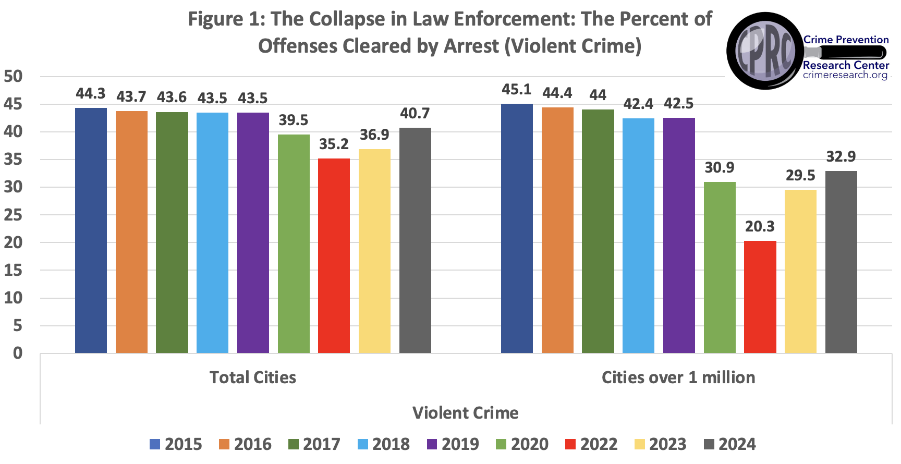

Slide 17
Who gets hurt – the direct and indirect impact of crime
  Businesses close
  jobs lost
  places to shop are more expensive and close
  property values fall.
Crime overwhelmingly occurs in heavily minority areas.

Slide 18
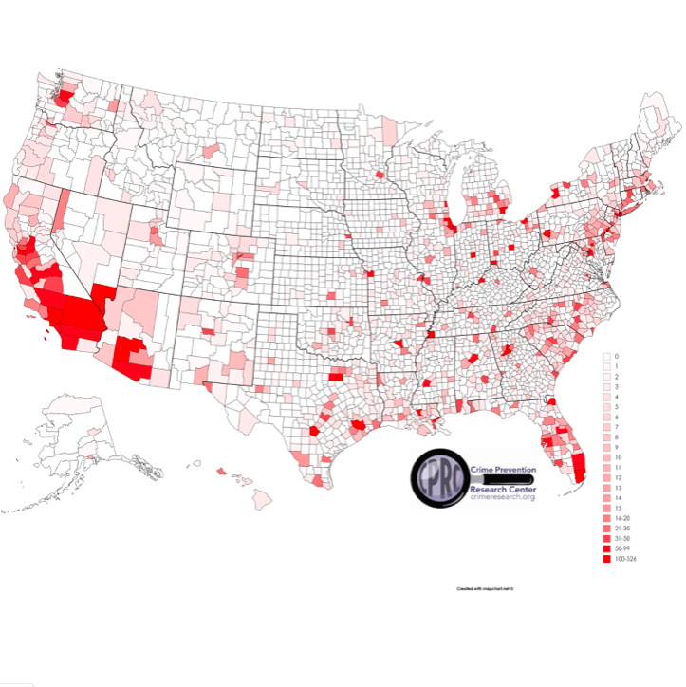
How concentrated murders are in the US
2% of counties have 23% of the population and account for 56% of murders.
  About 2/3rds of those murders occur within 10 block areas within those counties.
54% of the counties have 11% of the population and have zero murders
15% of counties have 10% of the population and have one murder each

Slide 19
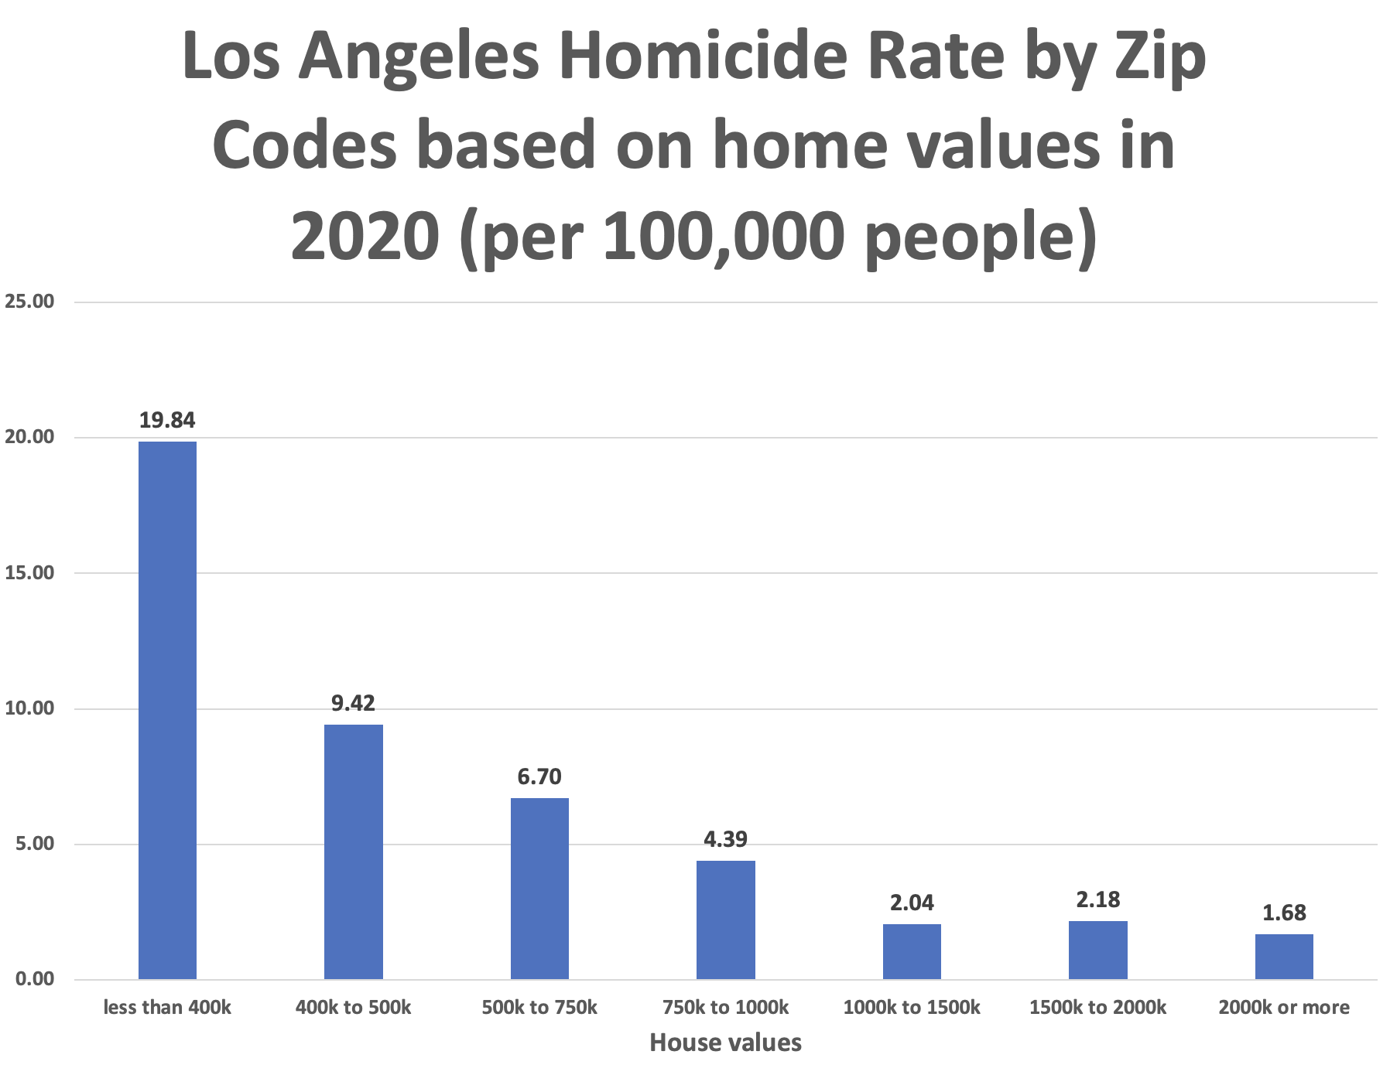

Slide 20
Who benefits the most from owning guns?
People who are the most likely victims of violent crime benefit the most. Overwhelmingly poor blacks who live in high crime urban areas.
People who are relatively weaker physically – women and the elderly.
There is now about 21.5 million concealed handgun permit holders.
Over the last eight years, the growth in permits for women was 109 percent faster than for men, and 136 percent faster for blacks than for whites.
Women now make up 28.3 percent of permit holders, and black Americans make up 12 percent, close to their share of the population.

Slide 21
How costs affect gun ownership: The example of concealed handgun permits
Compare Illinois with neighboring Indiana
  Illinois -- 4 percent of adults have a concealed handgun permits
  Indiana – 22 percent
Why? Pretty simple
  In Illinois, it costs about $450 to get a five-year concealed handgun permit (fee + training)
  In Indiana, it costs ZERO for five years.
But it isn’t just the number of people with permits. It is also changes who gets the permits.

Slide 22
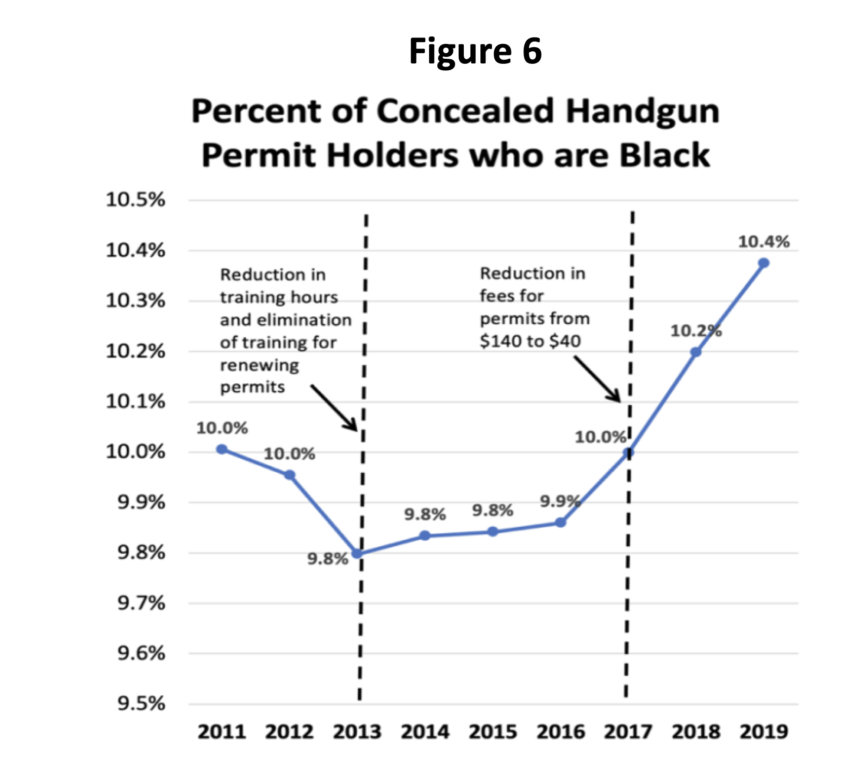

Slide 23
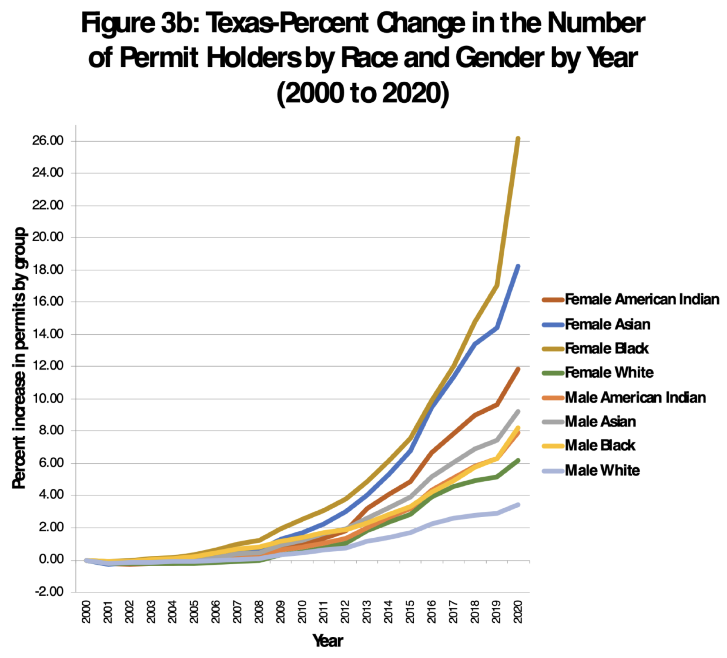

Slide 24
The big increases in Texas permits after the changes in permitting rules
Texas went from
656,243 in 2011
708,047 in 2013
1.15 million in 2016
1.36 million in 2018
1.63 million in 2020

Slide 25
NY v Bruen: Discretionary Issuance of Concealed Handgun Permits
Democrats claim that they care about women and minorities.
Los Angeles County
  In 2013, I obtained a list of the 341 concealed-carry permit holders in Los Angeles County, California. Those getting permits list was disproportionately wealthy, politically connected, white, and male, with only 7.6 percent female, 5 percent black, 6 percent Hispanic.
  By contrast, nationwide 29 percent of permit holders are women, 12 percent are blacks, which is very similar to their share of the national population.
  Hispanics make up 54 percent of the population in Los Angeles County
New York City is very similar

Slide 26
How to quickly pass Universal Background Checks
Continually called for after mass public shootings
  It would not have stopped any of the mass shootings we have seen in this century.
Frequent claim is: Background checks have stopped 4 million dangerous or prohibited people from buying guns.
  Virtually all of these false positives
  Hurts minorities
  “This incredibly high rate of false positives imposes a real burden on the most vulnerable people,” said Reagan Dunn, the first national coordinator for Project Safe Neighborhoods, a Justice Department program started in 2001 to ensure gun laws are enforced.
  War story from within the US DOJ
  Easy fix

Slide 27
Cost
  In Washington, DC, background checks on private gun transfers cost $125. In New York City, it costs $125 to $225. Oregon is fairly inexpensive with an average of $56.
  California is an outlier on the cost at $20 because it is imposed as a price control, which is used to help put gun dealers out of business.
  Democrats who think that voter ID laws are unfairly onerous for poor minorities ought to appreciate the obstacles presented by background check fees
  Discriminatory against the very people who need guns the most for self-defense
  If you believe that background checks reduce crime want to encourage people to do these background checks on private transfers, why would you make them pay a tax to do it?
  If you believe that background checks reduce crime, they reduce them for everyone
  Simple fix – if you believe that this reduces crime for everyone, then everyone should pay for it.

Slide 28
Other restrictions that disproportionately harm poor people
Even before the changes over the last year, many heavily Democratic places such as Illinois and New York that ban carrying permitted concealed handguns on public transportation.
Bans on guns in public housing.

Slide 29
Survey of Academic Researchers
Academic researchers broadly think that eliminating gun-free zones, such as where the attack in San Bernardino occurred, is a promising policy change that could save lives.
Criminologists and economists are the most interested in that solution, while public health researchers tend to favor traditional gun control methods. But outside of economists who favor eliminating gun-free zones, none of the groups are significantly above the midpoint (5.5) in supporting any type of gun control.

Slide 30
