Slide 1

Voter Fraud Mail-in Ballots and Government Issued Photo IDs:
The U.S. is an Extreme Outlier
John R Lott, Jr.

Slide 2
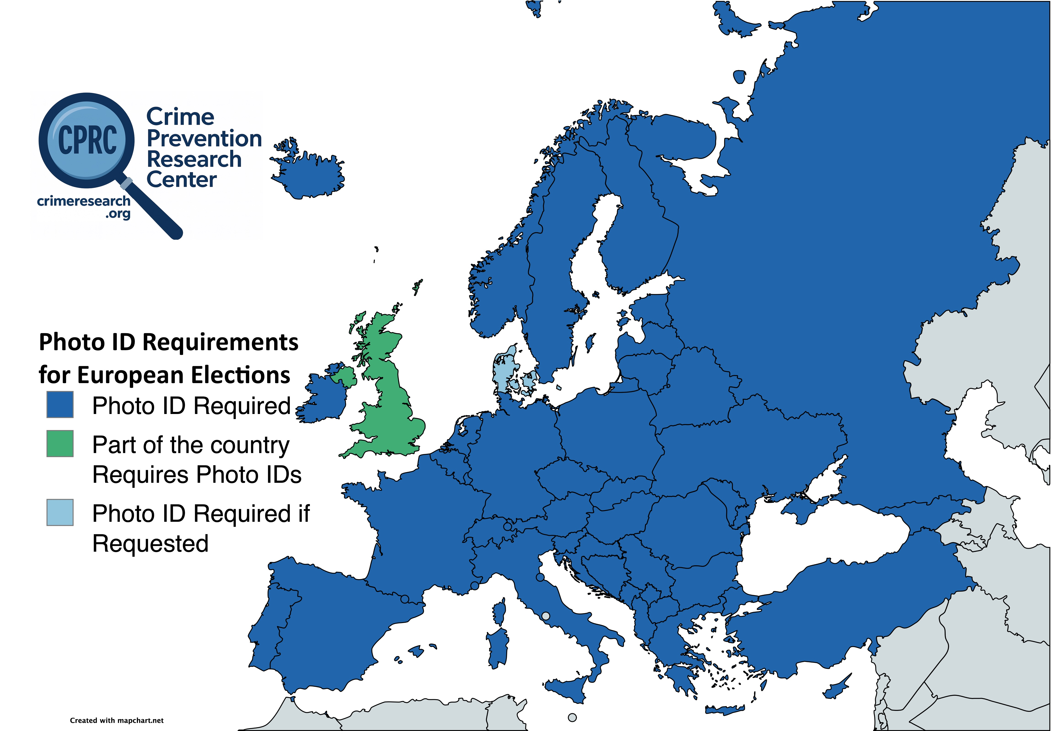

Slide 3
Other Countries also Require Voter IDs
All those European countries citizenship to register to vote, usually checked via population registers or for some cases confirmed through application-based systems where they can require you bring in documentation.
Democrats argue that requiring free voter photo IDs – even when the ID itself costs nothing – harms eligible voters by creating practical barriers to casting a ballot, especially for blacks and Hispanics.
Blacks – but every country in Africa requires government-issued identification to vote.
Hispanics -- yet Mexico, all twelve South American countries, and Spain require government-issued photo IDs to vote.
All of these countries have lower per-capita incomes than the United States.

Slide 4
Three Island Nations stand out as not requiring IDs, but even these countries are more restrictive than much of the US.
Japan provides each voter with tickets with unique bar codes. If the voter loses the ticket or accidentally brings the ticket for another family member, polling staff verifies the voter’s name and address using a computer with access to the city’s database. The voter may have to present government-issued photo identification.
New Zealand technically requires a photo ID with a unique code, but while it takes a little longer, it is possible to vote without the ID as they can confirm your identity by looking it up on a computer.
Australia has by far the loosest rules, and while a photo ID is required to register to vote, once at a polling station, voters need simply report their names, addresses, and whether they have voted in a previous election.

Slide 5
Other Countries have learned the hard way about the need for IDs
Northern Ireland
  Parties on all sides have engaged in what observers describe as “widespread and systemic“ voter fraud.
In 1985, under the conservative Margaret Thatcher, the U.K. began requiring voters to show identification before receiving a ballot, but that measure did not solve the problem.
In 1998, a Select Committee on Northern Ireland reported that people could “easily forge” medical cards – accepted as ID under the 1985 law – or obtain them fraudulently, enabling non-existent individuals to cast votes.
By 2002, the Labour government strengthened voter identification cards to make them far harder to forge.
A study of vote fraud in Northern Ireland before the 2002 reforms interviewed Brendan Hughes, the former IRA Belfast commander.

Slide 6
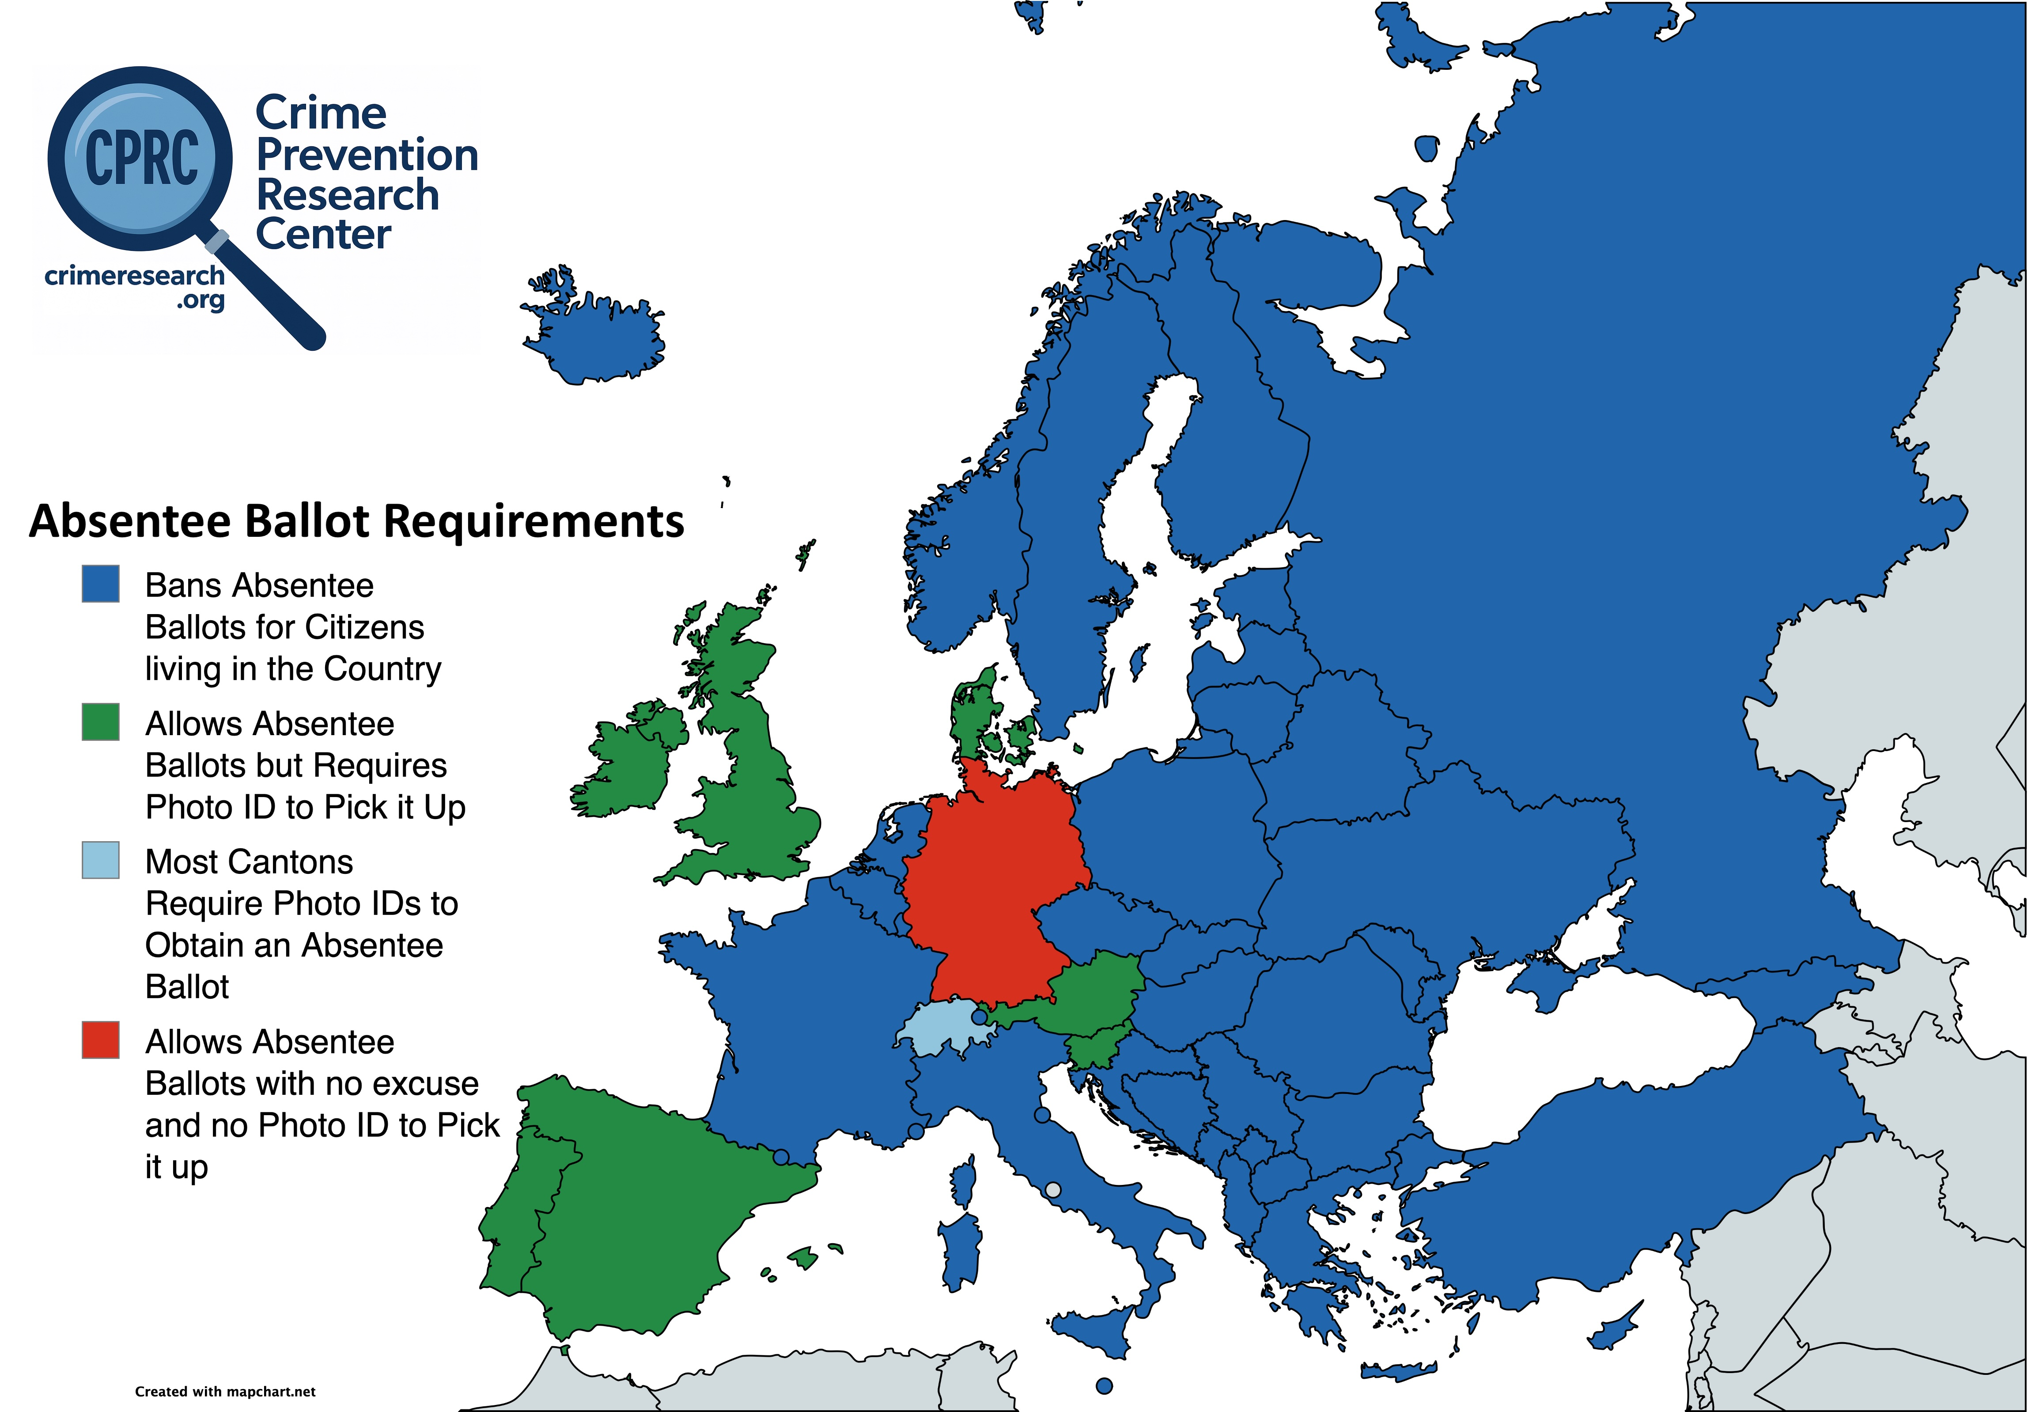

Slide 7
Other Countries have learned the hard way about vote fraud with absentee ballots, note absentee ballots not the same as mail-in voting
France once had similarly loose rules. But in 1975, authorities exposed large-scale fraud on the island of Corsica, where dead people “voted” in the hundreds of thousands and widespread vote-buying flourished. France responded by banning absentee voting altogether.
England once followed rules similar to America’s. But in 2004, officials uncovered what a judge later described as a “massive, systematic and organized” fraud in Birmingham city council races. Six winning Labour candidates had acquired about 40,000 fraudulent absentee votes, mainly from Muslim neighborhoods. England responded by ending the mailing of absentee ballots and requiring in-person pickup with photo ID.

Slide 8
Mexico’s 1991 Election Reform
Only one type of ID accepted to vote. Contains both a photo and thumbprint.
ID very difficult to counterfeit, with special holographic images, imbedded security codes, and a magnetic strip with still more security information.
Extra precaution, voters’ fingers are dipped in indelible ink to prevent people from voting multiple times.
Must go in person to register and go again to pick up the ID – in some states the trip is over 100 miles each way.
Must show a birth certificate or other proof of citizenship, another form of government issued photo identification, and a recent utility bill.
Banned all absentee ballots
The electoral fraud was later even acknowledged by the then-incumbent president, Miguel de la Madrid.

Slide 9
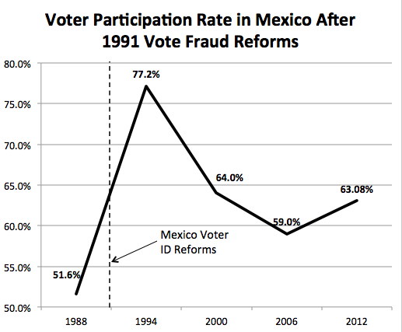

Slide 10
A Brief History of Voting in the US:
Secret Ballots
Secret ballots
  first state Kentucky 1882, last state South Carolina 1950
Previously voted with colored pieces of paper, with ballot box monitored by the political parties.
Parties would pay voters if they voted the right way.
The move to secret ballots prevented vote buying.
Absentee ballots strictly limited, first state with sending the ballots through the mail was Kansas in 1901, first no excuse absentee mail voting was California in 1978.
First mail-only federal election Oregon in 1996/first statewide election 2000.

Slide 11
Concerns over absentee ballots used to unite both Democrats and Republicans
“Absentee ballots are the largest source of potential voter fraud.” That warning comes from the bipartisan 2005 Commission on Federal Election Reform, led by former Democratic President Jimmy Carter and former Republican Secretary of State James Baker III.
Worries about vote buying, pressuring people to vote, or forging ballots.
Many examples, involving both parties. For example, a 1994 Pennsylvania race that gave Democrats control of the state Senate. Democratic candidate William Stinson’s staff forged the names on absentee ballots of people at nursing homes as well as people who were living in Puerto Rico or serving time in prison.

Slide 12
Empirical Work on Vote Fraud with Absentee Ballots in 2020
Compare absentee ballots voting precincts in a county with alleged fraud to adjacent precincts in neighboring counties with no allegations of fraud in Fulton County, Georgia and Allegheny County, Pennsylvania.
Compare the differences in President Trump’s vote shares on absentee ballots in those adjacent precincts, accounting for the differences in his vote shares on ballots cast in person, registered voters’ demographics. and compare data for the 2016 and 2020 presidential elections.
Found discrepancy in higher counts of provisional ballots in Allegheny Country where people were called up and allowed to fix mistakes in the ballots compared to adjacent precincts in neighboring counties where they weren’t given that option.
For Arizona, Georgia, Michigan, Nevada, Pennsylvania, and Wisconsin, I found 146,000 and 334,000 excess votes for Biden

Slide 13
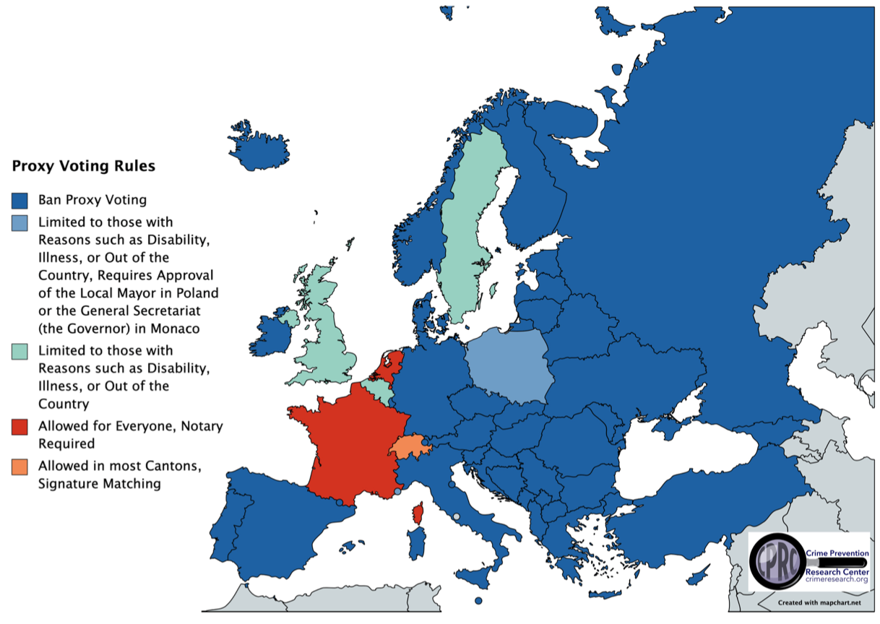

Slide 14
Voter Fraud Mail-in Ballots and Government Issued Photo IDs:
The U.S. is an Extreme Outlier
John R Lott, Jr.

