Slide 1
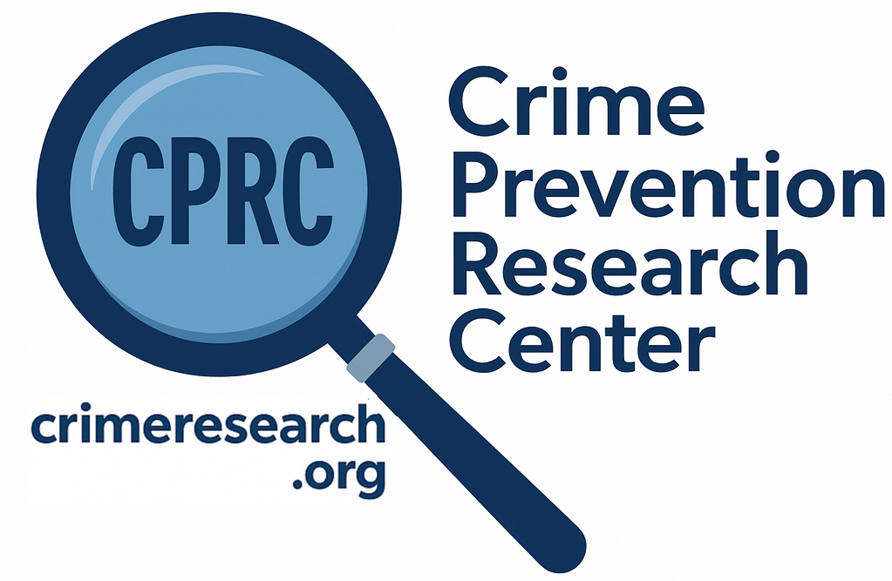
The Effects of Gun Control Policies on Crime and Public Safety
John R Lott, Jr.

Slide 2
Can you name one place anywhere in the world that has banned either all guns or all handguns and seen murder/homicide rates fall?

Slide 3
If guns on net are bad, it should be easy to find places where gun bans have lowered murder/homicide rates. Right?
Just out of randomness, you would expect to find a few times where murder/homicide rates went down.
Every single time murder/homicide rates have gone up.
But I can’t find such a place.

Slide 4
We have tried handgun bans in the United States: Washington, D.C. and Chicago

Slide 5
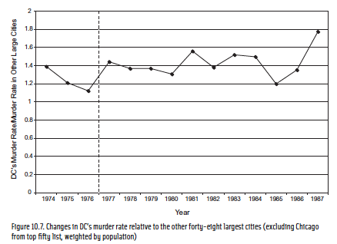

Slide 6
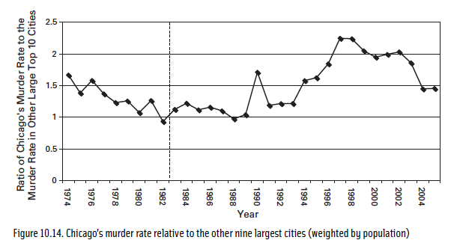

Slide 7
Gun control advocates say that the bans in DC and Chicago weren’t fair tests, that unless you ban guns everyplace in a country you can’t expect it to work.
Yet, even when whole nations have banned guns, it hasn’t worked. Take a few island nations that have banned guns.
But that can’t explain why murder rates went up. It might explain why they didn’t go down as they predicted, but criminals were able to obtain guns at those other places before the bans.

Slide 8
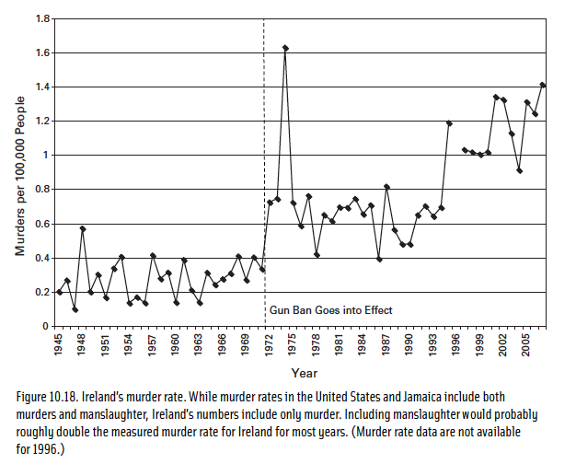
Republic of Ireland’s murder rate

Slide 9
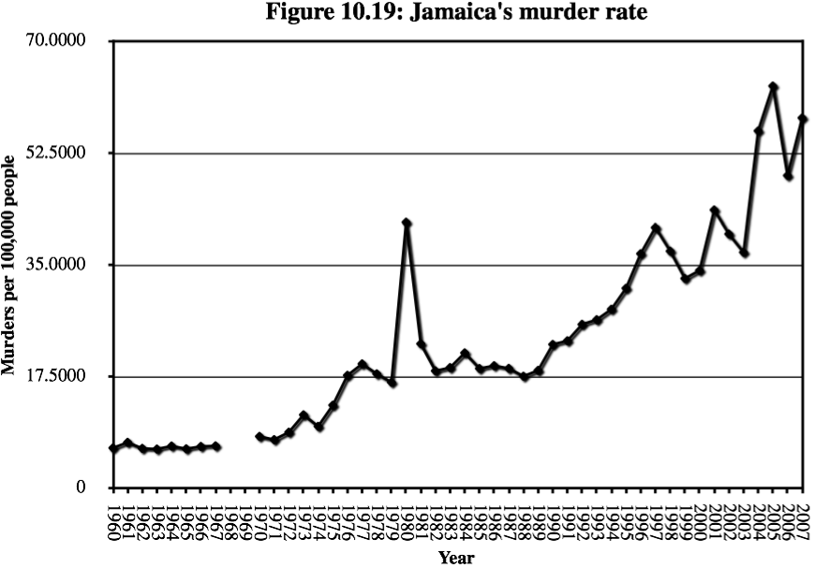

Slide 10
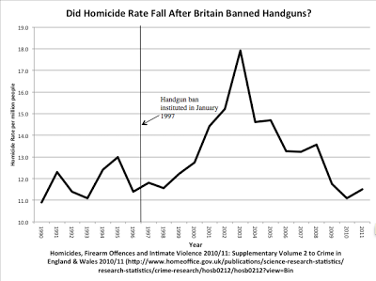

Slide 11
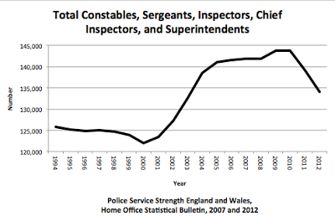

Slide 12
So why do murder/ homicide rates always rise after bans?
A ban might take some guns away from criminals, but the problem is if you primarily disarm law-abiding citizens, you will make it easier for criminals to commit crime.
This point applies to all gun control laws. You have to be careful that it isn’t the most law-abiding people that will obey the law and who you will primarily be disarming.
With gun bans, there is a drop in firearm suicides, but no change in total suicides

Slide 13
Gun laws stop law-abiding people, particularly the poor and minorities from obtaining protection
Important behind the Constitution’s 14th Amendment
Why do just 4% of adults in Illinois have a permit, but 23% in Indiana? Why do relatively few poor and minorities have permits in Illinois?
May Issue Gun Control Laws – Struck down by the Supreme Court’s Bruen Decision
For Los Angeles County, there were 341 concealed-carry permit holders in Los Angeles County, California. Democrats approved permits disproportionately for wealthy, politically connected, white, and male.
In LA, only 7.6% female, 5% black, 6% Hispanic
Background checks
Claim that background checks have stopped 4 million dangerous or prohibited people from obtaining guns, but 99% are mistakes.
Discriminates against minority males

Slide 14
A few basic facts
Police are the single most important factor in reducing crime
But the police themselves know that they virtually always arrive on the crime scene after the crime has occurred.
The people who benefit the most from owning guns are the most vulnerable. They fall into two groups.
The most likely victims – particularly poor blacks living in high crime areas
Those who are weaker physically – women and the elderly
92% of violent crime don’t involve guns in any way
Guns are used defensively to stop crime about 5 times more frequently than they are used to commit it.
Why don’t we hear about that more?
What is newsworthy doesn’t always reflect reality.
Only about 40% of violent crime is reported to police.
Media bias

Slide 15
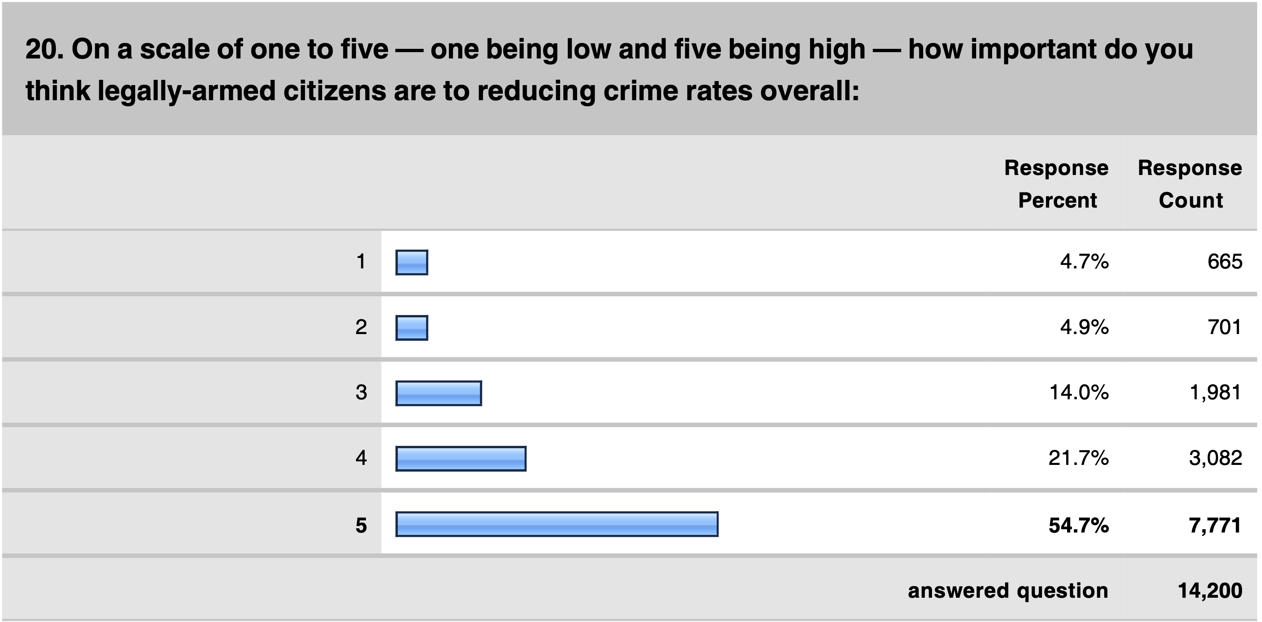
Surveys of Police Officers: PoliceOne is the largest organization of police with 375,000 active full-time Officers

Slide 16
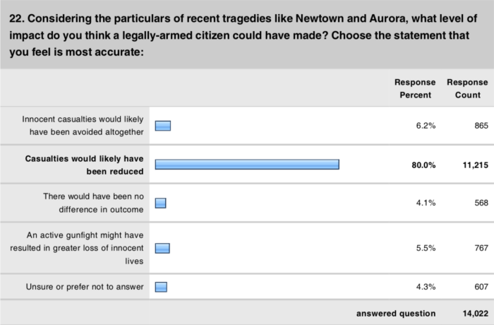

Slide 17
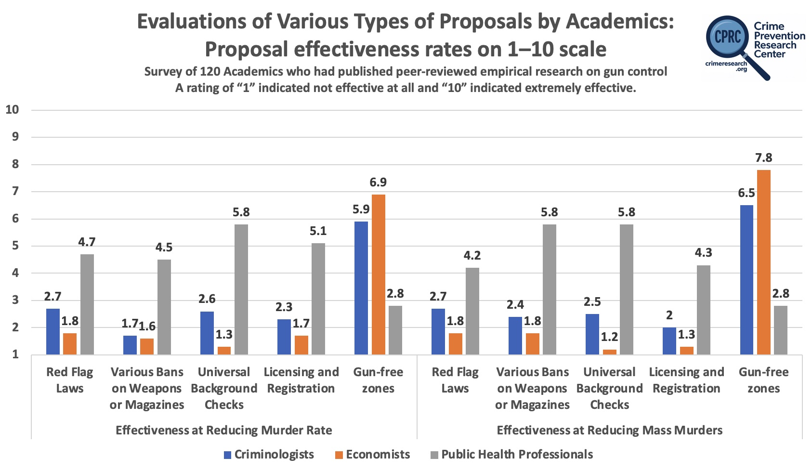

Slide 18
Overwhelmingly Academic Research Shows a Benefit from Self Defense
https://tinyurl.com/AcademicConcealedCarryResearch

Slide 19
How frequent are Mass Public Shootings? The Importance of Definitions
“Over the last year since Uvalde, our country has experienced a staggering 650 mass shootings,” President Joe Biden claimed when the Biden Administration released its report on the Uvalde school shooting in January.
After a mass murder in Lewiston, Maine in late October, CNN said that there had already been “586 mass shootings” that year.
Different Definitions
Gun Violence Archive
FBI Active Shooting
Traditional FBI Definition of ”Mass”
Comparison to other countries, even those with very strict gun control

Slide 20
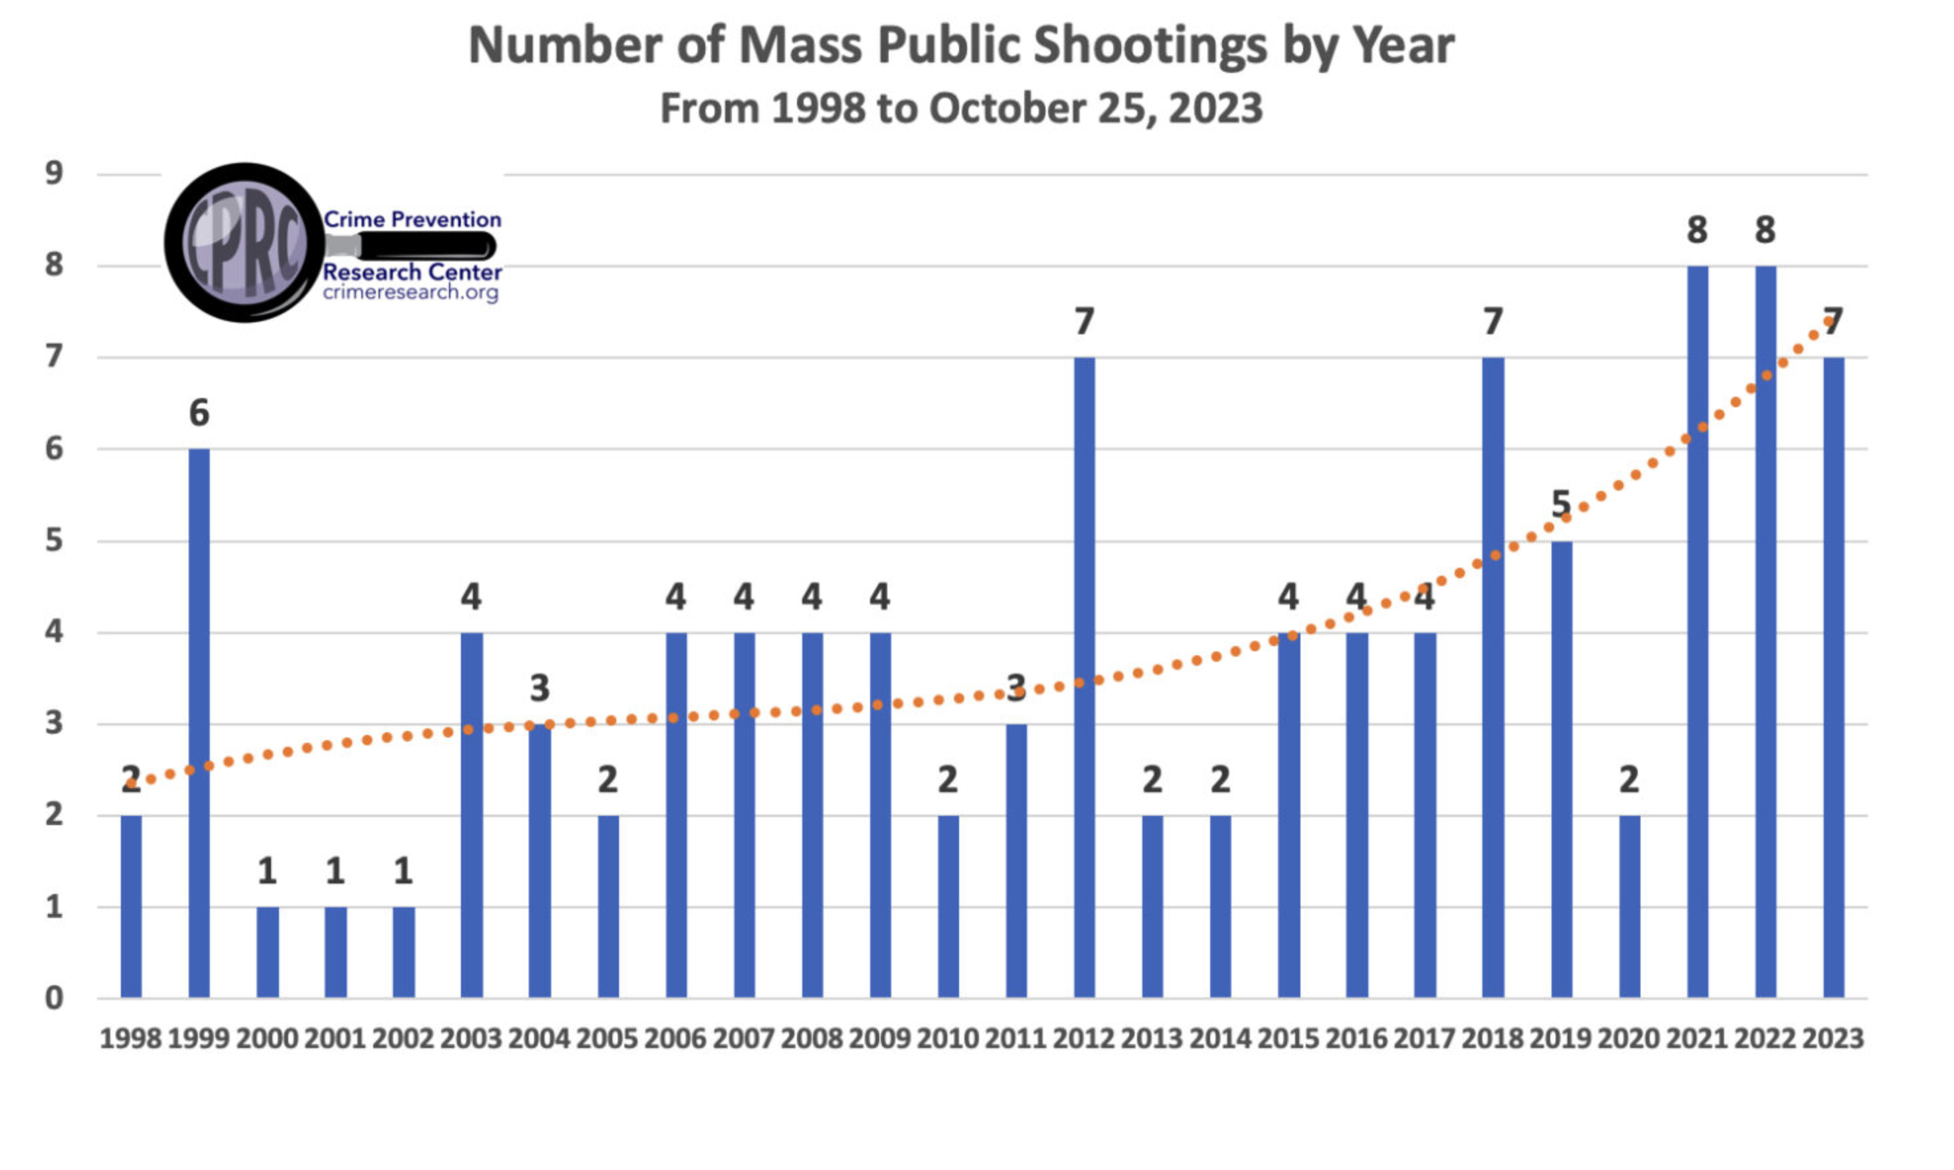
Number of attacks in public places that are not part of some other crime like a robbery or a gang fight over drug turf

Slide 21
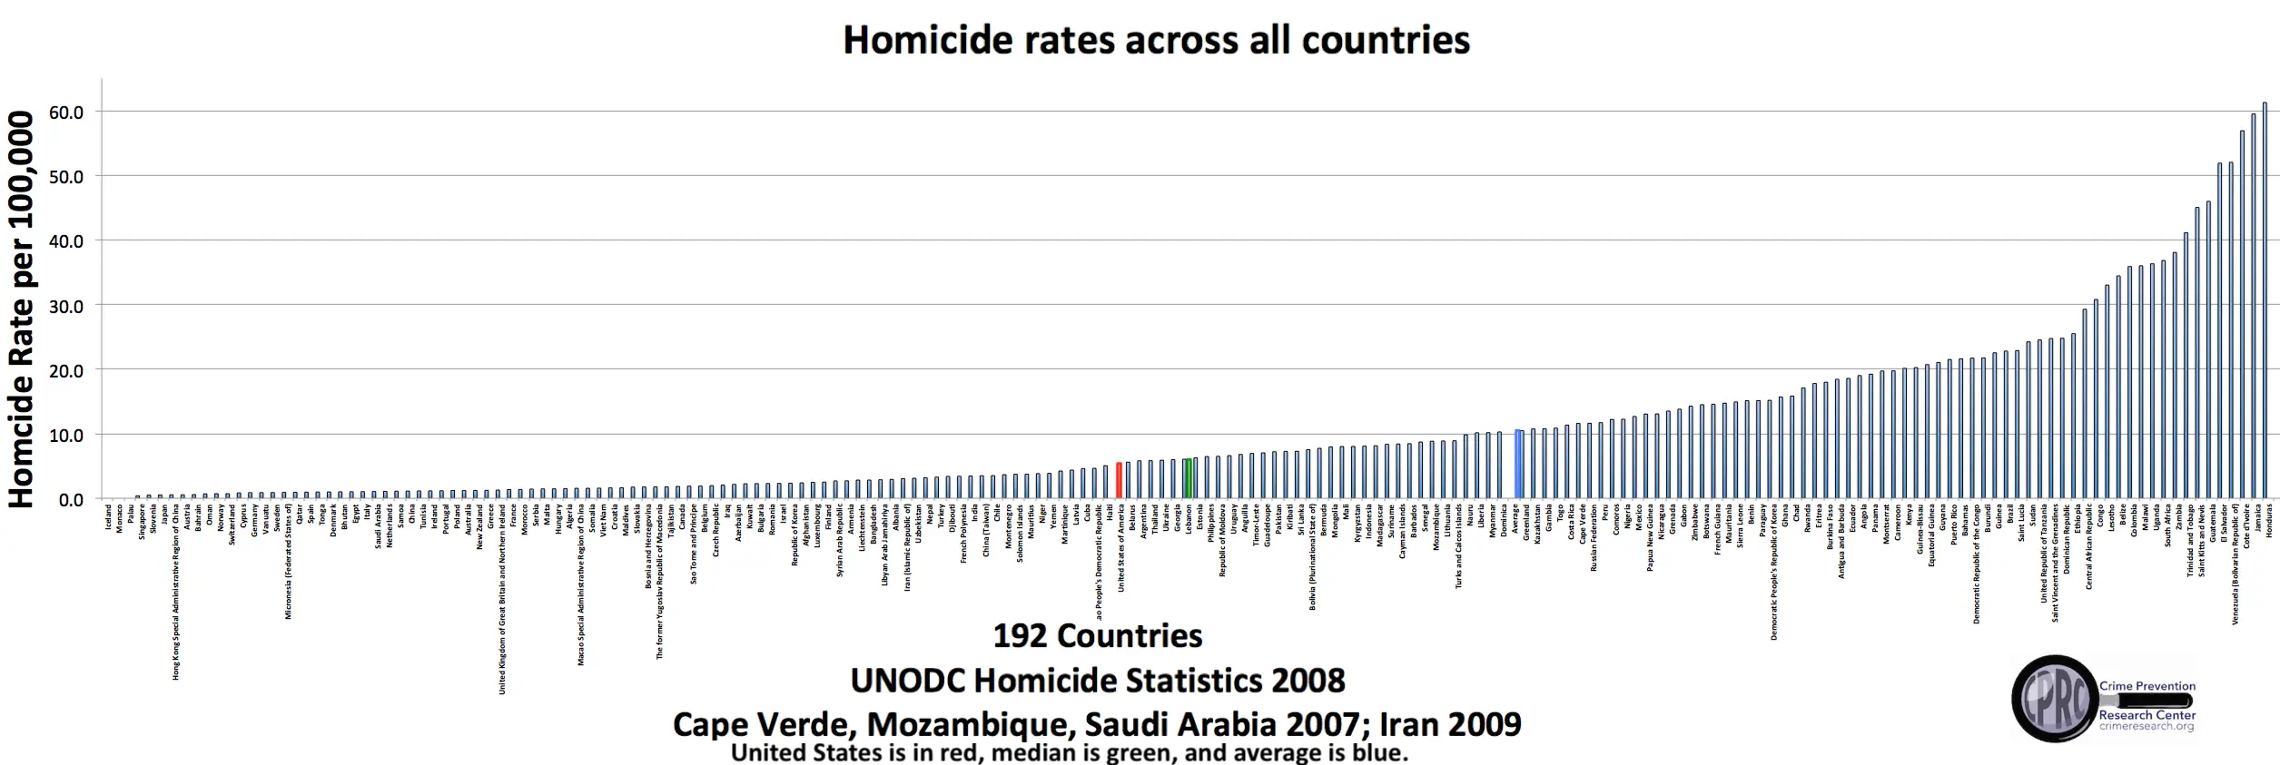

Slide 22
Notes
Gun control usually endangers public safety, and doesn’t lower crime rates
Gun control has been used consistently to disarm the poor and minorities
Many misimpressions about guns

Slide 23
The Effects of Gun Control Policies on Crime and Public Safety
John R Lott, Jr.

Slide 25
Australia
“there is a wide consensus that our 1996 reforms not only reduced the gun-related homicide rate, but also the suicide rate. … Our gun buyback scheme cut firearm suicides by 74 percent.”
-- John Howard prime minister of Australia from 1996 to 2007 in the New York Times, January 16, 2013 (https://archive.is/4h0Xi#selection-585.142-585.264)
“The average firearm homicide rate went down by about 42 percent.”
-- Zack Beauchamp, “Murders and suicides plummeted,” Vox, May 25, 2022

Slide 26
Considerations about Australia’s “buyback”/Confiscation of guns
-- almost 1 million guns being handed in and destroyed, 29% of total
-- since 1997 gun ownership in Australia grew over three times faster than the population (from 2.5 million guns in 1997 to 5.8 million in 2010).
-- So how would you predict how crime/suicide rates should change?
-- Why look at just firearm homicides and suicides? Why not total homicide and suicide?
-- Are homicide and murder the same thing? Why lump them together?
-- Could you give an example of a law reducing murder but increasing homicides? Or the reverse?

Slide 27
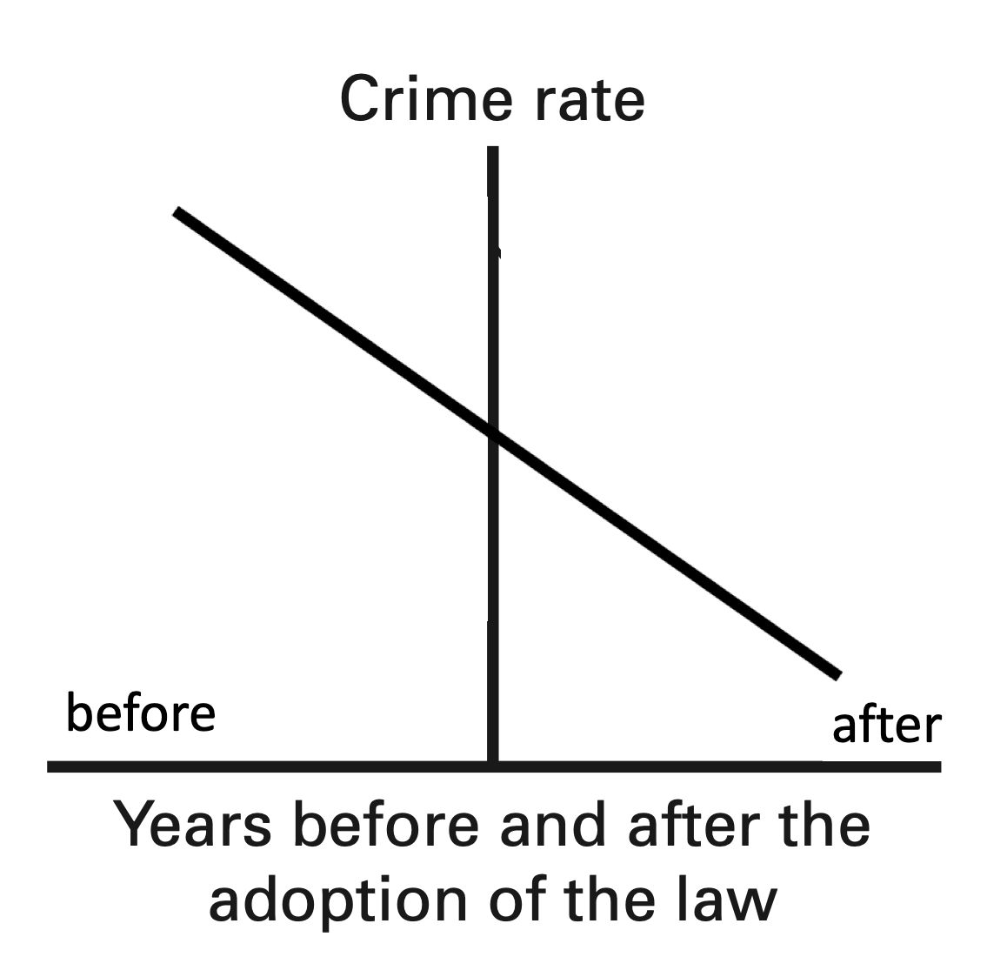

Slide 28
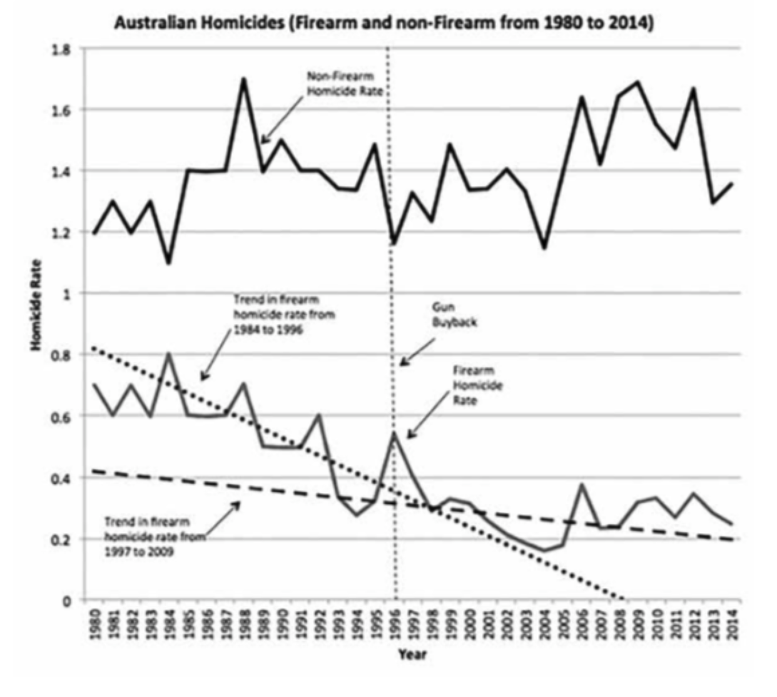

Slide 29
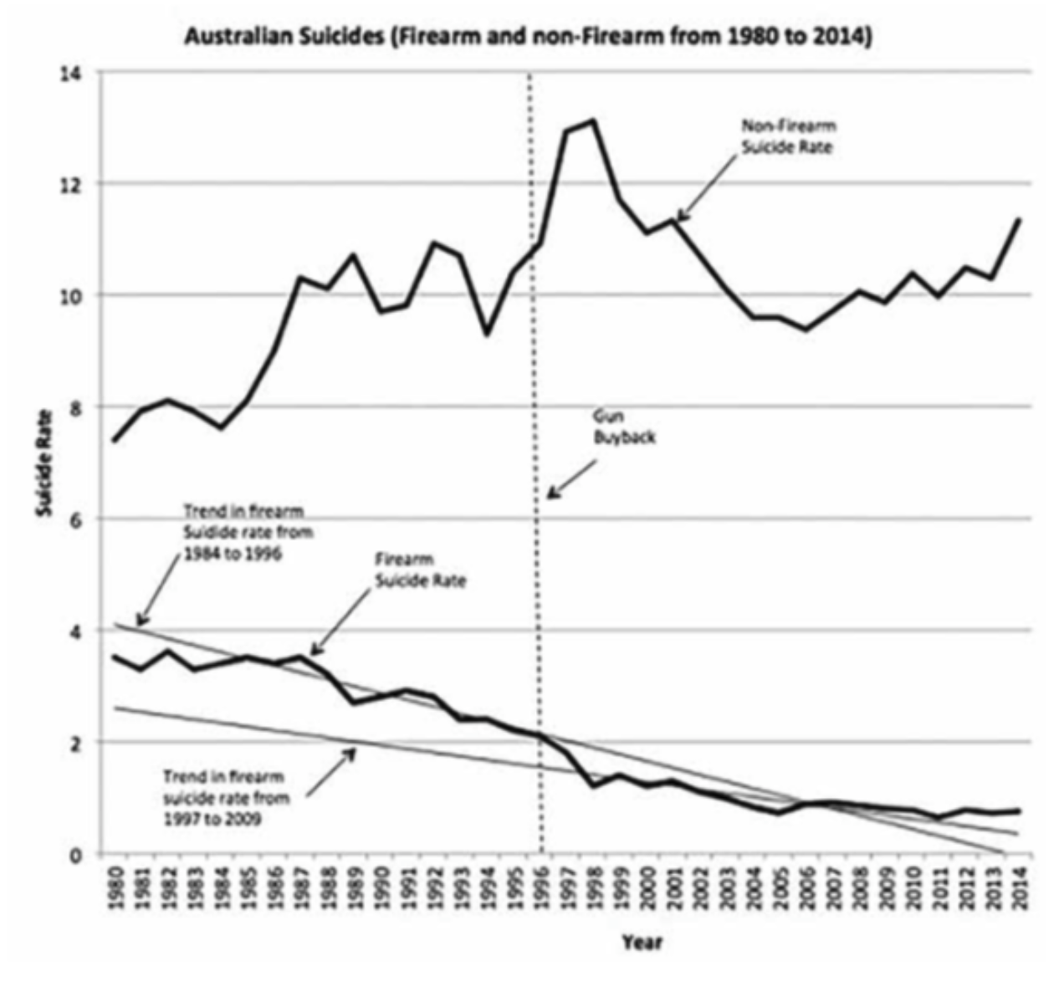

Slide 30
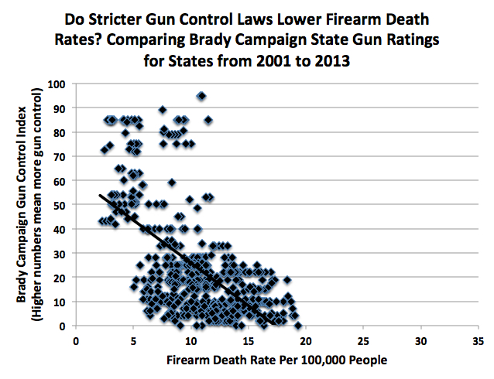

Slide 31
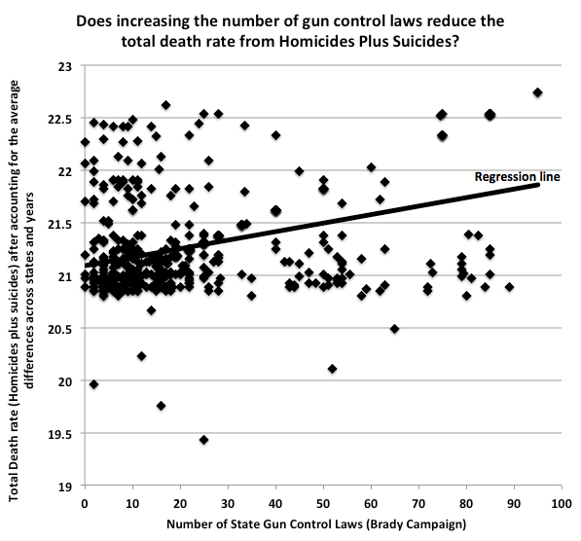
After taking account of average differences by state and time

Slide 32
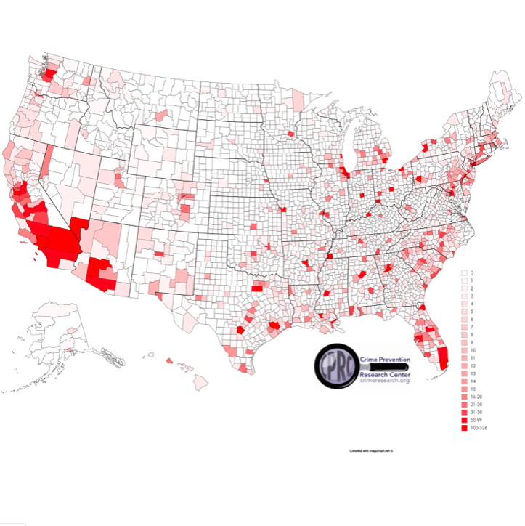
How concentrated murders are in the US
2% of counties have 23% of the population and account for 56% of murders.
About 2/3rds of those murders occur within 10 block areas within those counties.
54% of the counties have 11% of the population and have zero murders
15% of counties have 10% of the population and have one murder each

