Slide 1
The FBI Crime Data is a Politicized Mess
John R Lott, Jr.

Slide 2
What is at Stake
When I worked at the Department of Justice in 2020 and 2021, I would be asked how is it that you could have the FBI spy on a presidential campaign and not have some leaks or whistleblowers?
I can’t personally speak about the FBI or the DOJ generally, but I did have some experience with the data people at the FBI.
Who controls the data controls much of the political debate

Slide 3
Video Presented here

Slide 4
Interfering in the 2024 Election: FBI’s estimates of reported crime for 2022
Relying on the 2022 data, news headlines, like NPR in early 2024 asserted: “Violent crime is dropping fast in the US — even if Americans don’t believe it.”
ABC’s David Muir used this misleading data to “fact check” Donald Trump during the presidential debate against Kamala Harris. “Crime here is up and through the roof despite their fraudulent statements that they made,” Trump said. Muir rebutted him with, “President Trump, as you know, the FBI says overall violent crime is actually coming down in this country.”
The only finalized FBI crime data that existed at that point when David Muir made his claim was for 2022.

Slide 5
When the FBI released its numbers for 2023 in September 2024, it hid that it had revised its earlier crime data for 2021 and 2022, hiding the increase in 2022.
No mention in the press release
Just a one sentence footnote stating that they had revised the 2022 data
No mention if they had increased or decreased the numbers,
Never mentioned that the bureau had revised its violent crime for 2022 data from a 2.1 percent drop to a 4.5 percent increase.

Slide 6
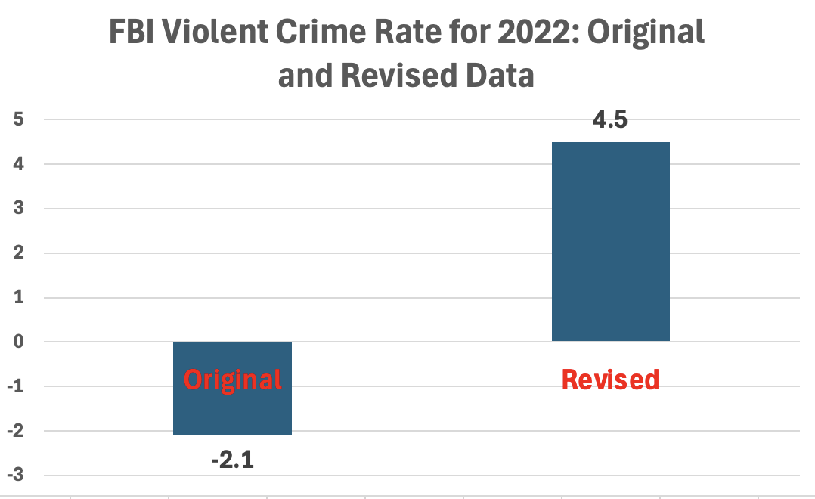

Slide 7
When the Change was Discovered the FBI wouldn’t clearly admit it
The FBI never explained the reason for the changed numbers in 2022 in their report nor in their responses to the media.
A former editor for USA Today, David Mastio, wrote about the FBI’s response to his inquiry about the changed data: “Here’s what I’ve learned in decades of covering Washington: When bad news is false, agency press people go out of their way to make it crystal clear that reports are definitely not true. When bad news is true, agency press people spew a wall of fog and bury you under an avalanche of distractions or in this case, contradictions.”

Slide 8
Note Even the FBI Data isn’t The Whole Story: National Crime Victimization Survey
NCVS measures Total Crime, FBI measures reported crime
Why differences: Arrest rates, More difficult to report crime
During the first 3 years of the Biden administration, total serious violent crime (rape, robbery, and aggravated assault), the categories that correspond to the FBI’s measure of violent crime, soared.
Total violent crime was 55.4% higher.
Rapes were up 42%, robbery 63%,aggravated assault 55%.
By far the largest percentage increases over any three-year period on record, more than doubling the previous record.

Slide 9
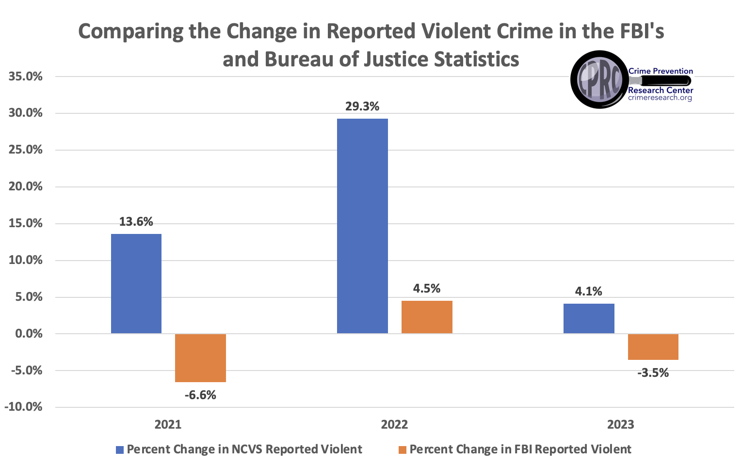

Slide 10
Errors in the FBI Active Shooting Reports
Until January 2021, I worked in the U.S. Department of Justice as the senior advisor for research and statistics in the Office of Justice Programs, and part of my job was to evaluate the FBI’s active shooting reports.
Define
Discovered the FBI either missed or misidentified many cases of civilians using guns to
the FBI either missed or misidentified many cases of civilians using guns to stop attacks.

Slide 11
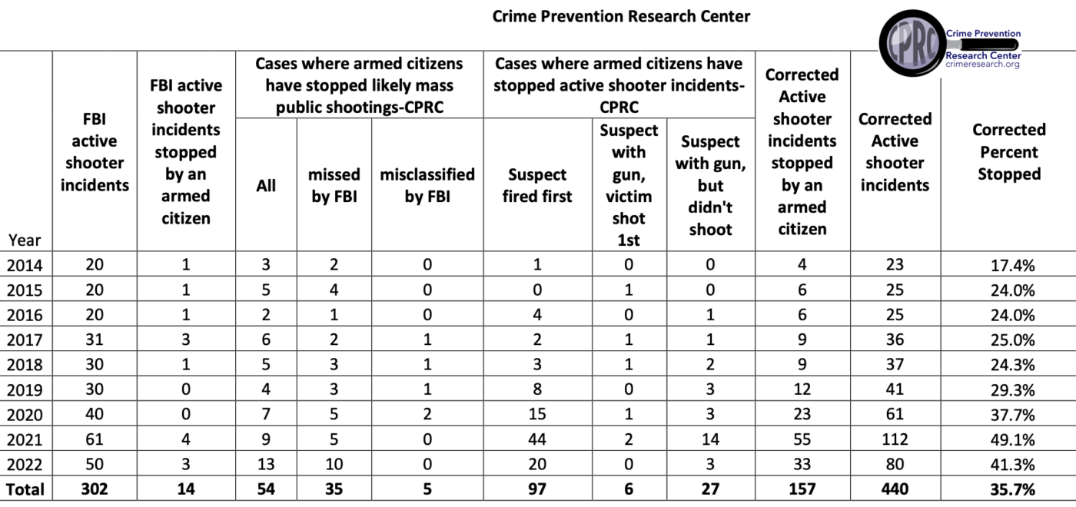

Slide 12
Summary
the FBI continues to report that armed citizens stopped only 14 of the 350 active shooter cases identified between 2014 to 2023
Corrected: Out of 515 active shooter incidents from 2014 to 2023, armed citizens stopped 180, saving countless innocent lives.
Our numbers even excluded 27 cases where a law-abiding citizen with a gun stopped an attacker before he could fire a shot.

Slide 13
Centers for Disease Control (CDC), under the Biden administration suppressed data
For almost a decade, the CDC referenced a 2013 National Academies of Sciences report noting that people used guns to stop crime anywhere from about 64,000 to 2.5 million times a year.
Even problems with these numbers
Mark Bryant, founder of the Gun Violence Archive, lobbied the CDC to remove defensive gun use estimates because it “has been used so often to stop [gun control] legislation” by “gun rights folks.”
Soon after, the CDC removed estimates of defensive gun use from their website.

Slide 14
War Story
Errors in the NICS background check system

